Slide 1
Solar Orbiter InfoDay 2 December 2019
ASI HQ
Via del Politecnico snc, 00133, Rome
www.asi.it

Slide 2
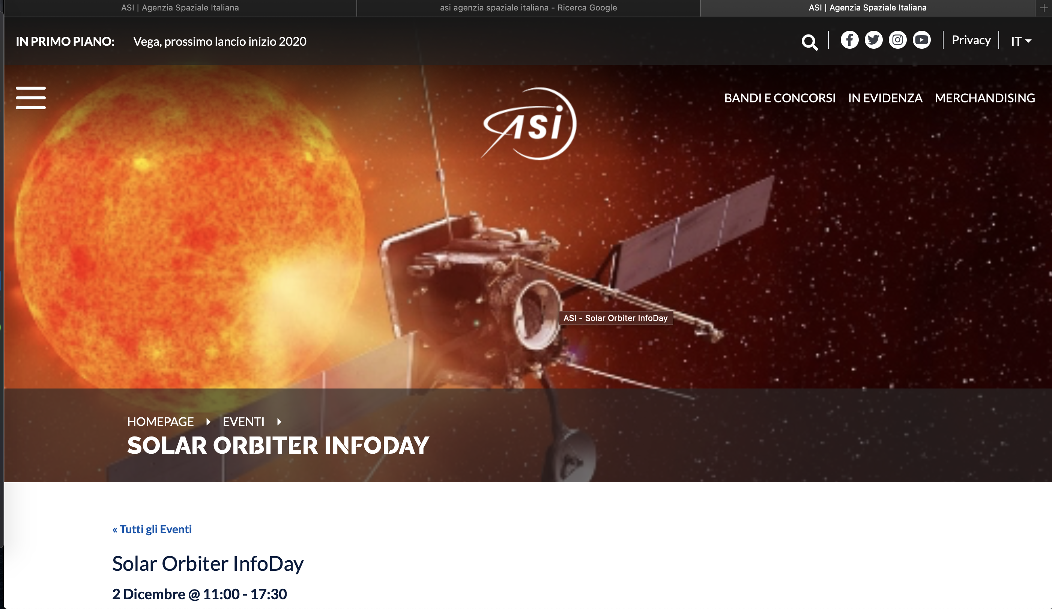
Register now at: https://www.asi.it/event/solar-orbiter-infoday/

Slide 3
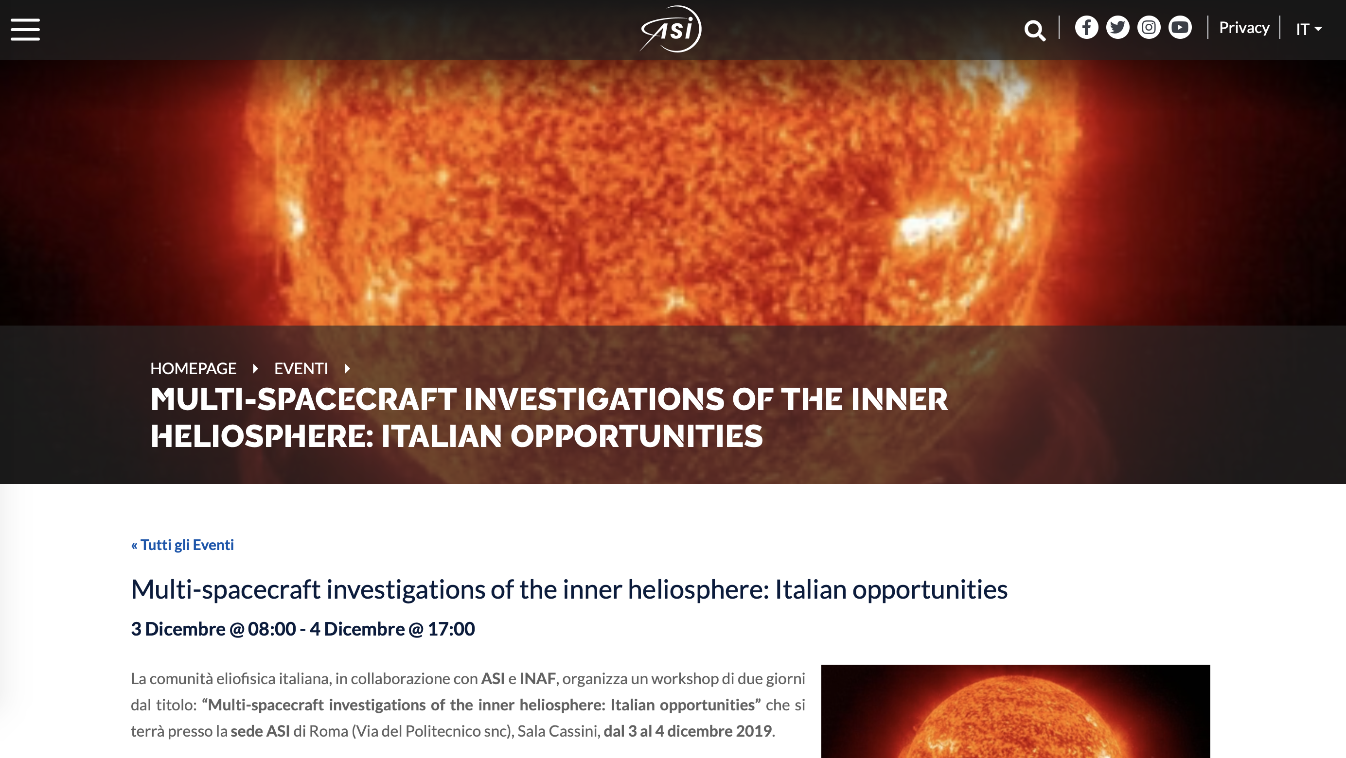
BepiColombo / Solar Orbiter / Proba3 workshop – 3-4 Dec 2019 ASI HQ - Rome
https://www.asi.it/event/multi-spacecraft-investigations-of-the-inner-heliosphere-italian-opportunities/

