Slide 1


MADAWG
Metis Workshop, 11-13 November 2019
C. Sasso (co-chair) on behalf of the team
Chair: A. Rouillard
Notes:
Good afternoon, the SLOW_SOURCE project aims at determining the origin of the slow solar wind using advanced numerical models of the corona combined with readily available data. It is also tailored to take full advantage the revolutionary data that will be obtained by the Solar Orbiter and Parker Solar Probe missions the first mission to plunge in the solar corona.

Slide 2
MADAWG: ESA Modeling and Data Analysis Working Group for the Solar Orbiter Mission
A little history ...
Originally known as the Data Analysis Working Group (DAWG),
then modeling was added to the group’s purpose.
Holds periodic meetings, both separately and in conjunction with Science Operations Working Group meetings.
The working group addresses the following areas:
-- Solar Orbiter metadata
-- Modeling support
-- Solar Orbiter archive and interoperability with other data centers
-- Data analysis tools

Slide 3
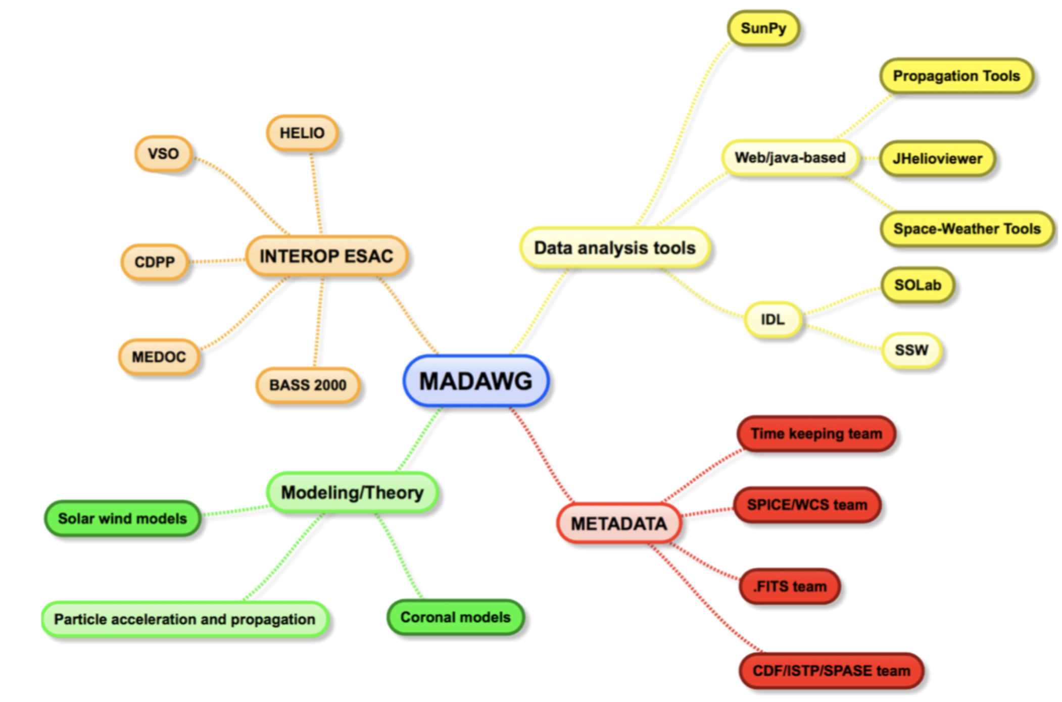

Slide 4
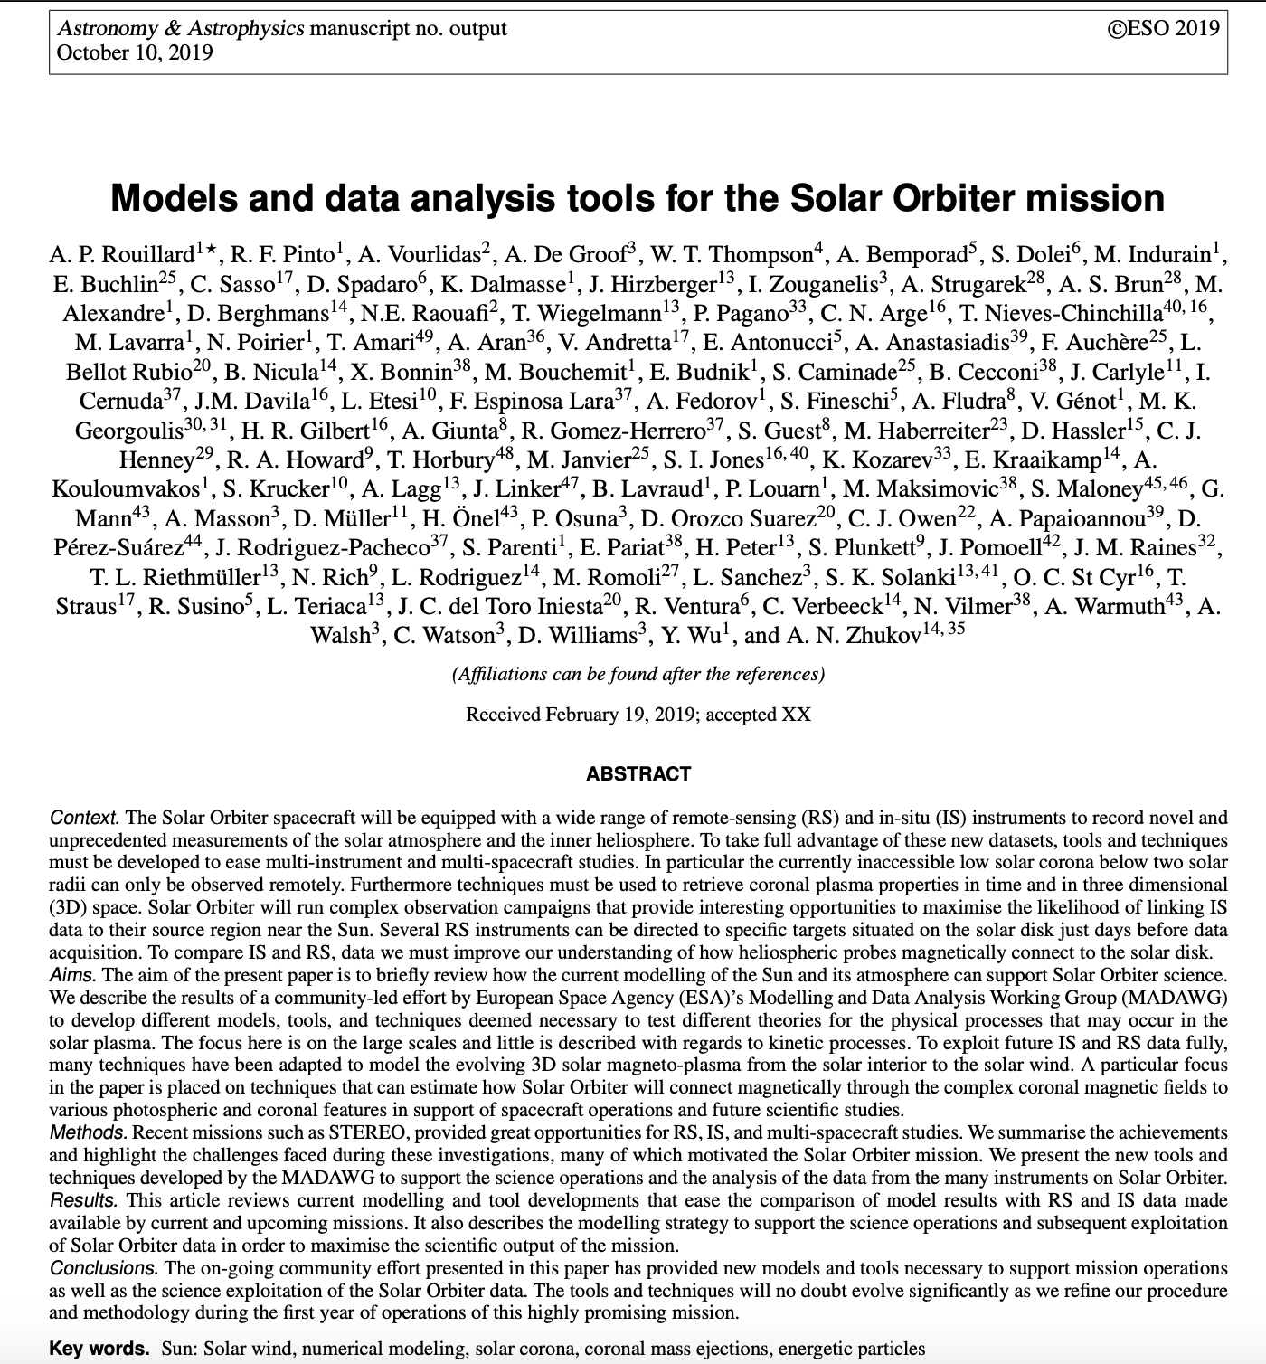
Activities in 2019
Two MADAWG meetings: Madrid (January) and London (September)
Publication of the MADAWG paper for the Solar Orbiter book
https://www.aanda.org/articles/aa/pdf/forth/aa35305-19.pdf
New version of the Connectivity Tool 3.0:
http://connect-tool.irap.omp.eu/
Connectivity Tool used for the first and second PSP perihelia to
coordinate Hinode/IRIS/ground based instruments (NSO) ->
excellent exercise for Solar Orbiter ops.
Coordination with more modellers to integrate new models in
the tools: led by Gherardo Valori (MSSL)

Slide 5
Two MADAWG meetings in 2019:
Meeting on 24-25 January 2019 in Madrid:
— report on on-going activities + Connectivity Tool
— new tools and models in support of PSP science: analysis of the first perihelion
— update on METADATA issues
— update on data-analysis tools for PSP/SolO (propagation tool, 3-D view, JHelioviewer)
— modelling the solar wind: new tools and data products
Meeting on 11-13 of September 2018 in London:
— report on on-going activities + Connectivity Tool
— preparing for SolO-Phi data
— integration of LLD in the tools for SolO operation and software libraries for SolO
— models and tools to support future SolO science and SolO-PSP coordinated science
— coordinating with SolO (Punch)
— discussion on MADAWG future

Slide 6
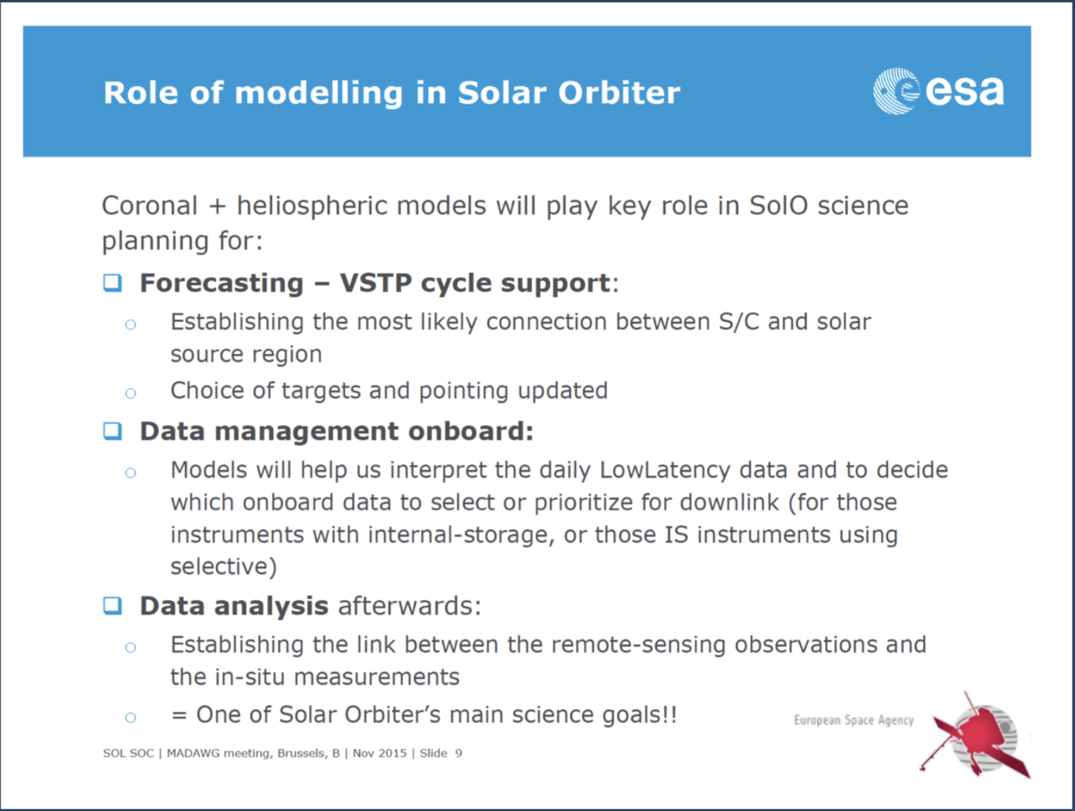

Slide 7
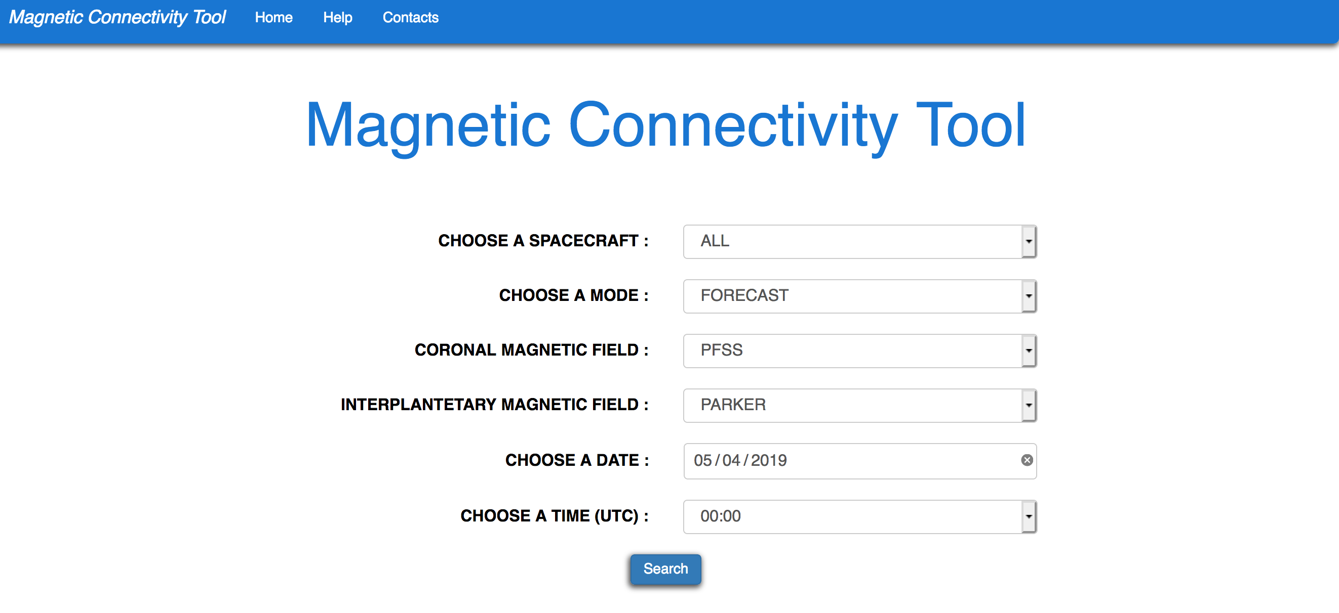
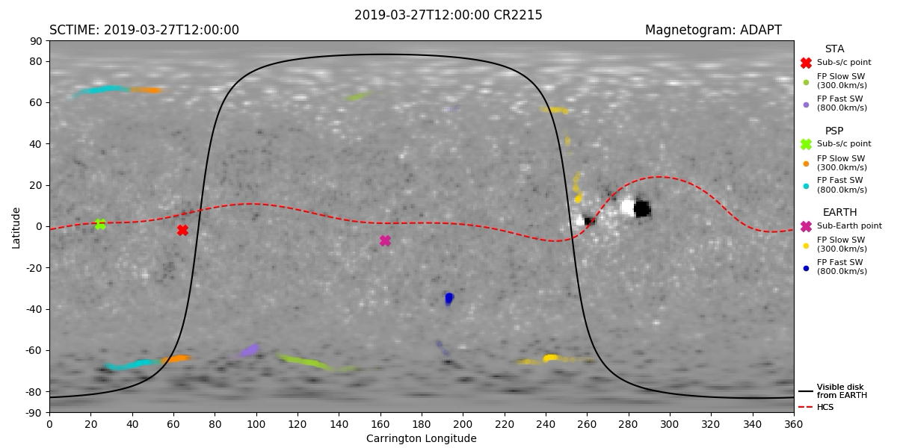
MAGNETIC CONNECTIVITY TOOL
NOW OPERATIONAL!
http://connect-tool.irap.omp.eu/
Forecast for first and second PSP perihelia to coordinate with Hinode pointing
Movie automatically
generated on the website
Latest forecasts for PSP
connectivitiy

Slide 8
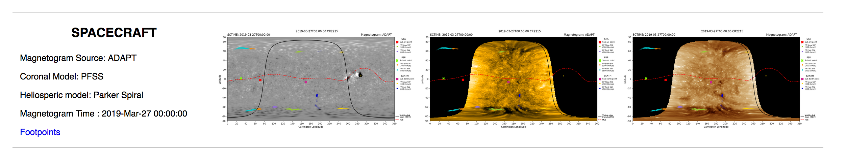
Connnectivity Tool (new features):
EUV Carrington maps done in real time (SDO and later SDO+STEREO)
WL Carrington maps (LASCO, pipeline in place not yet online)
Past and current flare locations
New extrapolations (DUMFRIC)
Integration of CME catologues
Movies of forecasts (done for PSP encounters, not yet for SolO)
First prototype of a tecnique to exploit IS data in real time and select best likely model
Ascii files with footpoints

Slide 9
Future developments of the Connectivity Tool:
Integration of flare forecasts using FLARECAST tools
Include forecasts of SEP events
Integration of field lines from MHD simulations (CEA+EUHFORIA) and NLFF (MPS)
Inert Carrington maps of simulations
Preparing for LLD data:
PHI magnetograms → Create simulated PHI observations – merging them with other magnetograms - and use them for the connectivity tool (involving PHI team, connectivity tool team, ADAPT team)
SWA (PAS bulk param and HIS charge states)
Setting up a pipeline to integrate LLD
A regional branch of the MADAWG has opened for our UK customers (not a Brexit)! G. Valori coordinates this group to to integrate other techniques to discriminate among extrapolations and improve the methodology employed to evaluate errors in connectivity, etc…
Last MADAWG: We agreed that the best available maps (to know where will be the emitted plasma) can be produced with three days in advance. Then, considering different wind velocities there will be predictions on where will be the plasma in more days and combine these predictions with the position of the spacecraft we can define the pointing on the Sun.
We will have an EUV image the first day of observation that can help (compared to the extrapolations) + a Metis one, through LLD --> devolpment of data analysis tools for LLD to compare with connectivity results.

Slide 10
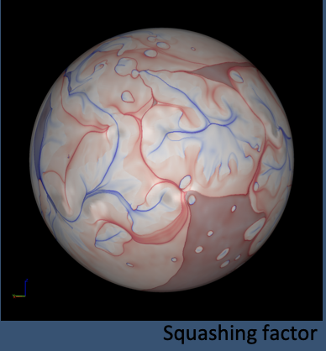
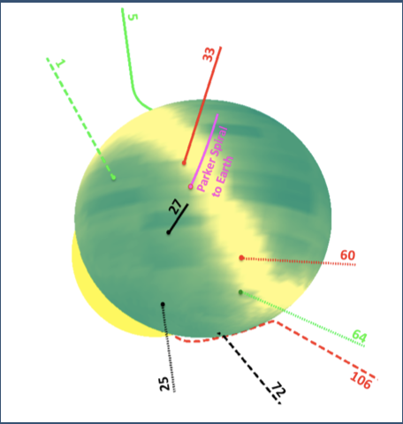
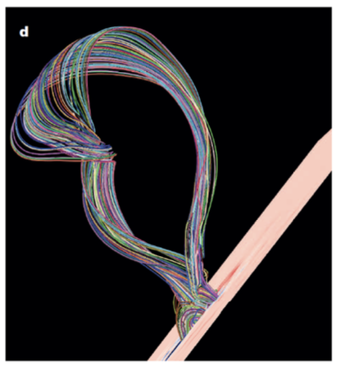
We need simulated or inferred physical parameters of the corona (magnetic fields, speeds, density, temperatures) for all topics (SEPs, solar wind, CMEs)
Slow solar wind
SEP studies
CME studies
Forward modelling: converting simulations into synthetic RS -> compare to observation
Inverse modelling: using RS observations to infer coronal properties -> compare to model
With multi-instrumental and multi-spacecraft studies we immediately face the problem of synchronicity and spatial variability.

Slide 11
Developments/adaption of tools to model
Solar wind at PSP/SolO in real time (in progress MULTI-VP)
Model flux ropes and shocks from the Sun to PSP (first papers to be submitted flux ropes in WISPR. Space Weather Tool V2 online and to be updated soon for PSP)
Models to identify possible eruptive active region (S2WARM– P. Pagano)
Develop coronal shocks catalogue and make it available on the tools (First catalogue done and study published)
Tomography reconstruction (?)
Modify tools to integrate PSP/SolO orbits/fov:
Propagation tool (Integration of the WISPR camera, SolO pending)
http://propagationtool.cdpp.eu
Interactive tool to track solar storms, streams and energetic particles in the heliosphere (CMEs, CIRs, SEPs).
3-D view (Integration of fovs done for MULTI-VP)
3DView is a science tool that offers immediate 3D visualization of spacecraft position and attitude, planetary
ephemerides, as well as scientific data (observations, simulations and models) representation.

Slide 12
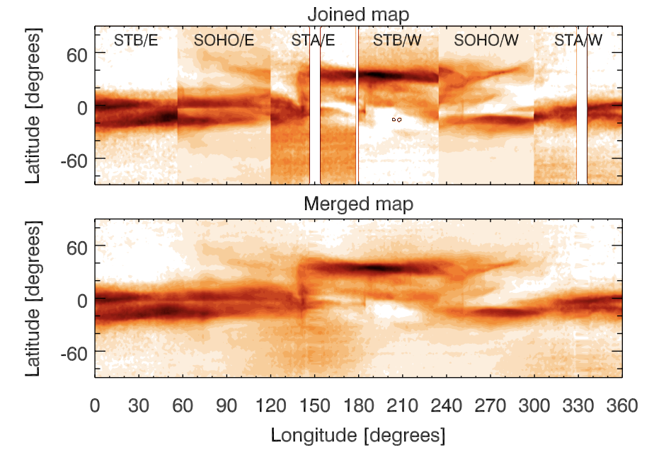
Important issues pending or in discussion (data analysis tools)
Evaluating model accuracy using real time data:
— use data from IS to get constrain (for example on ADAPT maps or MULTI-VP) —> LLD for SolO, PSP no
— comparison with EUV maps (coronal holes) —> now in place in the connectivity tool
— comparison with WL maps full images and CR maps: latest PSP studies show that for 40-60 Rsun there is an impressive match between density variation and streamers rays —> There are coordinate activities to produce maps of streamers in real-time (combining STEREO, SOHO) + find ways to exploit streamer maps in real time as additional selection criterion (and prepare for Solar Orbiter Metis)
Evaluating model accuracy after data acquisition:
— using the above techniques
— comparing the 3-D topologies provided by the
different models to determine why models can be
so different (Valori & co.)

Slide 13
SUNPY (David Perez-Suarez)
Pyton library for solar physicists, open source
Task 1: by January for the next MADAWG, each team should start a discussion on if and how they want to implement or develop codes in SunPy.
Task 2: Understand if SolO data can be used with SunPy:
there will be a first encounter with SOC and SunPy to check if simulated data (from EPD for example) can be handle with not too many problems by SunPy --> deadline: hopefully next MADAWG
They don’t do pipeline calibration in SunPy but if you plan to do it they can help and support (don’t send them a code of already thousand lines to be checked, though…)

Slide 14
Discussion on MADAWG future
How the group will evolve?
Leave it like it is but starting working more on the “Data Analysis” part: creation of tools that can involve more instruments to be used on the analysis of data
Multi-spacecraft and multi-instrumental in heliophysics.
Tools to process and visualise remote-sensing data.
Tools to process and visualise in situ data.
Tools to connect remote-sensing and in situ data.
Notes:
WP3: Ground-based support for Solar Orbiter:
- Task 1: Solar Orbiter Ground-based support white paper effort combined with the
mission book paper (Leads: Marco, Angelos, Ludwig, Gottfried, CLIMSO?)
- Task 2: Coordination of ground and spaceborne radio instrumentation (Milan!)
Paper 1: Theoretical modeling for the Solar Orbiter mission:
Modeling support at the dawn of a golden age in heliophysics (2 pages):
Modeling the generation and transmission of magnetic energy through the solar atmosphere (3 pages): Brun, Velli,
Connecting kinetic processes with global dynamics (3 pages): V. Pierrard, C. Vocks, Maksimovic
Modeling the origin and effects of eruptive processes: (3 pages): Vainio, Pariat, Aulanier, Pomoell, Masson
Validating models of the 3-D structure of the dynamic background atmosphere (3 pages):
Modeling to connect remote-sensing observations to in-situ measurements: (5 pages): Bemporad, Sasso,
Conclusive Remarks (1 page)
Paper 2 Title: Data Analysis Tools for multi-instrumental studies with Solar Orbiter:
Multi-spacecraft and multi-instrumental in heliophysics: Tools to process and visualise remote-sensing data: Tools to process and visualise in situ data:
Tools to connect remote-sensing and in situ data: Conclusive Remarks (1 page)

