Slide 1
Freeform optics for space instruments
Chiara Doria- 38th Cycle
Supervisor: Dott.ssa Irene Guerri Co-Supervisors: Prof. Giampiero Naletto,
Dott. Gabriele Cremonese
Admission to final exam evaluation - 11/09/2025

Slide 2


Freeform optics
Freeform Optics are optical components with a surface that lacks translational or rotational symmetry:
Their complex surfaces are defined by mathematical polynomials.
They offer unprecedented design freedom for compact and high-performance systems.
Nodal Aberration Theory (NAT) is a fundamental framework used to describe and understand the aberration properties of optical systems that lack symmetry.
It was originally developed to analyze the effects of misalignment (e.g., tilted or decentered lenses) in traditional systems.
NAT is the key analytical tool for designing and tolerancing freeform optics, as it predicts how aberration works with respect to the position of the surface in the system, allowing to control them during the design for optimal image quality.

Slide 3
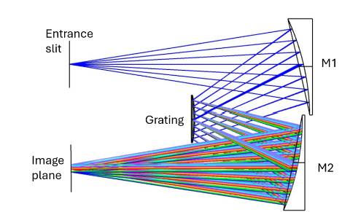
Study of the maximum FOV achievable with a FF Offner spectrometer:
Freeform optics on large satellites
The maximum achievable FoV (slit lenght) with only standard optics is 50 mm
With the integration of freeform to the grating a FoV of 56 mm has been achieved.
With the integration of freeform to the mirrors a FoV of 54 mm has been achieved.

Slide 4
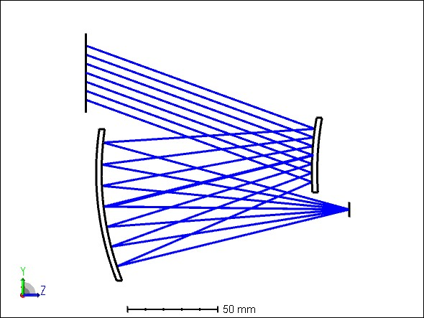
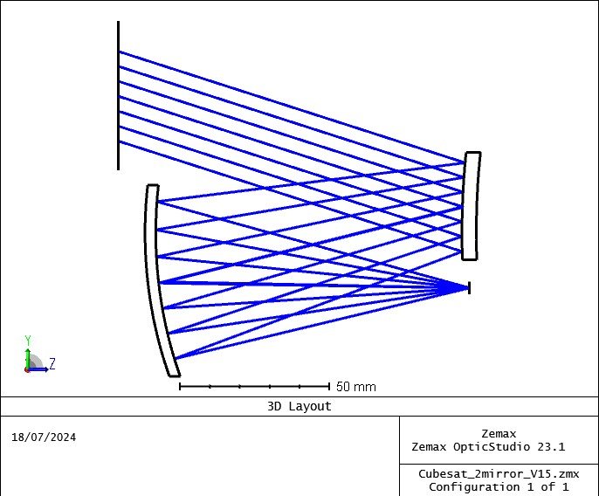
Freeform optics on CubeSat
Why CubeSat on space?
✓ Low cost of development and launch
✓ Short development time (typically 1–3 years)
✓ Use of commercial off-the-shelf components
X Limited in performance
X Strict volume constraints
Freeform Optics
Volume reduction of 57% with the introduction of FF also reaching higher performances!

Slide 5
Optical design of a 2U Hyperspectral camera
The objective was to design a hyperspectral camera for a 2U CubeSat, taking into account all the limitations typical of this category of space instruments and trying to solve them with freeforms.
The process began selecting a detector available on website.
The telescope and spectrometer components were then studied separately
GSD and SWATH were evaluated to determine whether the system met the desired requirements
→ focus on achieving the largest possible telescope aperture (important for good SNR)
→grating optimized to achieve the best possible spectral sampling interval (important for spectral resolution)

Slide 6
Mission first order specifications
1° step
Detector
Detector name | #pixel Spatial direction | #pixel Spectral direction | Pixel pitch (µm)
ams CMV12000 (package 47 x 33.8 mm) | 4096 | 3072 | 5.5
2° step
Volume | Orbital height (km) | Spectral Range (nm) | FOV (deg) | Focal length (mm)
2U | 500 | 400-1100 | 14 | 81.4
3° step
GSD (m) | SWATH (km)
33.8 | 98.23
Note: Given the difficulty of manufacturing a slit with a width of 5.5 µm, 2× binning was immediately considered.

Slide 7
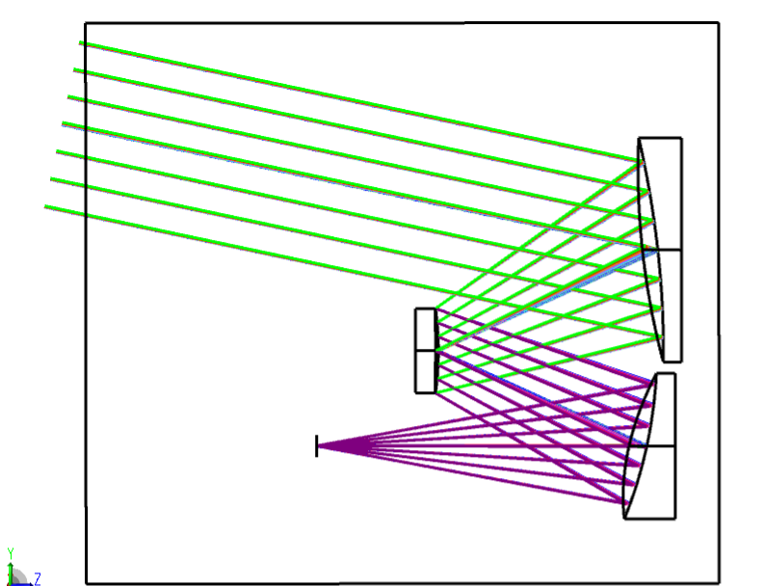
TM1, TM2 and TM3 are freeform Zernike FRINGE mirrors.
TMA- Telescope FF
TM1
100 mm
TM2
Image
Plane
TM3
100 mm

Slide 8
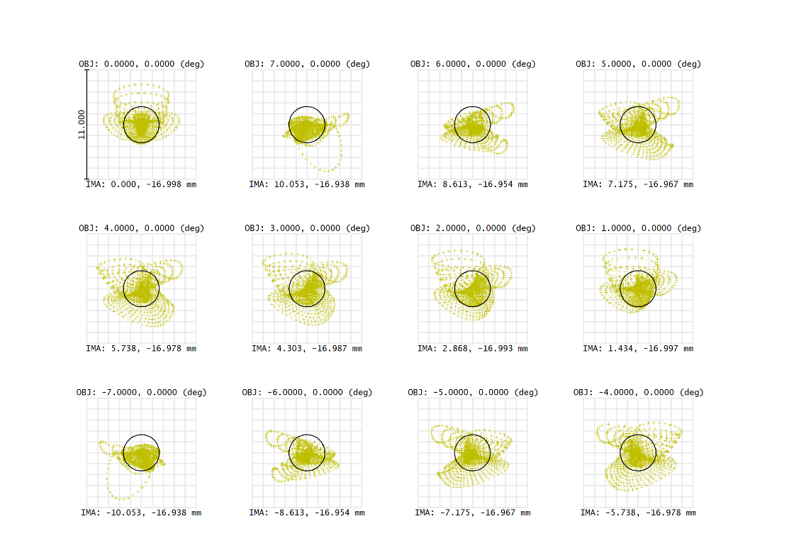
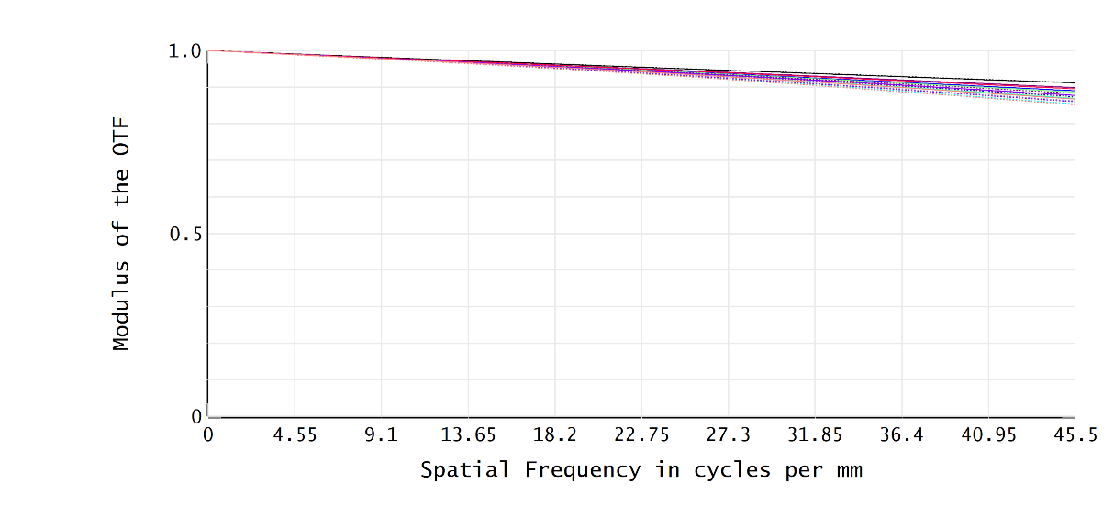
TMA Telescope performance
MTF and Spot @ reference lambda 539 nm
11 μm
The Nyquist frequency of 45.5 lines/mm corresponds to a pixel size of 11 μm.
Note: at 1100 nm minimum MTF: 0.78

Slide 9
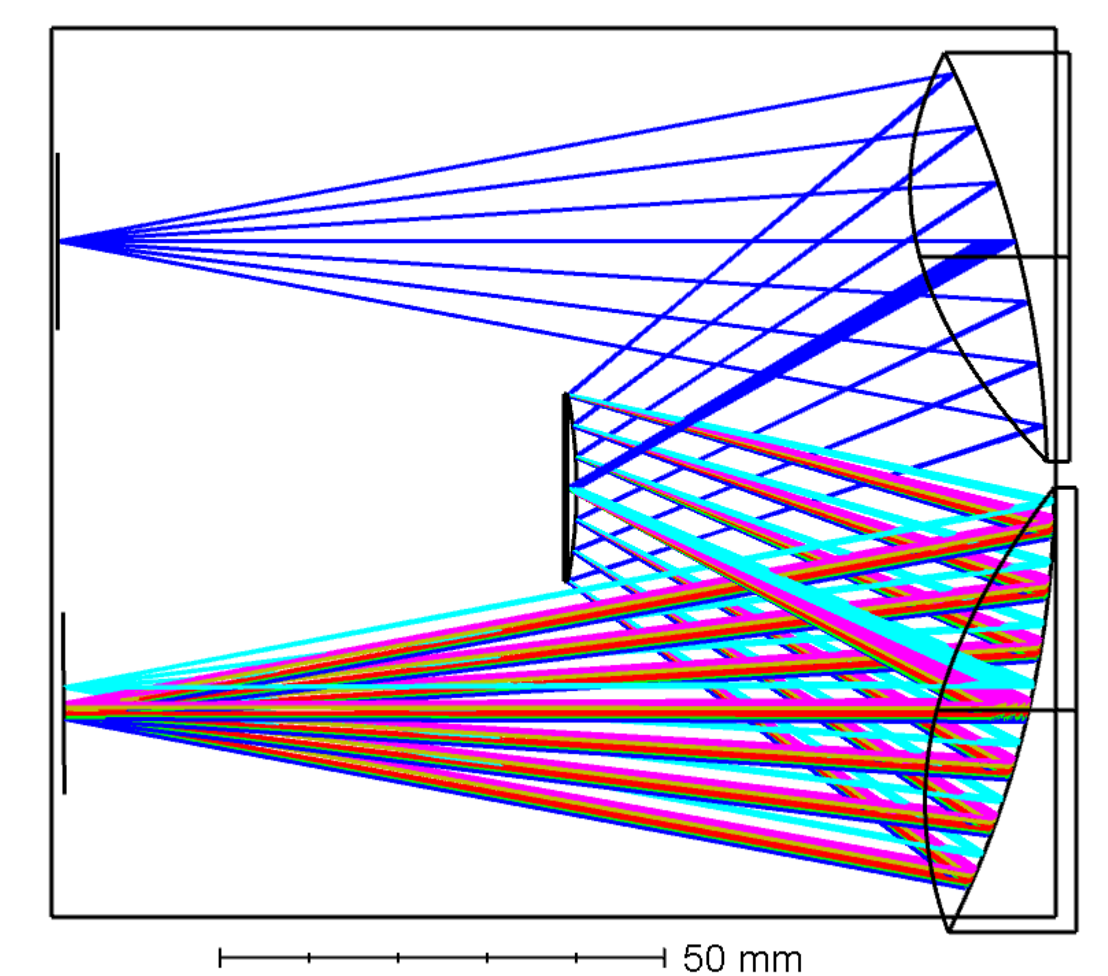
SM1 and SM2 are freeform Zernike FRINGE mirrors.
Offner Spectrometer FF
SM1
Entrance
slit
100 mm
Grating
Detector
SM2
100mm

Slide 10
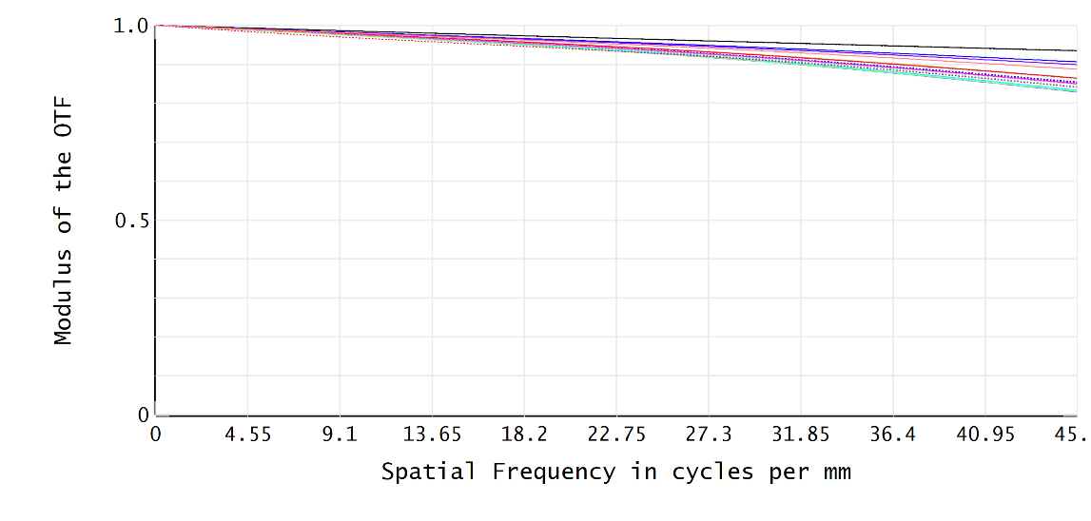
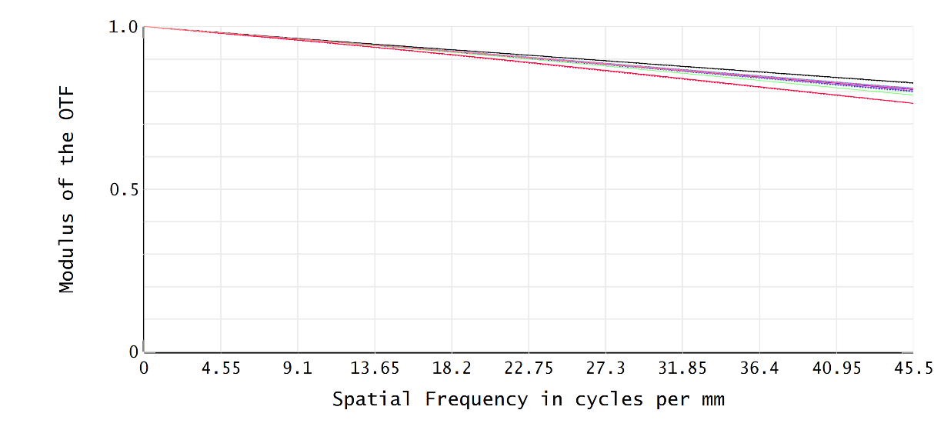
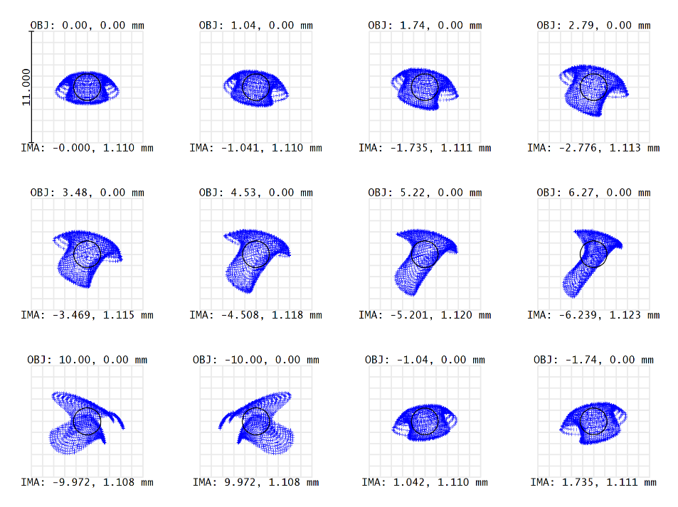
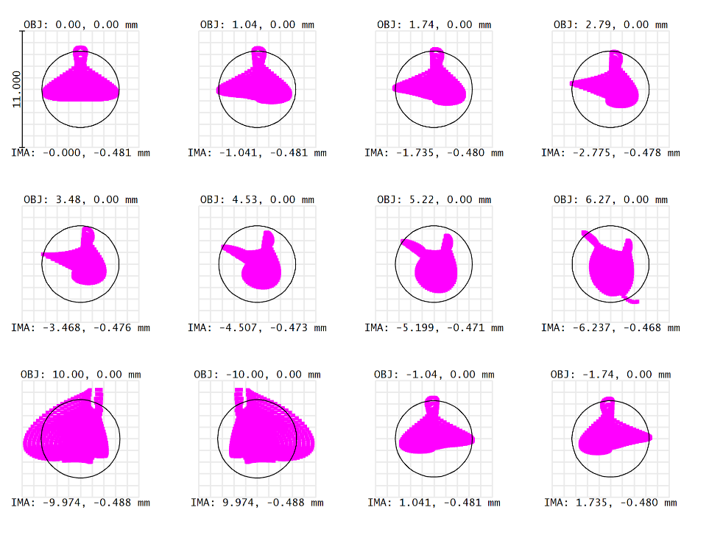
Spectrometer performance
400 nm
1100 nm
11 μm

Slide 11
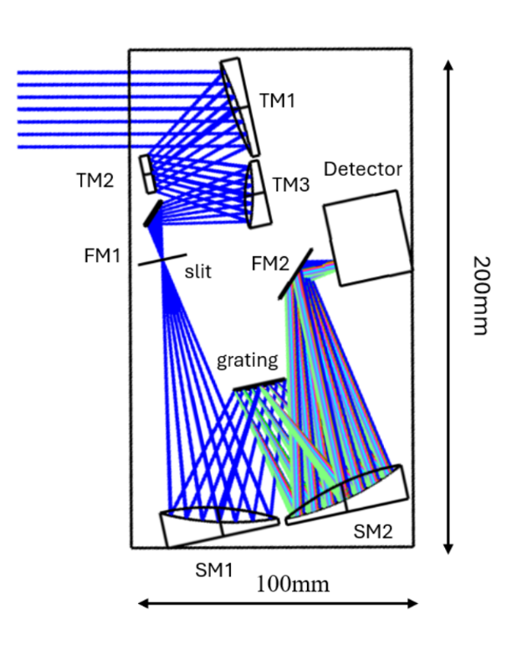
Coupled instrument layout
Two folding mirrors have been introduced to fold the optical path and enable accommodation within the 2U volume.

Slide 12
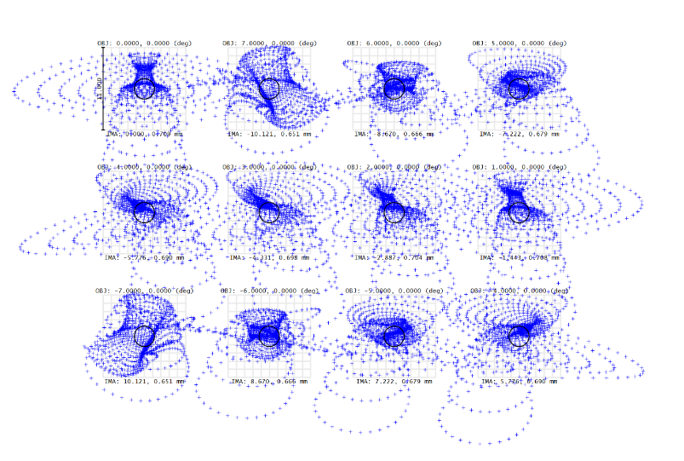
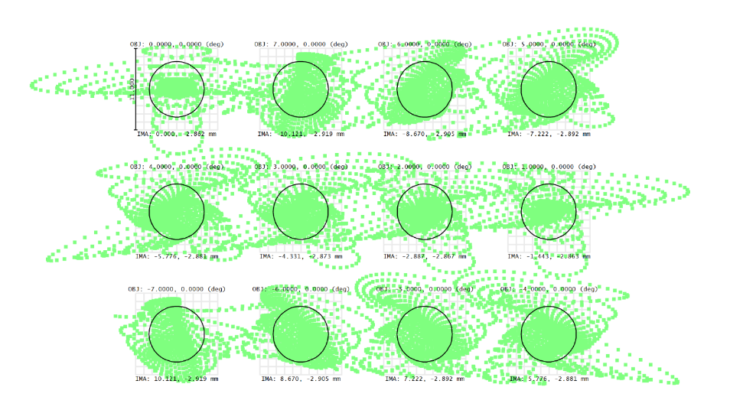
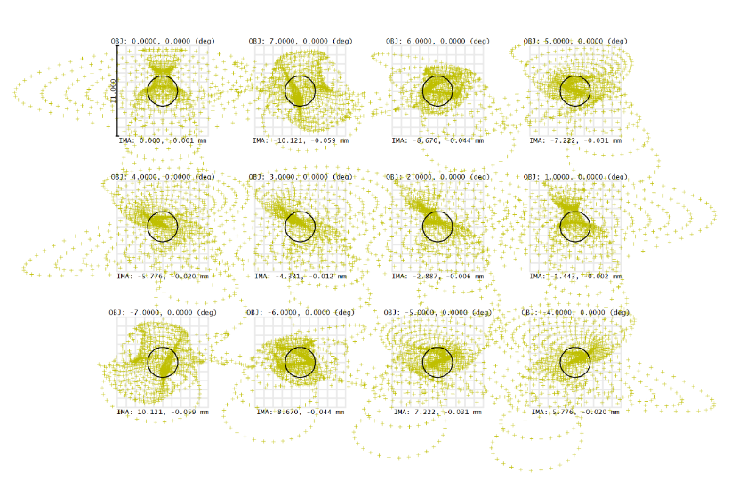
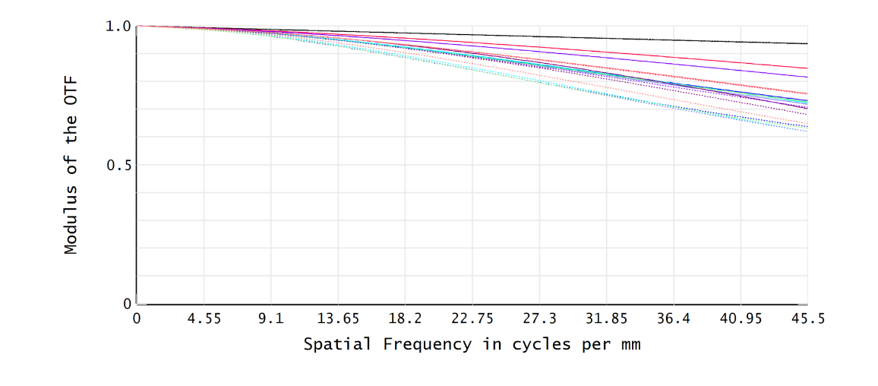
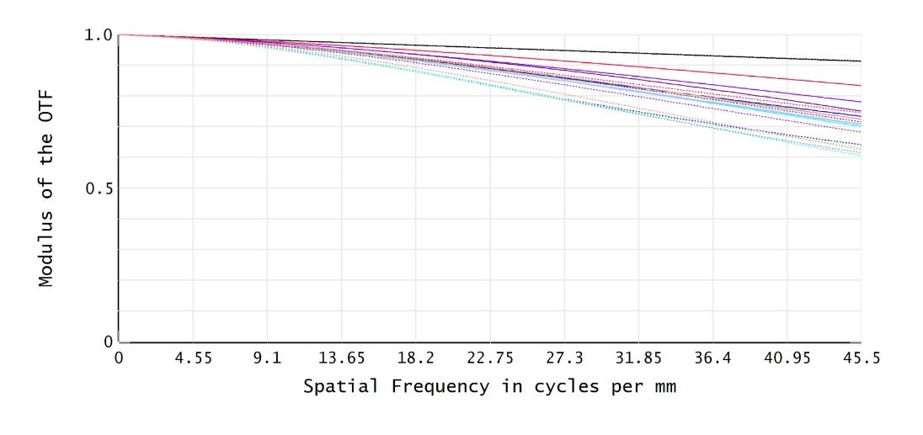
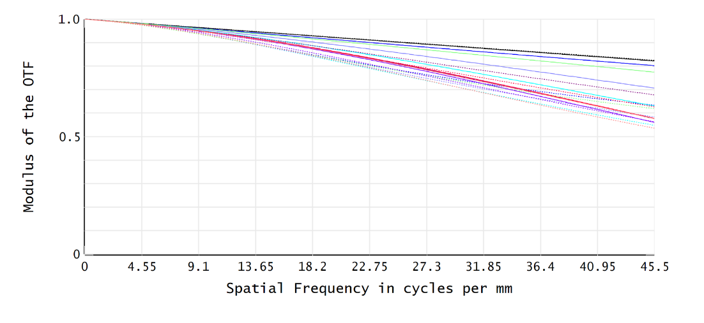
Final instrument performance
400 nm
539 nm
1100 nm
Note: at 1100 nm minimum MTF: 0.557

Slide 13
Tolerance Analysis
Telescope and spectrometer were analyzed separately.
Sensitivity analysis: was first performed in order to identify critical parameters and select compensators.
Monte Carlo simulation: 1,000 runs carried out for each subsystem, following the sensitivity analysis.
Performance metrics: MTF, WFE, and EFFL; nominal, mean, and standard deviation values are reported for each subsystem.

Slide 14
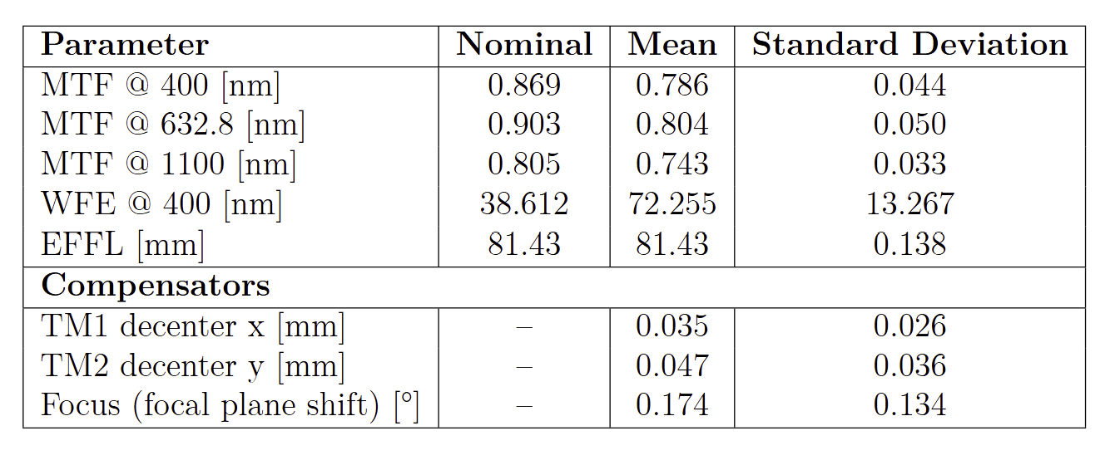
TMA - Telescope performance
TM1 is the compensator.
Monte Carlo simulation with 1000 runs.

Slide 15
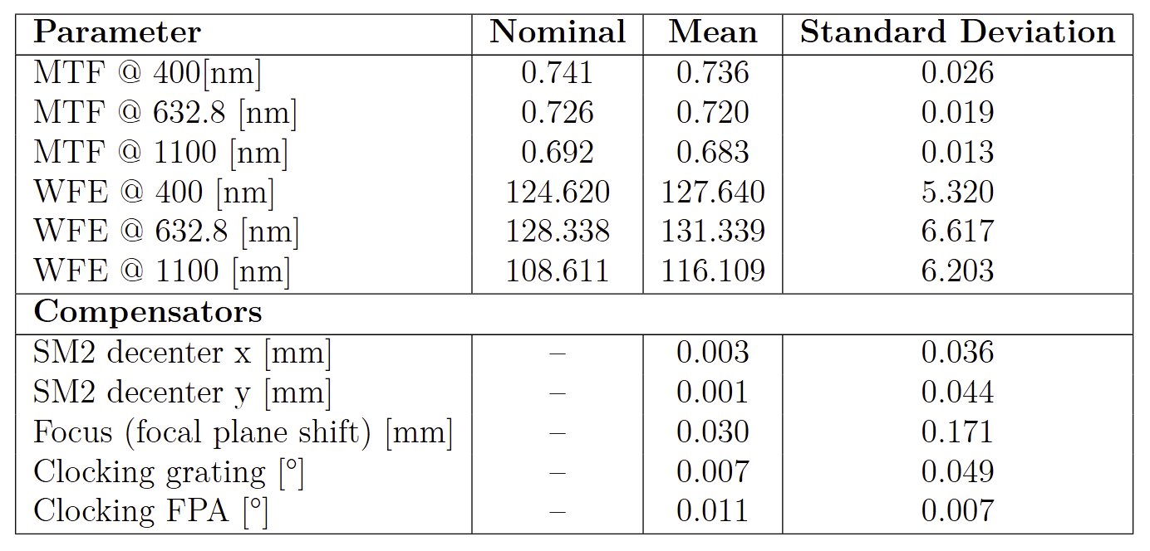
Offner- Spectrometer performance
SM2 is the compensator.
Monte Carlo simulation with 1000 runs.

Slide 16
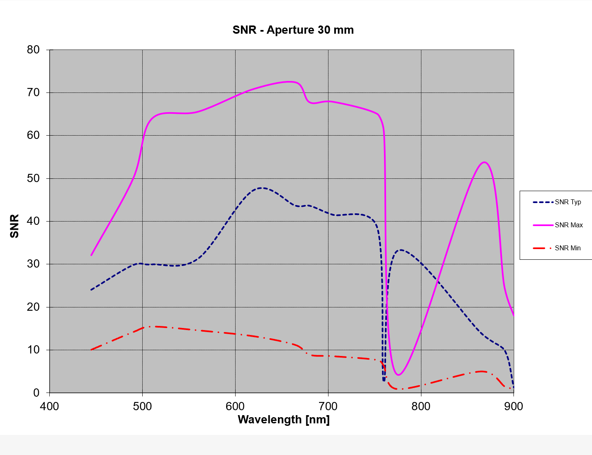
Signal-To-Noise ratio Analysis
Key Challenges
Small 30 mm aperture → inherently low SNR
High LEO velocity → potential image smearing
Analysis Setup
Inputs: Typical Earth radiance, grating
& detector efficiencies
Integration time: 2.25 ms (~½ pixel image shift)
Binning applied: 2 (spatial) × 6 (spectral) pixels in order to recover SNR, sacrifying the GSD and spectral sampling.
Results
Max SNR: Up to 71 (bright regions)
Effective GSD: 67 m
Spectral Sampling: 6 nm/px

Slide 17
Conclusions
During my three-year PhD journey, freeform surfaces have been deeply investigated from both the theoretical perspective and the design and implementation aspects.
The application of freeform optics was first explored in large satellites, particularly in Offner spectrometers, to help achieve a wider field of view while maintaining high performance.
Subsequently, the potential of freeform optics for reducing system volume was investigated through their application in small satellites.
As a final study, a 2U hyperspectral camera for CubeSats was developed. The final design, which integrates freeform optics in both the telescope and the spectrometer, demonstrated excellent performance and maintained robustness under tolerancing analysis. The SNR analysis ultimately validated the instrument.

Slide 18
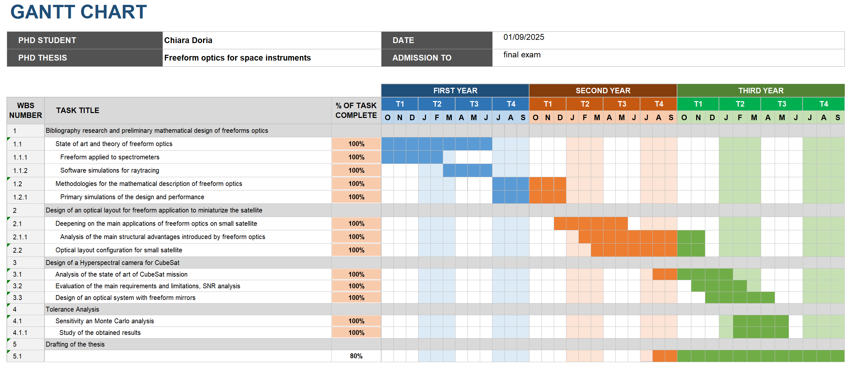

Slide 19

Industrial internship
From December 2024 to May 2025, I had the possibility to spend a period in Leonardo S.p.A., Cambi Bisenzio, Florence, to deeper focus on the design of the presented Hyperspectral camera.
List of Pubblications
III Aerospace PhD-Days International Congress of PhD Students in Aerospace Science and
Engineering: “Freeform Offner spectrometer for space applications”,
https://doi.org/10.21741/9781644902677-29
SPIE, Optical System Design: “OPTICAL DESIGN OF A FREEFORM OFFNER
SPECTROMETER ENABLING A VERY LARGE FIELD OF VIEW”.
https://doi.org/10.1117/12.3028600
International Conference on Space Optics: ICSO 2024: “Using freeform optics for CubeSat
optical layout: comparison between different telescopes architectures”.
https://doi.org/10.1117/12.3071285
SPIE, Optics and Photonics:” Optical Design of a freeform Hyperspectral camera for CubeSat”.

Slide 20
Thanks for the attention

