Slide 1
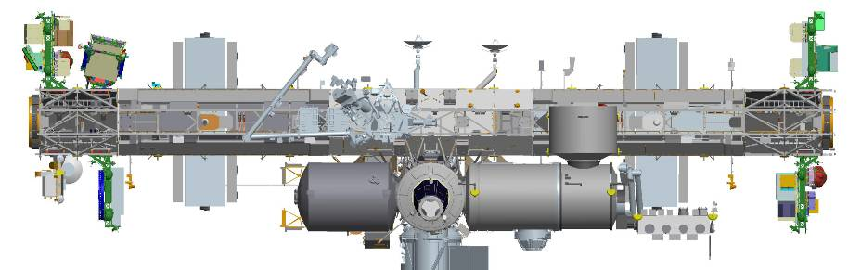
COronal Diagnostic EXperiment
(CODEX)
ELC2
ELC3
Keel Side
Keel Side
ESP-3
ELC4
ELC1
Columbus
External Payload Facility
JEM
External Facility
Jeff Newmark - NASA GSFC
Yeon-han Kim - KASI
A NASA-KASI Collaborative Project
Notes:
Febbraio 2023

Slide 2
CODEX QUAD Chart
CODEX Quad Chart
Objectives
Are there signatures of hot plasma released into the solar wind from previously closed fields?
What are the velocities and temperatures of the density sub-structures that are observed so ubiquitously in streamers and coronal holes?
Complementary Observations:
Significant enhancement to Parker Solar Probe, Solar Orbiter, and DoD UltraViolet Spectro-Coronagraph
Space Weather Applications – CMEs
What are the sources and acceleration mechanisms of the solar wind?
Key Team Organizations
NASA GSFC/GB: PI Institute, PI = J. Newmark, GSFC/GB Team. Coronagraph, Science, SE, SM&E, Environmental, etc.
NASA GSFC/WFF: PM = L. Thompson, and GSFC/WFF engineering team. Payload SE, pointing, power, mechanical, etc.
KASI (Korea): Major partner, Y.-H. Kim, K.-S. Cho and KASI team. Filter wheel, Camera/detector, C&DH computer and FSW.
NRL: Science, Calibration: L. Strachan
INAF (Italy): Science: S. Fineschi
INSPIRE
Schedule Milestones (DRAFT)
Guidelines and Status
A NPR7120.8 Tailored project following GPR 8705.4
Kickoff Meeting: October 16, 2019
Funding in place
Draft Schedule in place, started working details
Resources are in place with a couple exceptions.
Trade Studies identified and being worked
Documentation has started with some out for review.
Internal SRR Dec. 2019
Internal KASI PDR Feb. 2020
CODEX PDR May 2020
Safety Review #0/1 Jun. 2020
Internal KASI CDR Nov. 2020
CODEX CDR Dec. 2021
Safety Review #2 Jan. 2021
Pre-Environmental Review Aug. 2022
Safety Review #3 Nov. 2022
Pre-ship Review Dec. 2022
FRR/MRR Jan. 2023
Launch Feb. 2023

Slide 3
Roles and Responsibilities
GSFC Greenbelt | PI, Co-Is Coronagraph Science Operations and Data Center, Data Analysis Project Systems Engineering, S&MA, Environmental Testing, AI&T Thermal
GSFC Wallops Flight Facility | PM/DPM Payload Systems Engineering, S&MA Pointing System, AI&T Mechanical Structure/Mechanism Power Distribution
Naval Research Laboratory | Co-I Instrument Calibration
Korea Astronomy and Space Science Institute (Contributions) | Co-Is Command and Data Handling Computer (purchase GSFC hardware), flight and ground software Detector and readout electronics Filter Wheel Assembly Science Center and data analysis
Istituto Nazionale Di Astrofisica (INAF) | Collaborator - science
3

Slide 4
Science Motivation
CODEX
Abbo et al. 2015
Temperature (MK)
A crucial gap in the information on the physical conditions in the solar wind acceleration region (3-9 R☉)
The gap is between the spectroscopic measurements (<3 R☉) and the Parker Solar Probe measurements (>9 R☉)
An electron temperature variation (blue curve) is assumed by solar wind models to obtain the speed (red curve)
This new capability of combining simultaneous electron density, temperature, and velocity will be the first time all three have ever been measured simultaneously for this FOV, and we will do it globally, nearly daily for 6 months! This is a comprehensive dataset to test all models of solar wind acceleration and source and will be a regular, systematic, comprehensive validation of space-weather/operational models in the crucial source region of the solar wind.
CODEX will provide information on physical conditions in the coronal region not reachable by Parker Solar Probe.

Slide 5
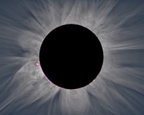
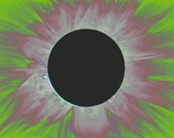
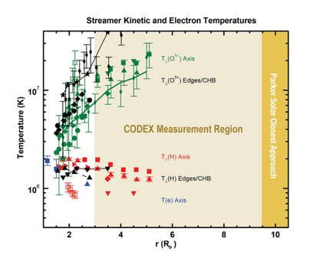
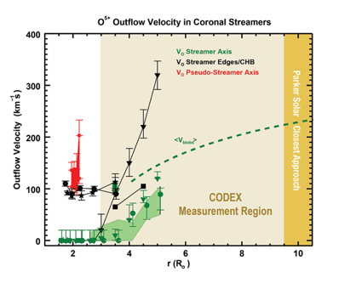
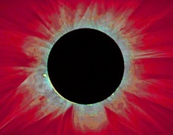
CODEX Will Provide Breakthrough Science Capability
Currently white light coronagraph images provide electron density
CODEX will use spectral information to also determine temperature and flow velocity. Allows fast and slow solar wind models to be tested.
Enhances Parker Solar Probe and Solar Orbiter science
Provides Space Weather relevant data – Coronal Mass Ejections (CMEs)
Density
Velocity
A crucial gap in the information on the physical conditions in the solar wind acceleration region (~3-10 R☉)
This new capability of combining simultaneous electron density, temperature, and velocity will be the first time all three have ever been measured simultaneously for this FOV, and we will do it globally, nearly daily for 6 months!
Temperature

Slide 6
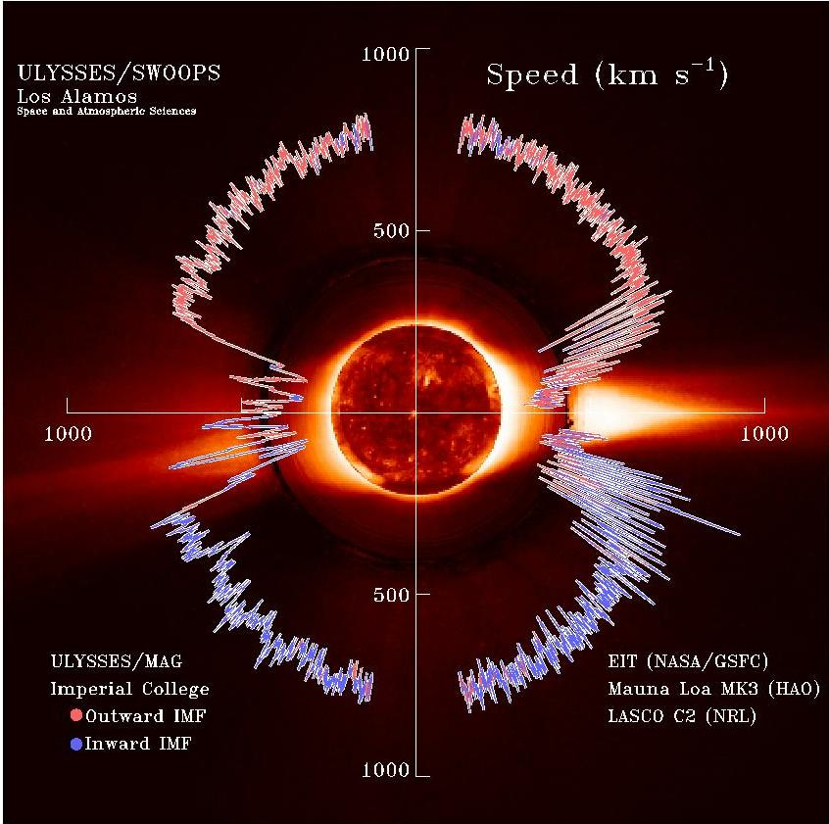
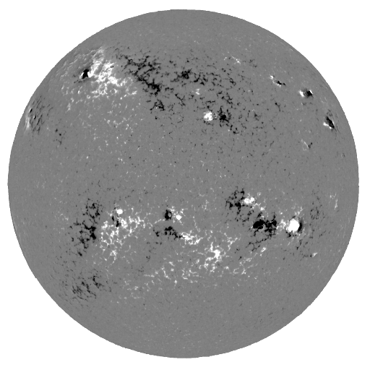
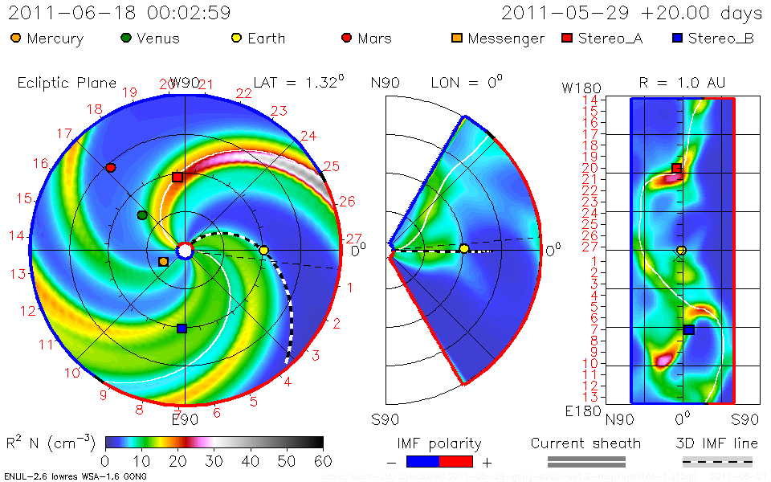
Knowledge of the Solar Wind,
Fundamental to All of Heliophysics…Provided by CODEX
Current State-of-the-Art
Surface magnetograms input into a model, results are then used in an empirical correlation to estimate the solar wind speed near the Sun
In addition, very few observations of the solar wind outside of Earth orbital plane exist. CODEX will observe high latitude solar wind every day
CODEX will provide solar wind speed data for input into models like ENLIL
Potential Field Source Surface Model
Wang, Sheely, Arge Model
Lo-Res LOS Magnetogram for last full rotation
At source surface
ENLIL Solar Wind Model

Slide 7
Science Traceability Matrix
Science Goal | Science Objectives | Scientific Measurement Requirements |  | Instrument Requirements
 |  | Physical Parameters | Observables
What are the sources and acceleration mechanisms of the solar wind? | Are the acceleration profiles different on the sub-structure within streamers or coronal holes? | Observe the radial temperature and velocity profile of the solar wind at a range of latitudes | A time series of images showing the motion and evolution of electron density structures in the solar wind in total brightness (density), temperature, and velocity structures from the tops of streamers out near the sonic point | Field of View (FOV) | 3-12 R☉
 |  |  |  | Image Cadence | 2 orbits = 3 hours for all measurements using 4 band pass filters
 |  |  | A time series of images showing the evolution of fine scale electron density, temperature, and velocity structures in coronal holes from near the surface to near the sonic point | Spatial Resolution | 30 arcsec for density 4 arcmin for temperature 4x10 arcmin (long direction is radial) for velocity
 | Is there evidence for magnetic field interchange reconnection contributing plasma from previously closed fields to the solar wind? | Observe the evolution of fine scale electron density structures showing the evolution of outward moving features (blobs) from near the closed field boundaries and streamer stalks | A time series of total brightness images showing the evolution of fine scale electron density structures in coronal holes from near the surface to near the sonic point
 |  |  |  | Stray light | < 1% of local corona for 3 < r < 12 R☉
 |  |  |  | Spectral Bandpass | 5 nm band pass filter @ 393.5, 405.0, 398.7 and 423.4 nm, plus broadband 380-430
Enable and validate the next generation of space weather science models | How accurate are present models at predicting the global coronal structure? | Observe the evolution of electron density structures to track the daily evolution of the global corona | An overlapping series of total brightness images showing global structure of coronal density features of the K-corona
 |  |  |  | Signal-to-Noise Ratio (SNR) | > 200 (for co-added exposures)
 | Observe the global radial temperature and velocity profile of the solar wind | Observe the global radial temperature and velocity profile of the solar wind | A time series of images showing coronal features in total brightness (density), temperature, and velocity of the K-corona to trace magnetic field lines

Slide 8
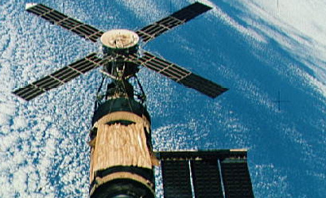
Why Have a Coronagraph on ISS?
Ground testing and the upcoming balloon flight, have proceeded as far as possible, the next step to utilizing this new coronagraph tool is to fly in space.
ISS is a cost effective platform to demonstrate the new instrument technology and scientific utility of the new diagnostic coronagraph.
  Demonstrates the ability to meet future space weather observing needs.
Flying CODEX on ISS serves as a pathfinder for a improved instrument to fly on the Lunar Orbiter Platform – Gateway (LOP-G). This upcoming platform provides extended solar viewing an ideal location for performing continued science and long-term space weather requirements.
  A coronagraph onboard SKYLAB provided some of the earliest images of solar Coronal Mass Ejections (CMEs)

Slide 9
Why Now? Societal Benefits
CODEX serves a NASA, national (and international) need to replace aging coronagraphs which provide data in support of space weather modeling used by NASA, NOAA, European Space Agency-Space Situational Awareness and others.
  NOAA Space-Weather-Follow-On may not launch until 2024 or later!
  A successful mission now demonstrates the technology and providing key science and space weather relevant data while this key asset is readily available!
CODEX will provide observations that support the long term forecasts of CME arrival by understanding the background solar wind and directly imaging CMEs.
New data products from CODEX
  Will stimulate advances in scientific modeling capabilities to improve modeling of the heliosphere.
  Will provide data to continue the development of National and International models in the event of a failure of the SOHO (launched 1995) or STEREO (launched 2006, only 1 currently functioning) coronagraphs (only 2 current coronagraphs in space).
The improved models will provide the scientific basis to support future space travel to the Moon, Mars, and other destinations in the Solar System.
Next Generation of Coronagraphs called out in the National Space Weather Strategy and Action Plan!

Slide 10
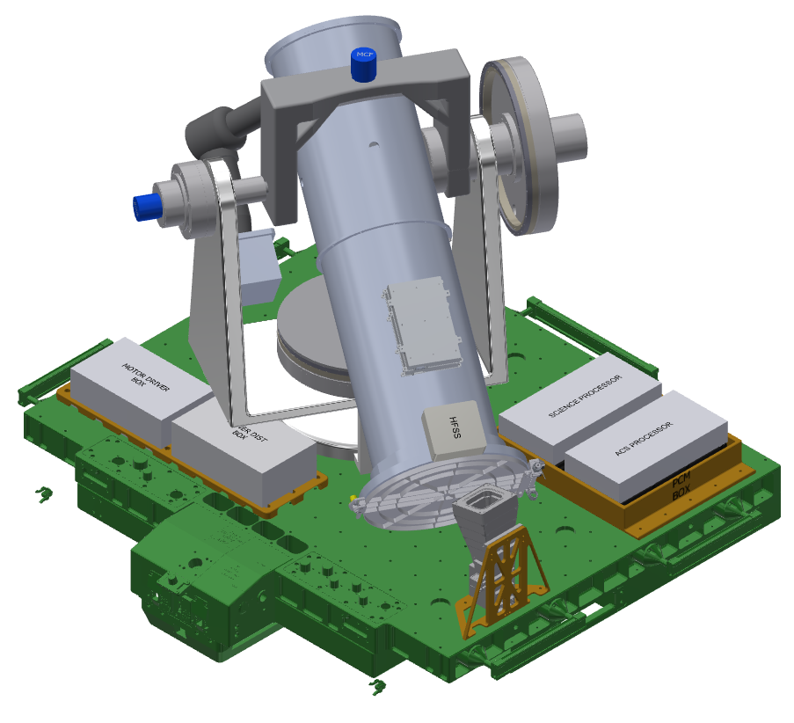
CODEX
EVR Micro-fixtures
Gimbal
Coronagraph
IMU
Motor Driver
HFSS
SpaceCube Mini processors
Power Distribution unit
FRAM (ISS RIO Provided)
Star Tracker

Slide 11
CODEX Coronagraph
Optics
Camera
Aperture Door
Baffles
External Occulter
Heat Rejection Mirror
Light Path

Slide 12
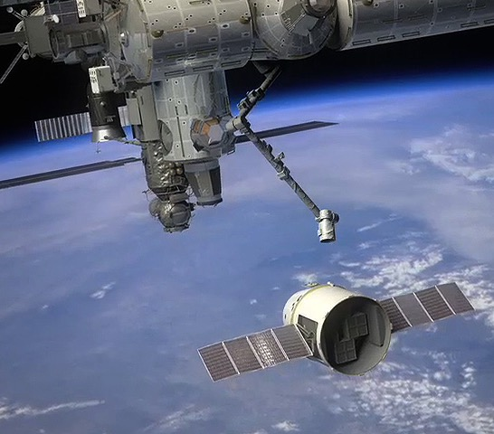
What Aspect of the CODEX Mission
Will Most Engage the General Public ?
The anticipated CODEX discoveries will underscore the value of the ISS for accommodating instruments capable of achieving breakthrough science.
We learned from SDO/STEREO/SOHO that there is significant public interest in how observations are used to answer long-standing questions about how the Sun affects the rest of the solar system.
The public should be interested in CODEX’s discoveries that lay the groundwork for understanding our space environment, improving our ability to forecast space weather, and fostering the commercialization of space.
The key to predicting space weather is to understand the underlying physical processes that control it.
Source: ESA
CODEX will achieve breakthrough science, operationally relevant data, and fascinate the public!

