Slide 1
Additive manufacturing for the development of a sustainable aerospace industry
Zahra Shafiei - 38th Cycle
Supervisor: Prof. Mirco Zaccariotto
Co-supervisors: Prof. Ugo Galvanetto and Dr. Vito Diana
Meeting - 19 October

Slide 2
additive manufacturing for the development of a sustainable aerospace industry
Introduction of Additive Manufacturing
Material Extrusion (MEX)
Additive Manufacturing and Aerospace
Important Parameters in Modeling
Peridynamic Theory
Final Remarks
References

Slide 3
Introduction of Additive Manufacturing
Additive Manufacturing is the formalized term for what used to be called Rapid Prototyping and what is popularly called 3D Printing.
The key to how AM works is that parts are made by adding material in layers
Produce solid structures
complex construction
high accuracy
cuts down greatly the design time
developing for the new products

Slide 4
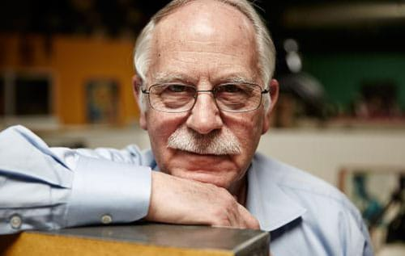
Introduction of Additive Manufacturing
1983 Hull
Working for a company that used UV lamps to make hard-top tables and furniture
The company's UV lamps be used differently:
Polishing layer by layer of photosensitive resin, until the piece is made
A system for producing three-dimensional parts by creating a pattern of the cross-section of the object
Stereolithography (SLA) technology

Slide 5
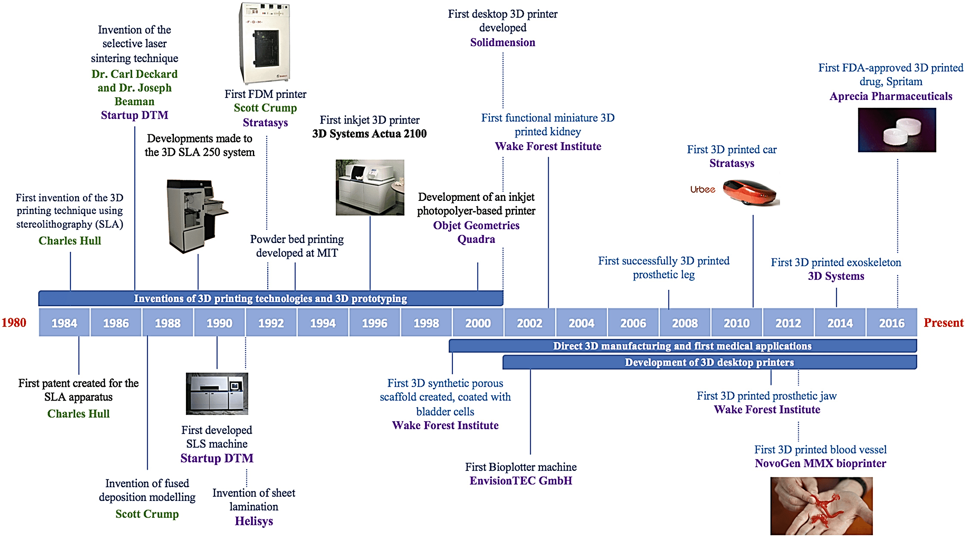
Introduction of Additive Manufacturing

Slide 6
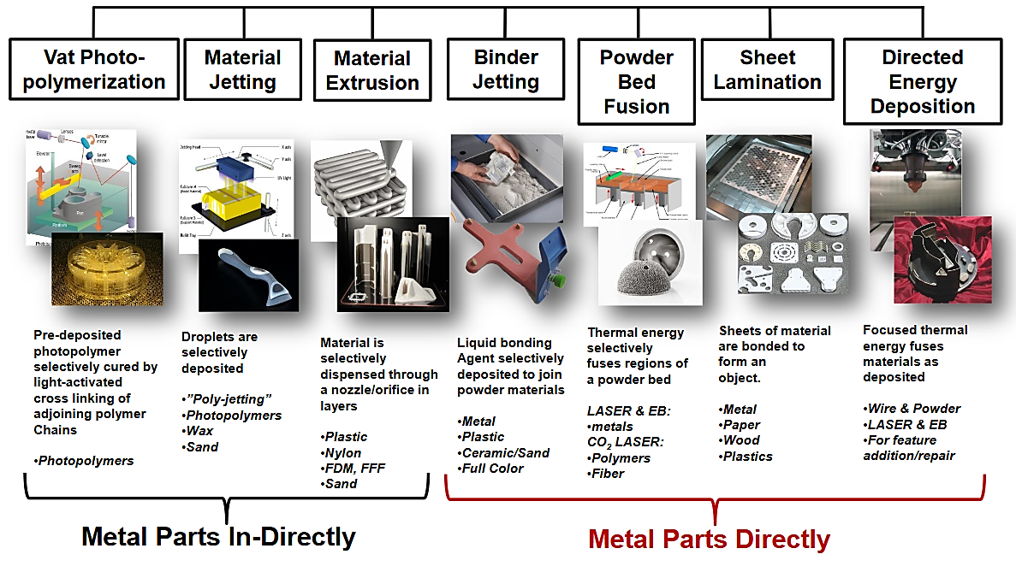
Introduction of Additive Manufacturing
All commercialized AM machines are different in the materials that can be used, how the layers are created, and how the layers are bonded to each other.
Additive manufacturing technologies:
Vat Photopolymerization (VPP)
Powder Bed Fusion (PBF)
Material Extrusion (MEX)
Material Jetting (MJT)
Binder Jetting (BJT)
Sheet Lamination (SHL)
Directed Energy Deposition (DED)

Slide 7
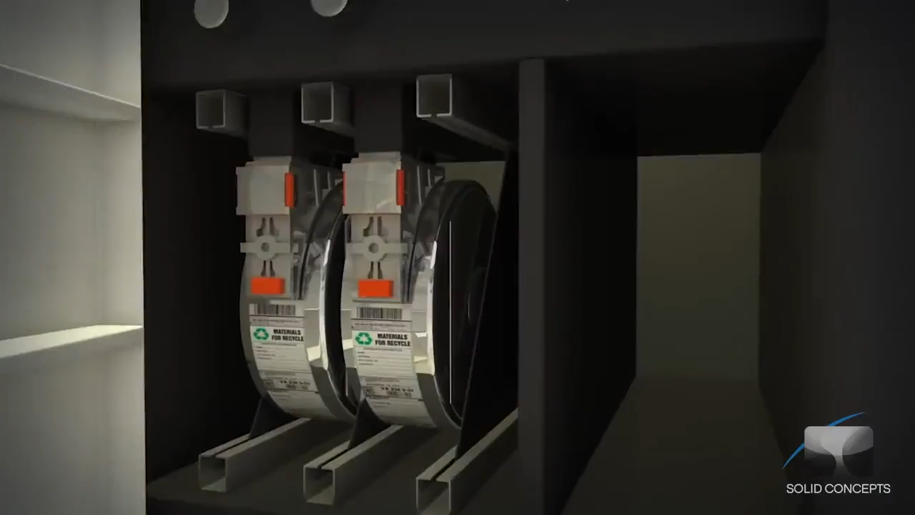
Material Extrusion (MEX)
Material Extrusion [9]
Material Extrusion (MEX): processes that deposit a material by extruding it through a nozzle, typically while scanning the nozzle in a pattern that produces a part cross-section.

Slide 8
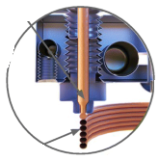
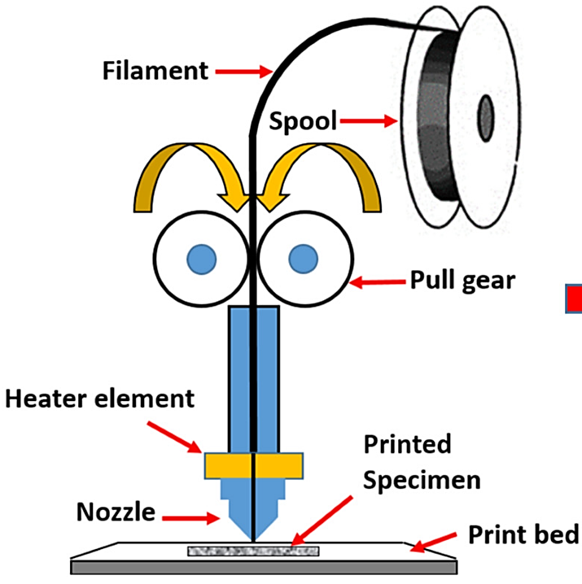
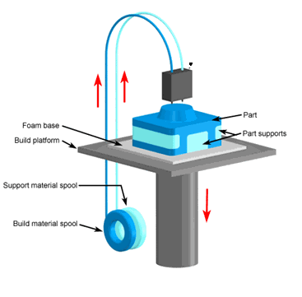
Material Extrusion (MEX)
Material Extrusion Printing Process
Layer-by-Layer Deposition
Material Loading
Heating
Extrusion
Platform Movement

Slide 9
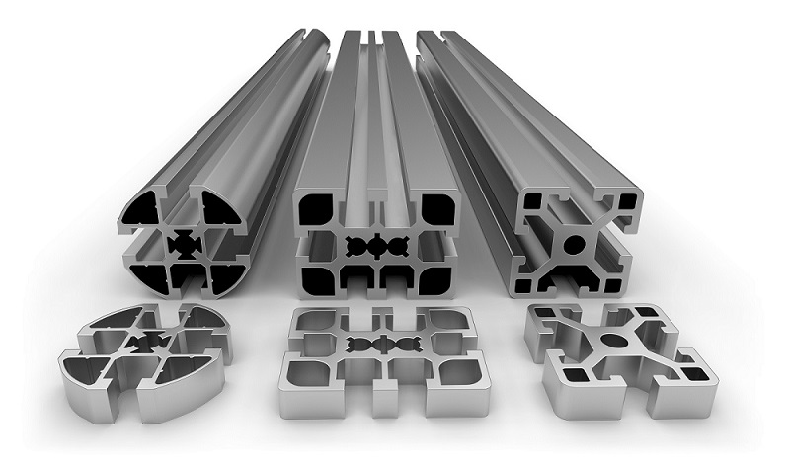
Material Extrusion (MEX)
Advantages of Material Extrusion:
1- Customization
11- Accessibility for Education
2- Reduced Material Waste
3- Rapid Prototyping
4- Cost-Effective
5- Low Tooling Costs
6- Ease of Iteration
7- Versatile Materials
8- Layered Structure Inspection
9- Reduced Lead Times
10- Complex Internal Structures

Slide 10
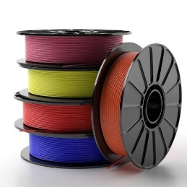
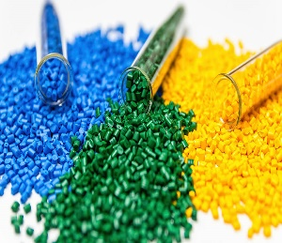
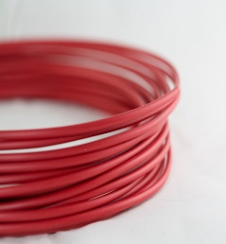
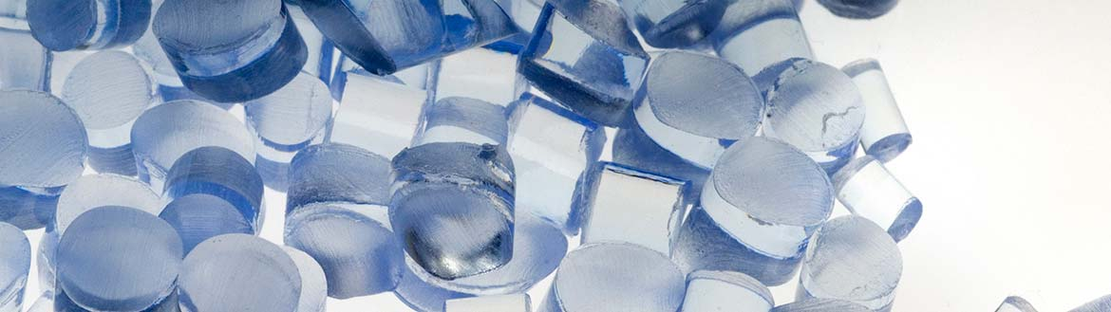
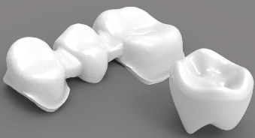
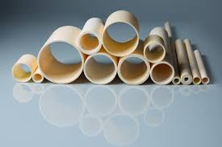
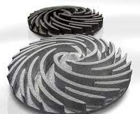
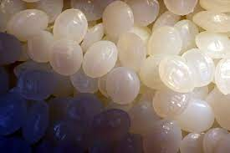
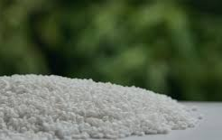
Material Extrusion (MEX)
Materials Used in Material Extrusion
PLA (Polylactic Acid)
ABS (Acrylonitrile Butadiene Styrene)
PETG (Polyethylene Terephthalate Glycol)
TPU (Thermoplastic Polyurethane)
3- Ceramics
1- Plastics
2- Metals
aluminum, stainless steel, and titanium
zirconia
silicon carbide
4- Composites
alumina
5- Biodegradable Materials
6- Food-Grade Materials
PCL (Polycaprolactone)
PHA (Polyhydroxyalkanoates)

Slide 11
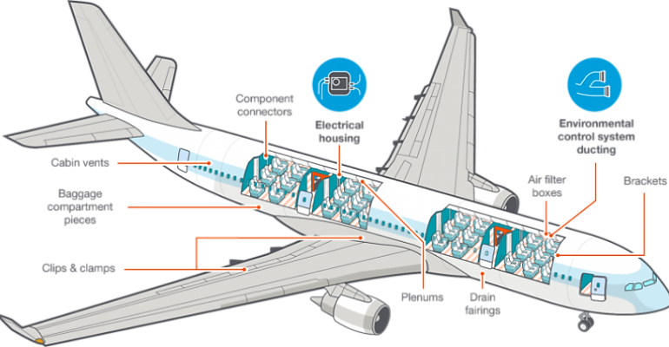
Additive Manufacturing and Aerospace
Applications of Material Extrusion in Aerospace
1- Prototyping and Concept Models
2- Customized Components
3- Ducting and Ventilation Systems
4- Lightweight Structures
5- Cabin Components
6- Tooling and Ground Support Equipment
7- Aircraft Interiors
8- Prototypes for UAVs (Unmanned Aerial Vehicles)
9- Rapid Repairs
10- Material Selection

Slide 12
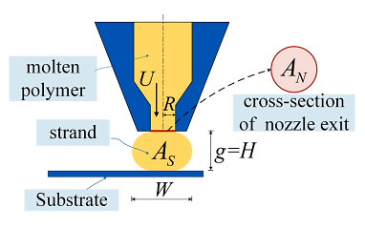
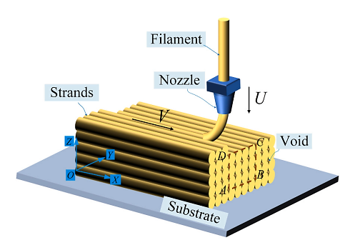
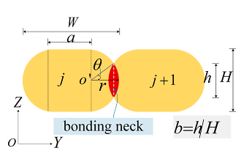
Important Parameters in Modeling
The dependence of the ME’ mesostructure on printing parameters [2]
printing speed
flow rate

Slide 13
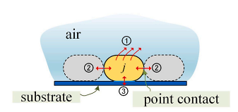
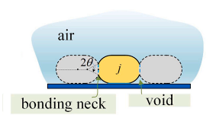
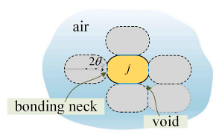
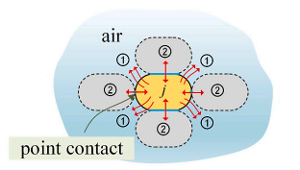
Important Parameters in Modeling
The dependence of the ME’ mesostructure on printing parameters [2]
Surface
tension
Viscosity
dissipation
temperature-dependent surface tension
viscosity

Slide 14
Peridynamic Theory
Classical continuum theory
Each material node is only related to its adjacent node
The mass and energy exchange only with adjacent nodes
Crack propagation requires special techniques to be managed
Singular stresses at the tip of the crack
x
nodes associated with the x
x

Slide 15
Peridynamic Theory
molecular or atomistic simulation
Each node is associated with all nodes
Time-consuming and costly for real engineering structures
x
x
nonlocal theories
Interaction between material nodes are within finite rang
x
nodes associated with the x
x

Slide 16
Peridynamic Theory
Each material node interact with the material nodes in certain radius around it which is called the neighborhood radius (δ) of that material node
δ
j
Each material node is affected by all material nodes in its neighborhood, and the effect is defined by micro-potential w_{kj}
k
δ
y
z
x

Slide 17
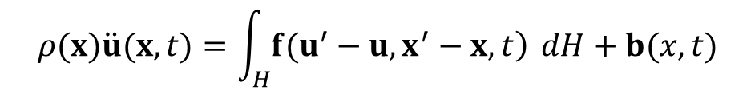
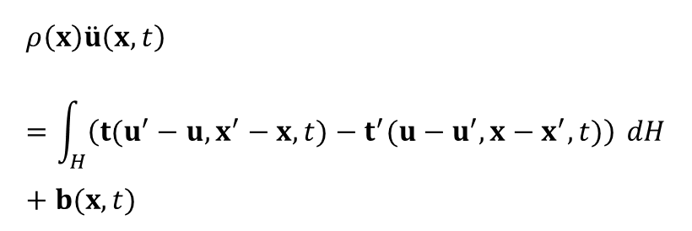
Peridynamic Theory
$$ρ\left(x\right)\ddot{u}\left(x,t\right)=\int_{H}{\left(t(u^{′}−u,x^{′}−x,t)−t^{′}(u−u^{′},x−x^{′},t)\right)} dH+b(x,t)$$
$$ρ(x)\ddot{u}(x,t)=\int_{H}{\left.f(u^{′}−u,x^{′}−x,t\right)} dH+b(x,t)$$

Slide 18
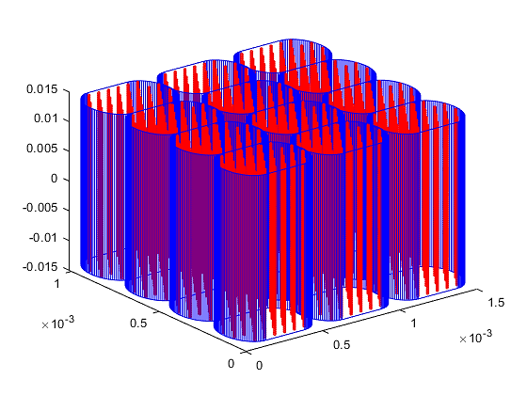
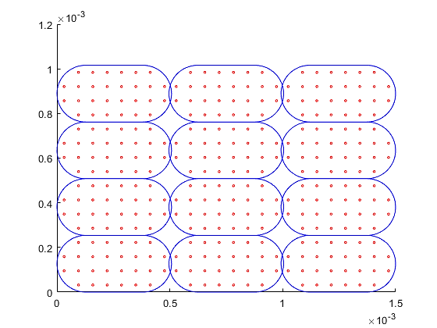
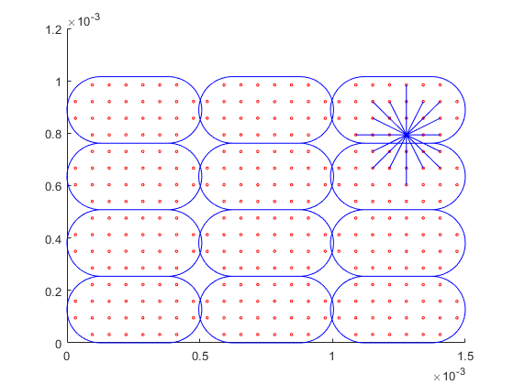
Peridynamic Theory

Slide 19
Final Remarks
An extensive literature search was conducted on additive manufacturing technologies with a focus on processes based on material extrusion. The most important process parameters, how these parameters affect the strand cross-section and the connection between these strands were identified.
A thorough literature search on peridynamic theory was carried out.
The aim of the research is to predict, with numerical models, the effect of the process parameters of 3D printing technology on the mechanical properties of the manufactured product.
The bond-based peridynamic model will be used to simulate the effects of porosity, non-uniformity of strand cross-section and strand arrangement.
The peridynamic model will also allow the study of debonding in the connection of strands, fracture and crack propagation in 3D printed materials.

Slide 20
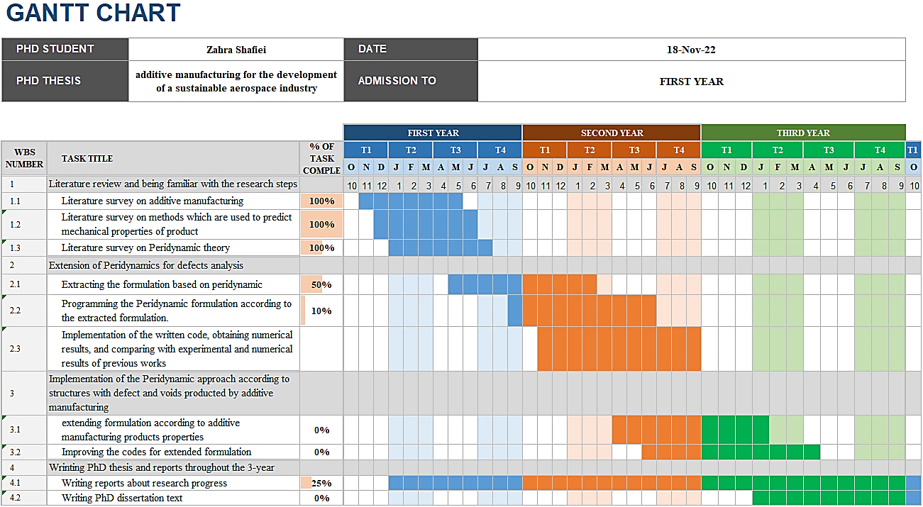
Final Remarks

Slide 21
References
[1] Rodríguez, José F., James P. Thomas, and John E. Renaud. "Mechanical behavior of acrylonitrile butadiene styrene (ABS) fused deposition materials. Experimental investigation." Rapid prototyping journal 7.3 (2001): 148-158.
[2] Rao, Yanni, et al. "A process-structure-performance modeling for thermoplastic polymers via material extrusion additive manufacturing." Additive Manufacturing 39 (2021): 101857.
[3] Hartmann, Philipp, Christian Weißenfels, and Peter Wriggers. "A curing model for the numerical simulation within additive manufacturing of soft polymers using peridynamics." Computational Particle Mechanics 8 (2021): 369-388.
[4] Zhu, Jinggao, Xiaodan Ren, and Miguel Cervera. "Peridynamic buildability analysis of 3D-printed concrete including damage, plastic flow and collapse." Additive Manufacturing 73 (2023): 103683.
[5] P. Parandoush and D. Lin, "A review on additive manufacturing of polymer-fiber composites," Composite Structures, vol. 182, pp. 36-53, 2017.
[6] Wang, Bingquan, Selda Oterkus, and Erkan Oterkus. "Thermomechanical phase change peridynamic model for welding analysis." Engineering Analysis with Boundary Elements 140 (2022): 371-385.
[7] Gibson, Ian, et al. Additive manufacturing technologies. Vol. 17. Cham, Switzerland: Springer, 2021.
[8] Pradel, Patrick, et al. "Investigation of design for additive manufacturing in professional design practice." Journal of Engineering Design 29.4-5 (2018): 165-200.
[9] material extrusion - YouTube

Slide 22
Thanks for the attention

