Slide 1

Study of a Coronal Mass Ejection with UV and WL coronagraphs
Beili Ying（应蓓丽）
Purple Mountain Observatory, CAS
Co-authors: A. Bemporad, L. Feng

Slide 2
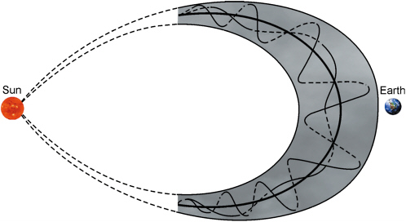
Background
Coronal mass ejection (CME)
Notes:
by tracking brighter features (such as the CME front and core) in visible light (VL) coronagraphic images and by deriving unidimensional profiles of the CME speed as a function of altitude or time.
CMEs are usually characterized by the presence of significant density inhomogeneities propagating outward with different radial and tangential speeds, resulting in a complex evolution eventually resulting in the Interplanetary CME.
A great advantage in the interpretation of white-light coronagraph images is the fact that the major part of their brightness signal is produced by Thomson scattering, which depends linearly on the density N e of the scattering free electrons.

Slide 3
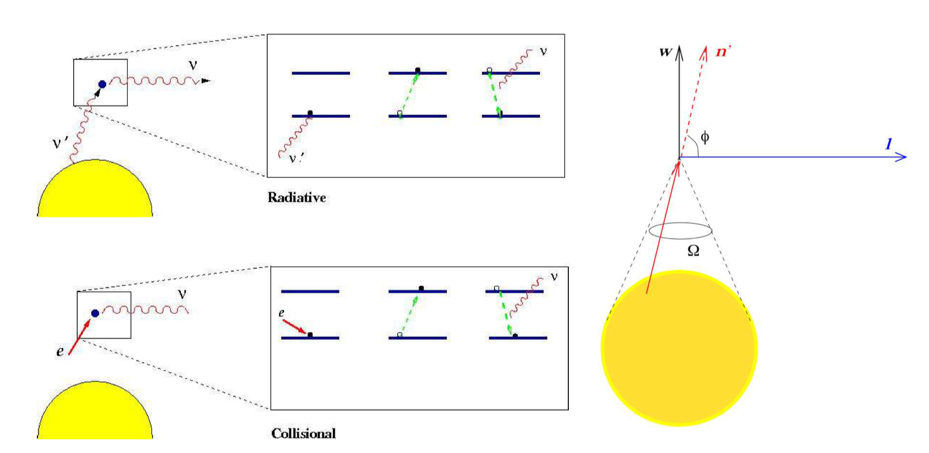
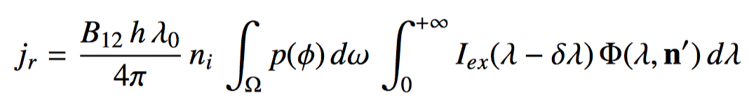
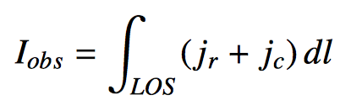
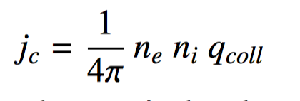
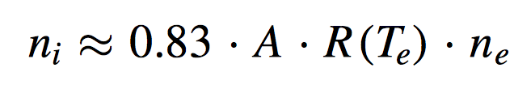
Mechanism of ly-alpha line
Resonant Scattering processes
Collisional Scattering processes
the neutral hydrogen number density
the solid angle
Doppler dimming factor F_{D}
3
collisional excitation rate
the element ionization fraction
Notes:
followed by spontaneous emission. A is the element abundance relative to hydrogen
the resonant scattering of the disk radiation by coronal ions/atoms,
the collisional component is the excitation of a coronal ion/atom by collision with a free electron
and p((j))d(o f is the probability that a photon traveling along n would have been in dœ‘ before scattering, the intensity line profile of the chromospheric radiation, the normalized coronal absorption profile

Slide 4
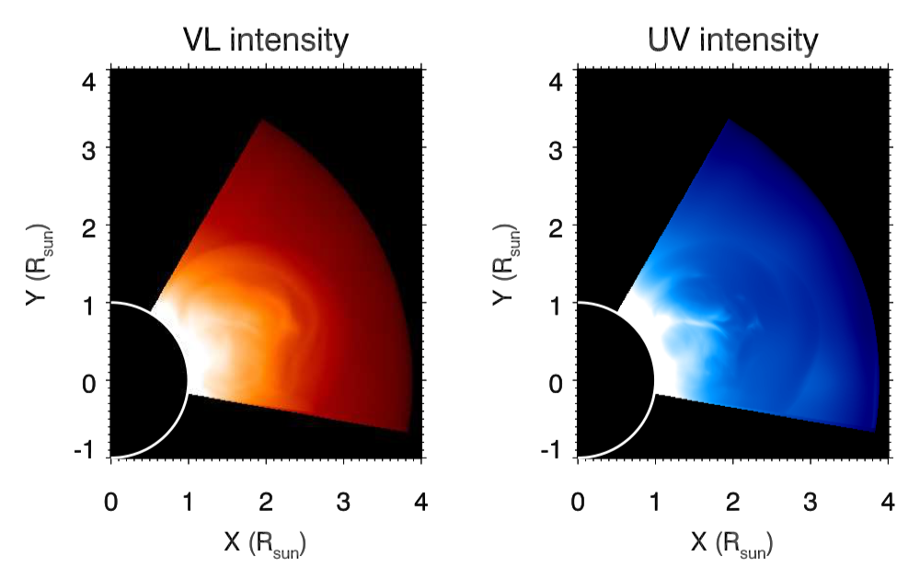

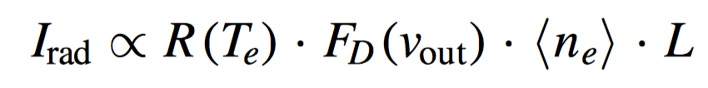
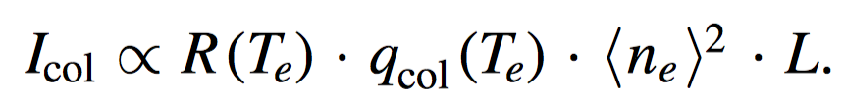
SUN
POS
LOS
Bemporad et al. 2018
Susino & Bemporad
2016
F _{D} (v _{out}) is Doppler-dimming factor
<n_{e}> is the average volume electron
density
L is the thickness along the LOS of the emitting plasma

Slide 5
Overview
UVCS slit center: PA=252 deg, R =2.45 Rsun
Date: 2002-April-30
SOHO/EIT 195 A
LASCO C2 and C3
UVCS WL channel
UV channel
~1100 km/s
UVCS WL channel have been employed to measure with polarization ratio technique the CME propagation angle
~19°

Slide 6
Overview
UV coronagraph:
UVCS OVI channel (OVI and Lya lines)
Core
+70%
Lya intensity
Normalized profile width

Slide 7
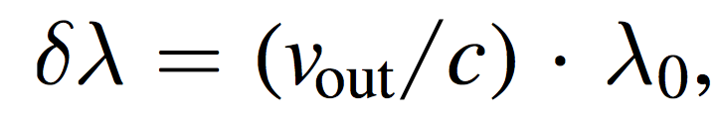
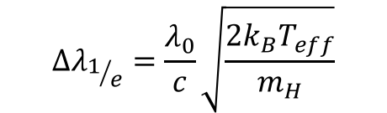
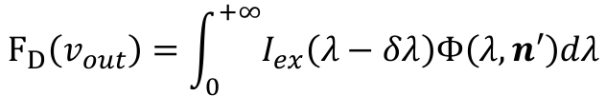
WL Data:
UV Data:
L=0.25 and 1 Rsun
$$∆λ_{1/e}=\frac{λ_{0}}{c}\sqrt{\frac{2k_{B}T_{eff}}{m_{H}}}$$
T_{eff}
Aloq10[T (K)]
T_{e}
$$F_{D}（v_{out}）=\int_{0}^{+∞}{I_{ex}\left(λ−δλ\right)Φ\left(λ,n′\right)dλ}$$
Void and Core
Notes:
The absorption profile was assumed to be Gaussian with a 1/e line width equal to the average Lyα line width measured by UVCS
we obtain the 2D radial speed map of the CME with a simple assumption that the radial speed of the CME increases linearly along the radial orientation, due to the low cadence of the LASCO WL images.

Slide 8
The evolution of Electron and effective temperatures
10^{4.8} K
1.The evolution of the derived electron temperature imply the cold plasma coming from the erupting prominence embedded in the CME core.
2. The difference between the effective and electron temperatures might indicate that in the CME core the potentially lower kinetic temperatures are counter-balanced by higher non-thermal plasma motions.

Slide 9
Synthetic UV images of the CME
Te=6e5 K
With 24hr-minimal background subtraction
L=1 Rsun
Te=1e6 K
Only the CME emission without foreground and background emission!
Te=3e6 K

Slide 10
Determination of 2D Speed Distribution of the CME with Cross-correlation Analysis
Ying et al. 2019 ApJ, 880, 41

Slide 11
Conclusions
In this work we studied a fast CME with the combination of WL images acquired by SOHO/LASCO coronagraphs, and intensities measured by SOHO/UVCS at 2.45 Rsun both in the UV and WL channels. Data from UVCS WL channel have been employed to measure with polarization ratio technique the CME propagation angle.
The CME core is clearly observed in the Ly-alpha intensity, while it is not negligible in the WL images. The front is observed as a significant dimming in the Ly-alpha intensity, associated with a line broadening due to plasma flows along the line-of-sight.
Plasma electron and effective temperatures of the CME core and void have been estimated combining UV and WL data. The transit of the CME core (and possibly of cooler plasma in the embedded prominence) results in a decrease of the electron temperature down to 10^{4.8}K.
For the lower-cadence LASCO images, the 2D distribution of plasma speeds within the CME body has been reconstructed and employed to constrain the Doppler dimming of Ly-alpha line and simulate future observations by Metis and LST. In the future, the 2D velocities of CMEs observed by new instruments with higher temporal and spatial resolutions can be determined by the cross-correlation method.

Slide 12
Thank you for your attention!!

