Slide 1
Refining the Drag Parameter for Coronal Mass Ejection propagation models
D. Del Moro^{(1),}, F. Berrilli⁽¹⁾, R. Foldes⁽¹⁾, L. Giovannelli⁽¹⁾, G. Napoletano⁽²⁾, E. Pietropaolo⁽²⁾
⁽¹⁾Università degli Studi di Roma “Tor Vergata”, Via della Ricerca Scientifica, 1, 00133 Rome, Italy;
⁽²⁾Università de L’Aquila, Via Vetoio, 48, 67100 Coppito L’Aquila, Italy.
ICME (Interplanetary Coronal Mass Ejection) are violent phenomena of solar activity that affect the whole heliosphere and the prediction of their impact on different solar system bodies is one of the primary goals of the planetary space weather forecasting. The travel time of ICME from the Sun to the Earth can be computed through Drag Based Model (DBM) approach, which is based on a simple equation of motion for the ICME that defines the acceleration as a=-Γ(v-w)|v-w|, where a and v are the CME acceleration and speed, w is the ambient solar-wind speed and Γ is the so-called drag parameter (Vršnak et al., 2013). In this framework, Γ depends on the ICME mass and cross-section, on the solar-wind density and, to a lesser degree, on other parameters. The typical working hypothesis for DBM implies that both Γ and w are constant far from the Sun. To run the codes, forecasters use empirical input values for Γ and w. In the 'Ensemble' approaches (Dumbovich et al., 2018; Napoletano et al. 2018), the uncertainty about the actual values of such inputs are rendered by Probability Distribution Functions (PDFs), accounting for the values variability and our lack of knowledge. Among those PDFs, that of Γ is poorly defined due to the relatively scarce statistics of recorded values.
Taking advantage of the large data-set of ICMEs registered by Richardson & Cane (2010), we computed how Γ depends on SW velocity, and found evidence of a variation in the Γ PDFs if the SW is accelerating or braking the propagation. By using a set of simulations of an ICME structure into the SW fluid, we link this change to the structure of the ICME.
This is a pioneering work in the exploration on how Γ depends on the physical parameters of the ICME, to verify and extend the work by Vršnak et al. (2010). This would lead to a more robust definition of the PDF of the drag parameter Γ that could be used in the various DBM approaches to real-time ICME travel time forecasting.

Slide 2
Refining the Drag Parameter for Coronal Mass Ejection propagation models
D. Del Moro^{(1),}, F. Berrilli⁽¹⁾, R. Foldes⁽¹⁾, L. Giovannelli⁽¹⁾, G. Napoletano⁽²⁾, E. Pietropaolo⁽²⁾
⁽¹⁾Università degli Studi di Roma “Tor Vergata”, Via della Ricerca Scientifica, 1, 00133 Rome, Italy;
⁽²⁾Università de L’Aquila, Via Vetoio, 48, 67100 Coppito L’Aquila, Italy.
INTRO:
ICME (Interplanetary Coronal Mass Ejection) are violent phenomena of solar activity that affect the whole heliosphere and the prediction of their impact on different solar system bodies is one of the primary goals of the planetary space weather forecasting.
What: an exploratory work on how the drag parameter depends on the physical parameters of the ICME, to verify and extend the work by Vršnak et al. (2010).
Scope: a more robust definition of the PDF of the drag parameter that could be used in the various approaches to ICME propagation forecasting.

Slide 3
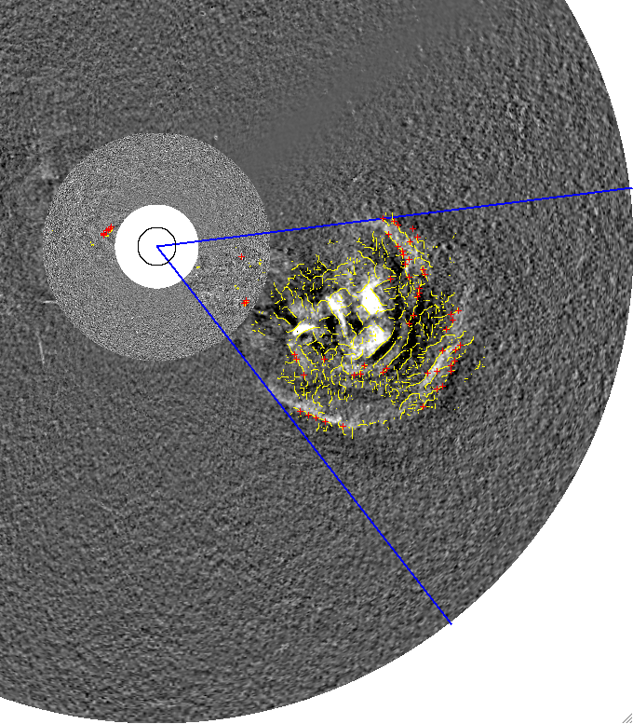
Methods for CME detection and characterization
Predictions of the arrival of ICMEs in geospace are produced through use of CME geometric models combined with ICME propagation models, constraining these models with the available Coronagraph and Heliospheric Imager data.
Notes:
In the very first hours after the liftoff
Imaging from coronagraph
Differente techniques for detection and then fitting
Different assumptions and data availability meand differnces in the resulting CME model

Slide 4
Often, geometric models provide inconsistent results because assumptions inherent to each model are being invalidated
Notes:
Problems even if data is good quality and image are available from different point of view...
Because we apply simplified models to the CME
Inconsistency btw model and reality results in wrong information fed to the propagation model

Slide 5
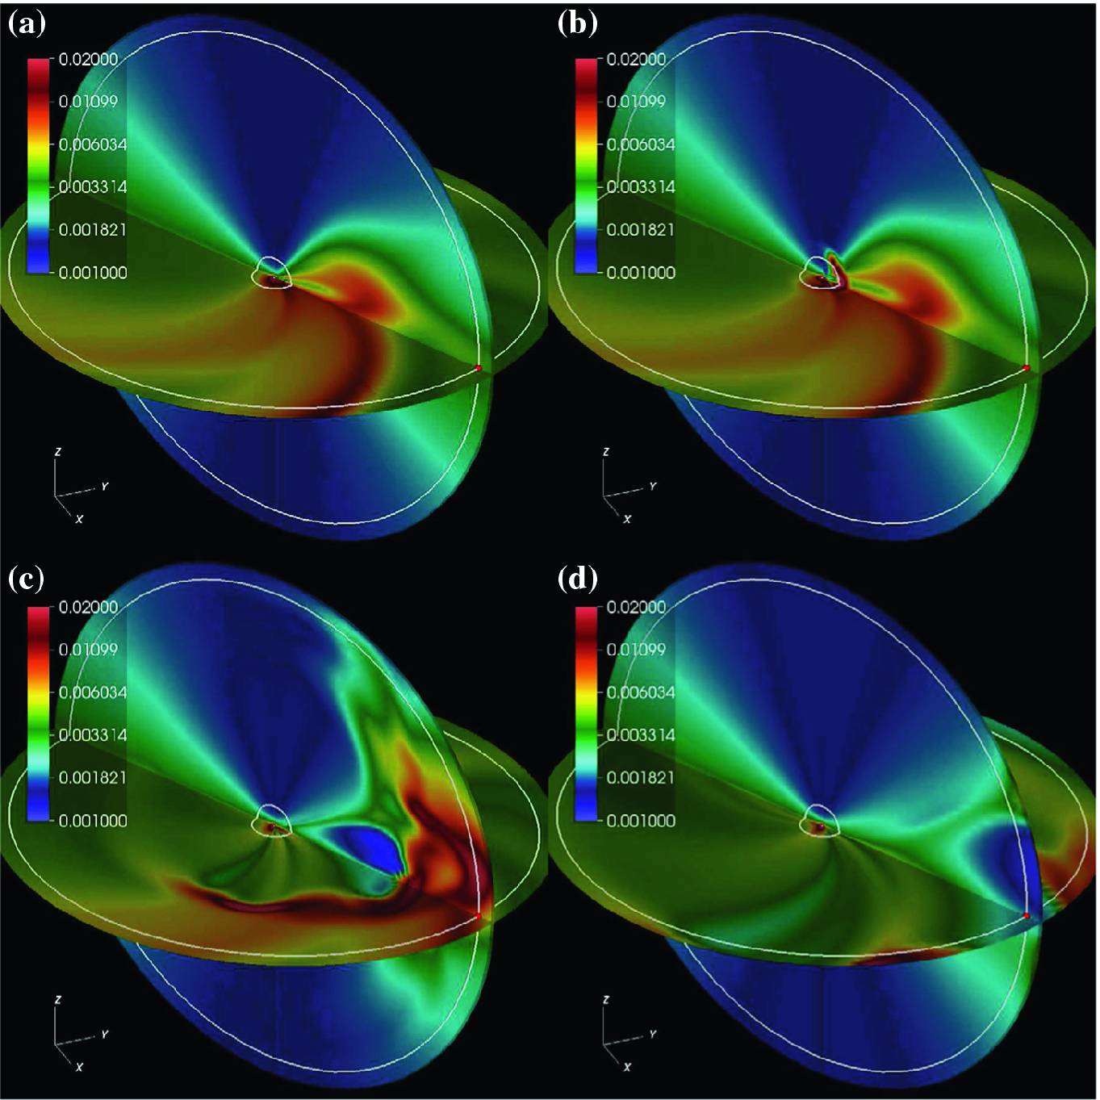
Models for ICME propagation
Predictions of the arrival of ICMEs in geospace are produced through use of CME geometric models combined with ICME propagation models, constraining these models with the available Coronagraph and Heliospheric Imager data.
Notes:
Propagation models can be divided in 3 large families
The one that try to solve a complex and large (M)HD system in computational boxes
The ones that employ empirical correlation derive from past experience
The other in between...
If some information about the problem is partially known or has errors, this results in a wrong model for the ICME

Slide 6
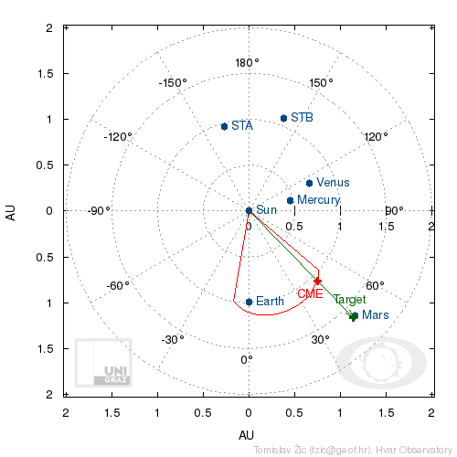
The DBM equation and assumptions
Self-Similar expansion
Evolution entirely governed by fluid dynamics (i.e. the interplanetary magnetic field plays no role)
Constant solar wind speed and drag parameter
The Drag Based Model approach is based on a simple equation for the ICME acceleration as
where w is the ambient solar-wind speed and γ is the so-called drag parameter (Vršnak et al., 2013).
In this framework, γ depends on the ICME mass and cross-section, on the solar-wind density and, to a lesser degree, on other parameters.
The typical working hypothesis for DBM implies that both γ and w are constant far from the Sun.
To run the codes, forecasters use empirical input values for γ and w.
Notes:
One propagation model which is in the middle
Assumes that after a certain distance, the propagation of the CME is that of a rigid body in a moving fluid
Simple assumption, simple equation for the acceleration of the ICME
Gamma hides a lot of physics: it tells us about the CME-wind interaction
In its many implementations, the DBM working hypotheses are that gamma and sw are constant during the propagation
And we use empirical values for gamma and SW, from the past statistics...

Slide 7
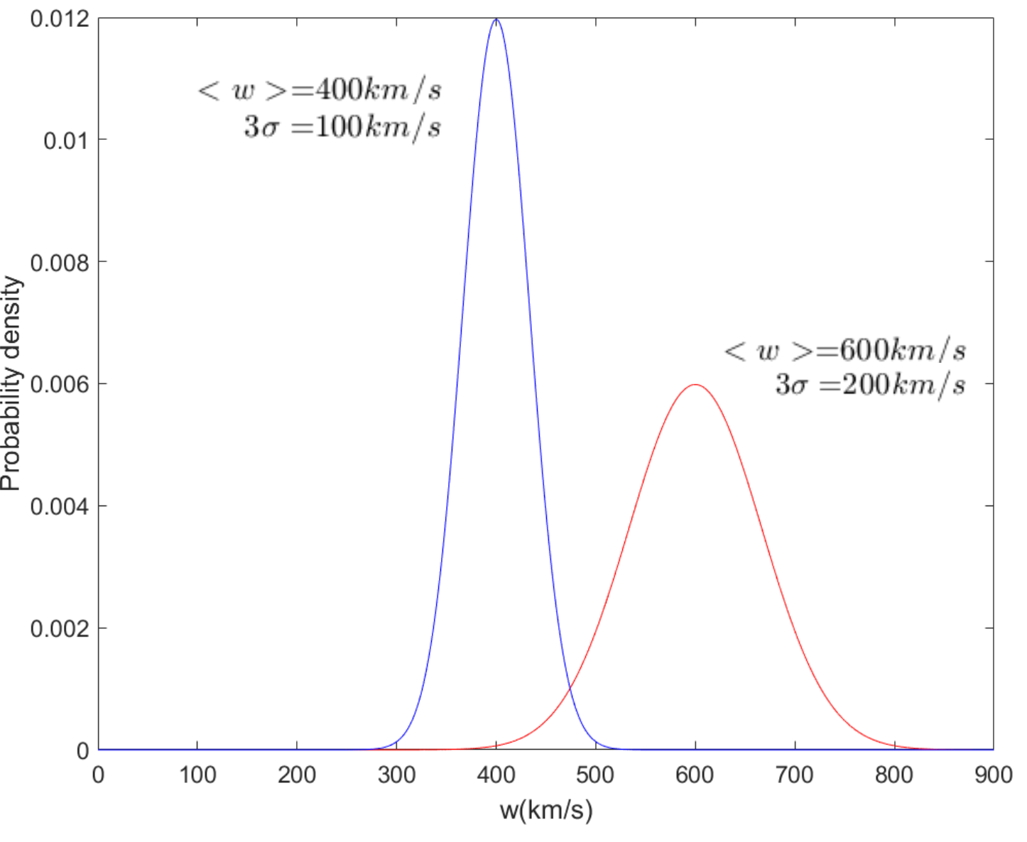
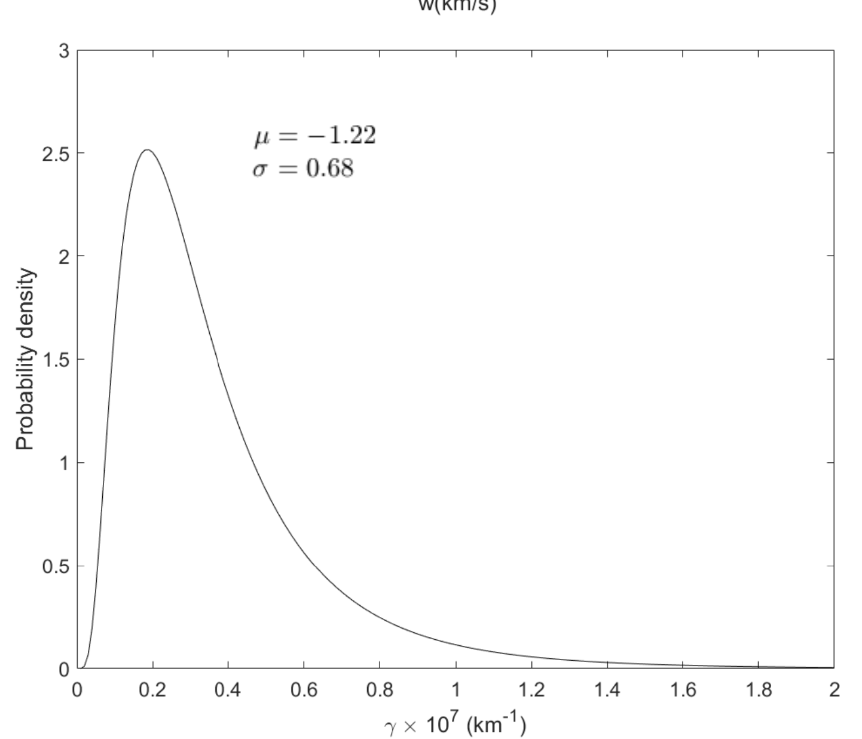
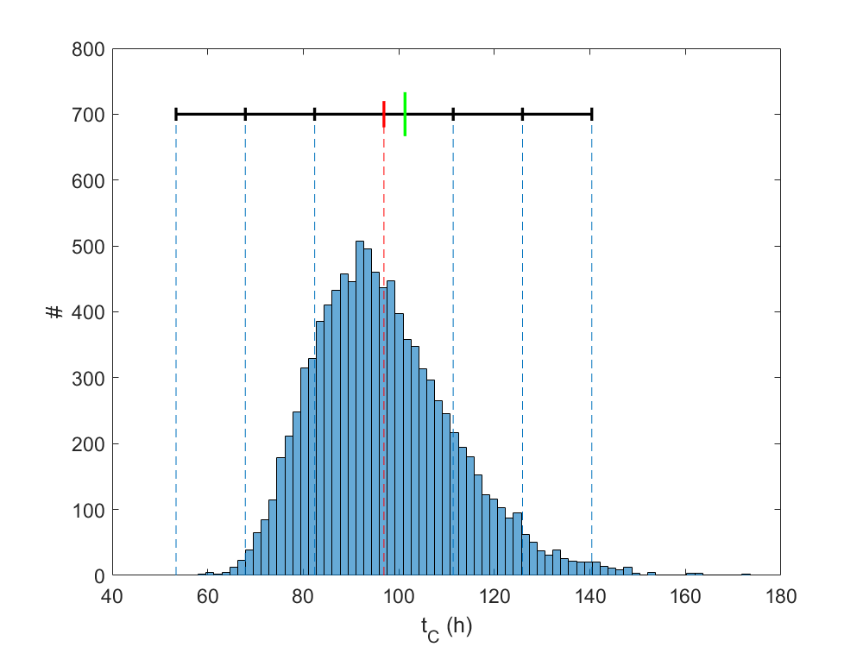
The P-DBM : the PDFs.
In the DBM 'Ensemble' approaches (Dumbovich et al., 2018; Napoletano et al. 2018), the uncertainty about the actual values of such inputs are rendered by Probability Distribution Functions (PDFs), accounting for the values variability and our lack of knowledge.
Among those PDFs, that of γ is poorly defined due to the relatively scarce statistics of recorded values.
Notes:
Recently, both DBM and more complex MHD models have gone ‘statistic’...
Many runs to explore the parameter space due unknown or partially known values for the simulations
The dBM is suited because it is simple to simulate and you can run thousands of different CMEs in seconds
The inputs are extracted from PDFs, which can be constained by direct measures of the CME parameters or from past statistics...
And the output are PDFs as well from which one can extract the most probable outcome and an associated error
Among the input PDFs Gamma in scarcely defined, we tried to shed some more light on it, using past data and a statistical approach

Slide 8
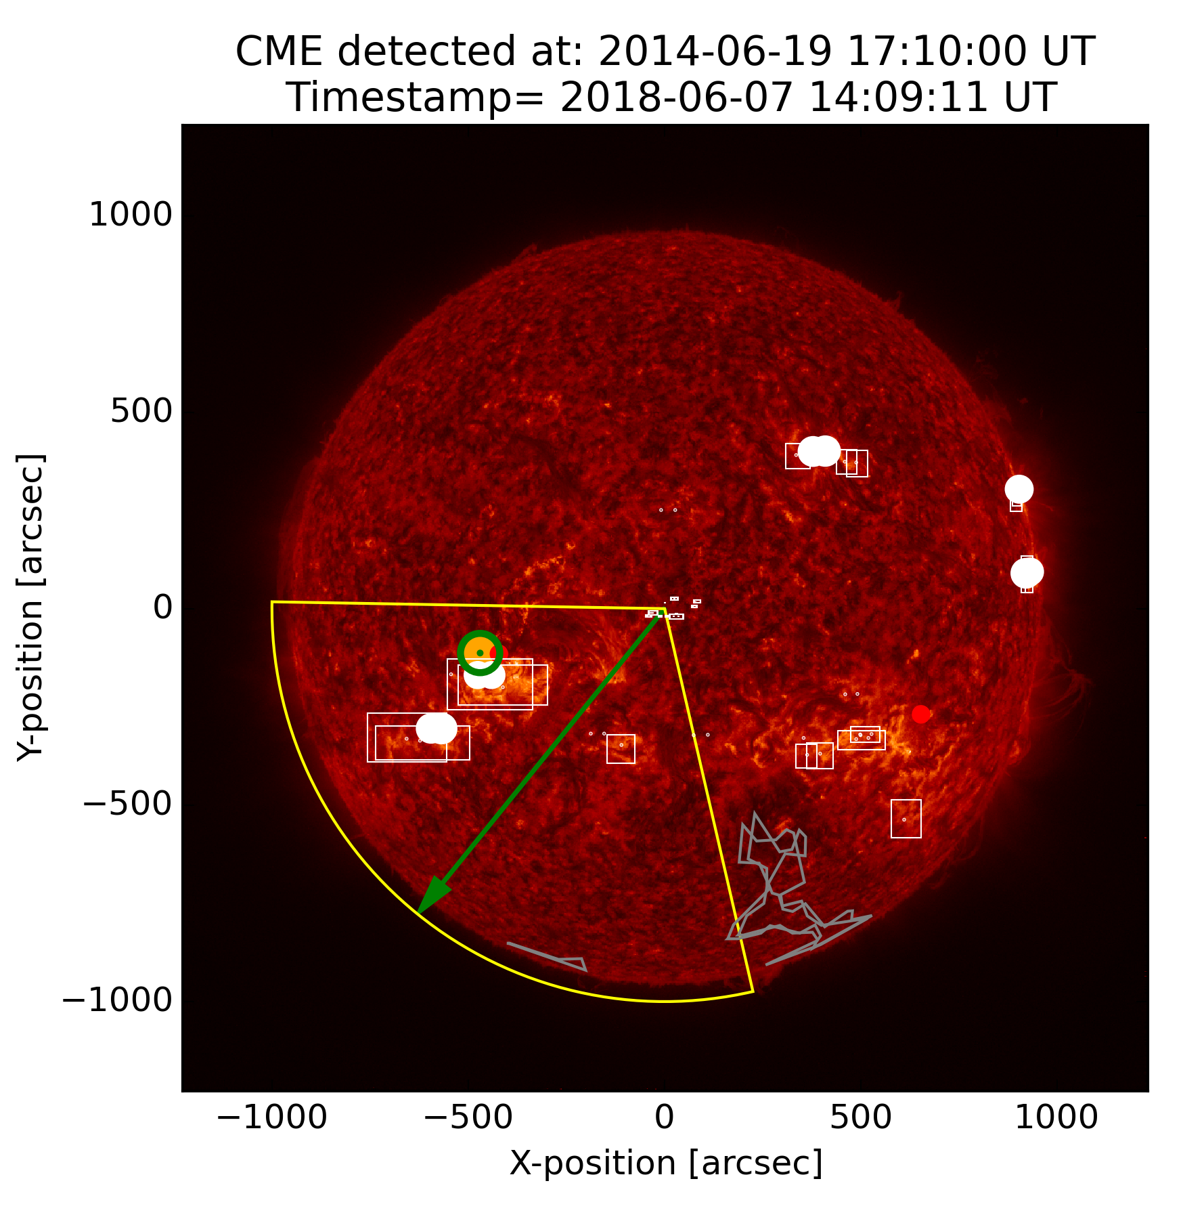
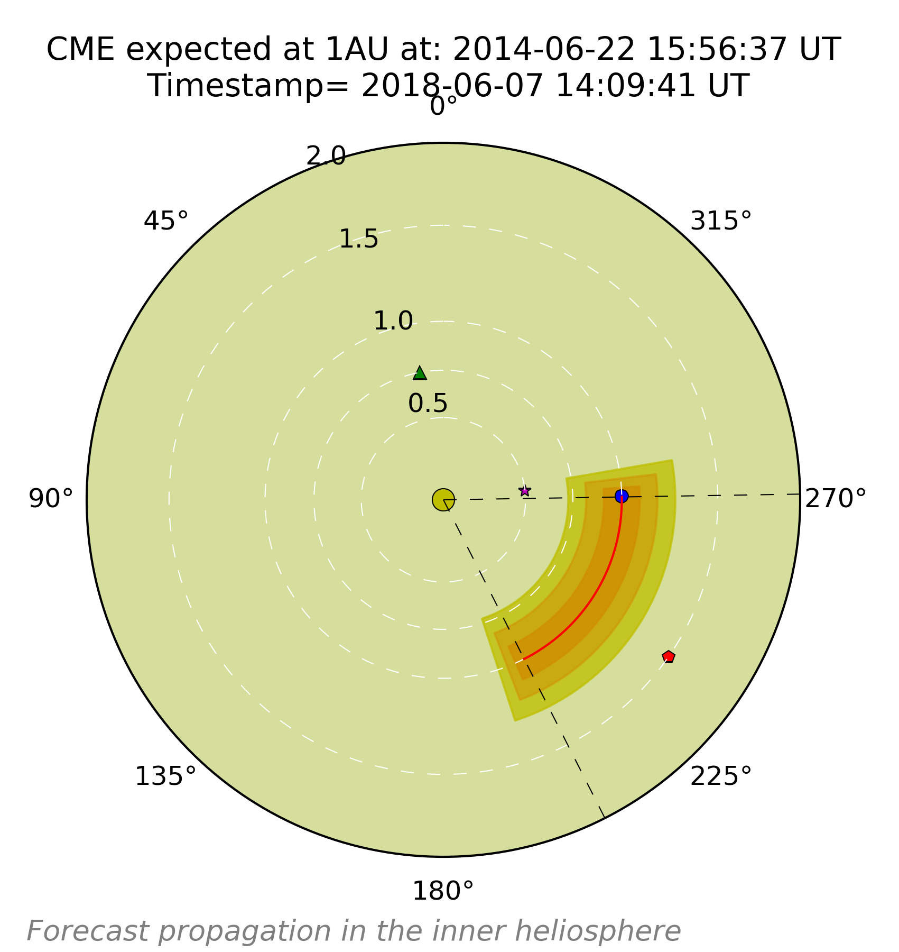
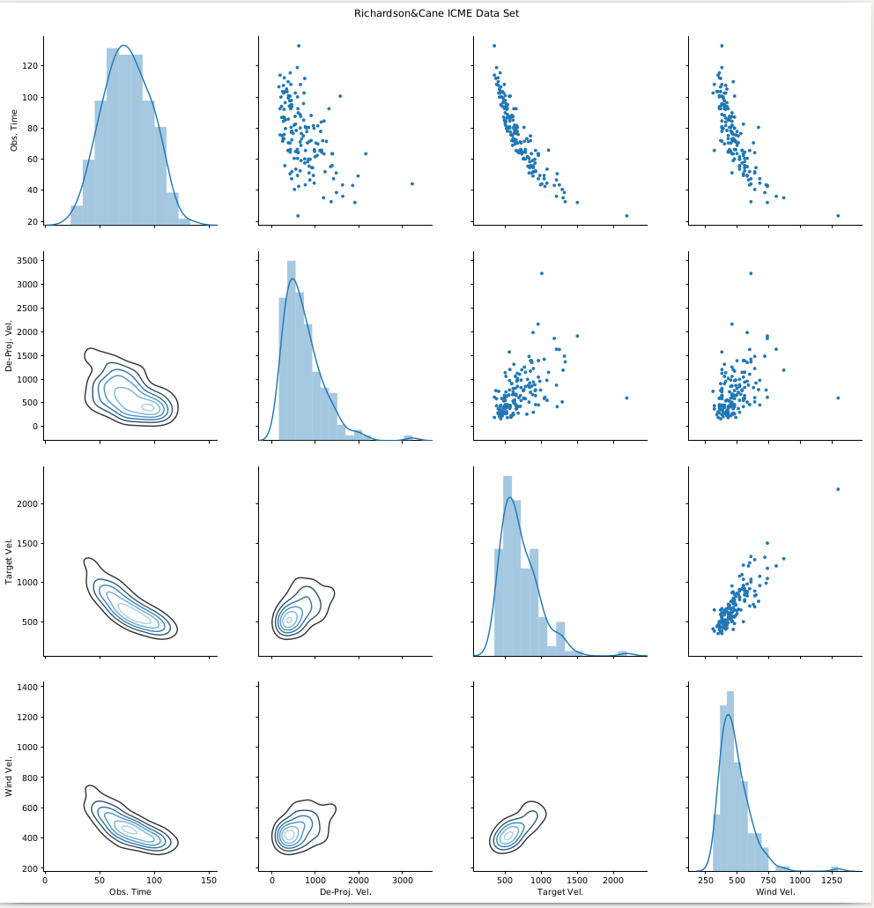
Our works: stats from R&C and our algorithms
Taking advantage of the large data-set of ICMEs registered by Richardson & Cane (2010), we computed how γ depends on SW velocity...
Notes:
The CME list by R&C is publicy available on the web, it has the arrival time at Earth of a few hundreds of CMEs.
By cross-checking thi information with the CDAW LASCO-CME database and the SDO images database, we are able to have the set of CME proeperties that allow us to invert the DBM equation and obtain gamma

Slide 9
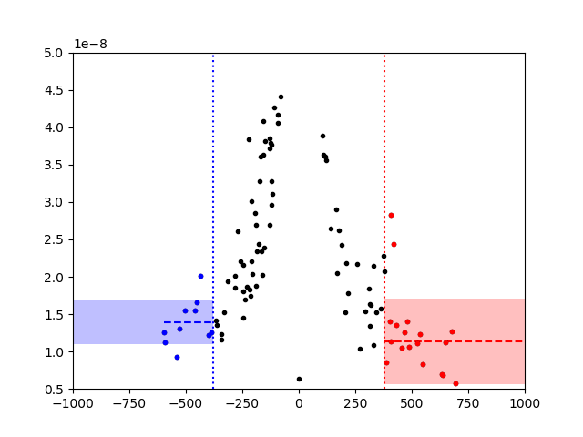
The hypothesis: γ(Δv) → Simulations
...found evidence of a variation in the γ PDF if the SW is accelerating or braking the ICME propagation.
By using a set of simulations of an ICME structure into the SW fluid, we try to link this change to the structure of the ICME.
γ [km⁻¹]
Δv [km/s]
Notes:
We can now compare gamma against other CME propagation parameters...
That can be used to tell us something about the interaction btw the CME and the im
Here we report the plot versus the velocity diffrence: the difference btw the CME liftoff velocity and the solar wind velocity that the CME experienced during propagation
Due to the gamma equation itself, there is an indetermination of gamma whene dv=w
Also, due to error measures, the values of gamma where |dv|<err(v) are of little use.
Therefore, we limit to the ranges where data is robust enough.
It is at the limit, but there may be difference when the SW is pushing the CME and when it is decelerating it...
This is interesting, we tried to investigate abit deeper and..

Slide 10
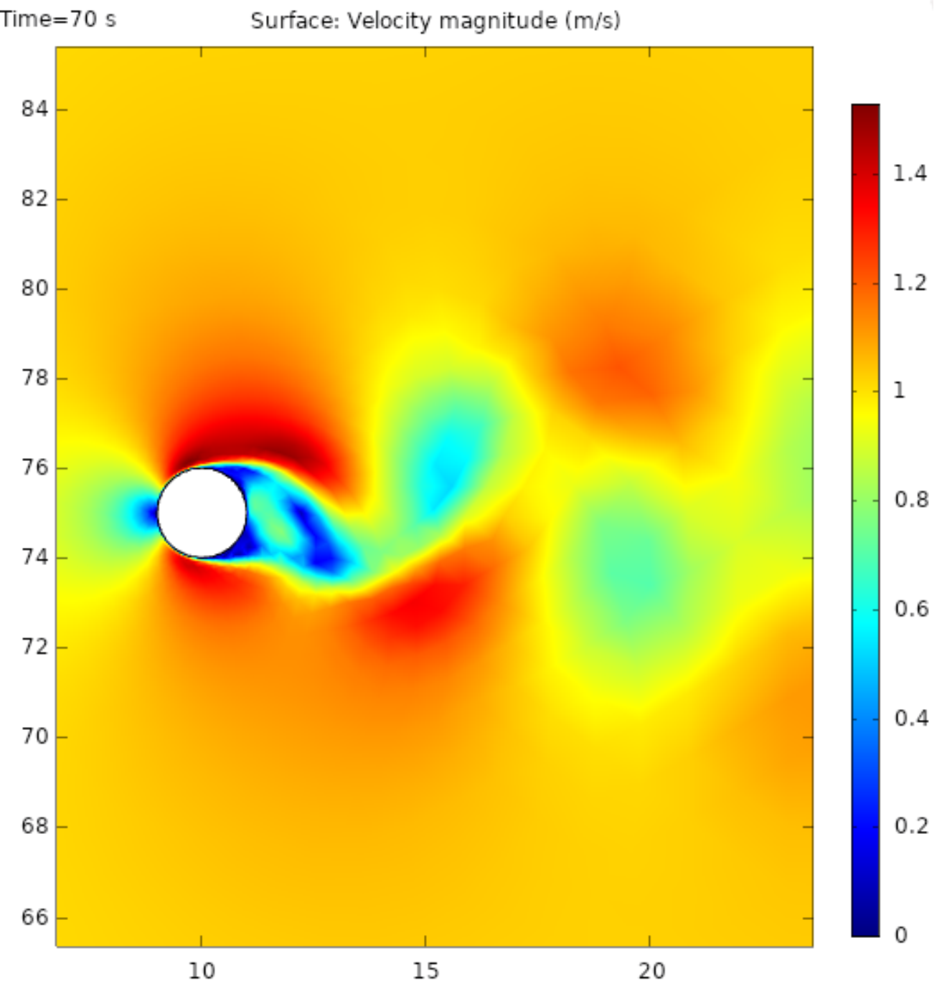
The hypothesis: γ(Δv) → Simulations
...found evidence of a variation in the γ PDF if the SW is accelerating or braking the ICME propagation.
By using a set of simulations of an ICME structure into the SW fluid, we try to link this change to the structure of the ICME.
Notes:
... And had a few simulation on how the gamma changed when the CME was accelerated/decelerated by the SW, by changing the CME shape.
The simulation is for a rigid body in a turbulent fluid, and put the numbers to simulate the propagation in the SW of a CME-like structure
Now, the simulation is only 2D, nevertheless, we found some hints from the results.

Slide 11
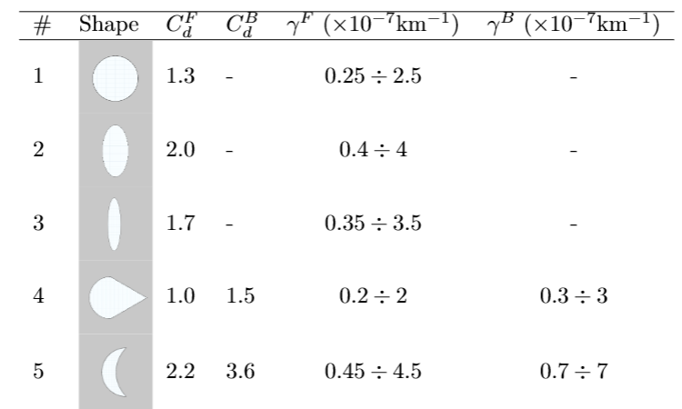
ICME simulation results:
...found evidence of a variation in the γ PDF if the SW is accelerating or braking the ICME propagation.
By using a set of simulations of an ICME structure into the SW fluid, we try to link this change to the structure of the ICME.
Notes:
The results from some simultaions are compatible with the measures.
Appraently, some CME shapes are preferred. Remember thought that the simulation is 2D and that the results from the data are very preliminary
We are trying to extend the statistics, to clean the data and refine the results.... Nevertheless...

Slide 12
Conclusions:
A dependence of γ on Δv is possible/likely, but we are at the very limit of what can be obtained by available data.
We are striving to refine the dataset to get further statistics
We are working on upgrading the simulation framework.
“The remote sensing package on Solar Orbiter, in particular the METIS and SoloHI instruments, may well provide the CME observations needed to improve our understanding of the time dependence of these parameters.”
Barnard et al. 2017
Notes:
Nevertheless, it appears that interesting studied on how the drag parameter depends on the ther physical parameters of the CME can be performed.
What is limiting us at present are the errors associated to the measures, which come from errors in modeling the first hours of the CME
The model and the measures of the CME liftoff are critically important to retrive robust information on the parameter, and we look forward to METIS and the whole SolO instrument suit to retrive more precise measure of the CME liftoff and to substantially improve our modeling capabilities for the first our of the CME propagation.

Slide 14
Refining the Drag Parameter for Coronal Mass Ejection propagation models
D. Del Moro^{(1),}, F. Berrilli⁽¹⁾, R. Foldes⁽¹⁾, L. Giovannelli⁽¹⁾, G. Napoletano⁽²⁾, E. Pietropaolo⁽²⁾
⁽¹⁾Università degli Studi di Roma “Tor Vergata”, Via della Ricerca Scientifica, 1, 00133 Rome, Italy;
⁽²⁾Università de L’Aquila, Via Vetoio, 48, 67100 Coppito L’Aquila, Italy.
ICME (Interplanetary Coronal Mass Ejection) are violent phenomena of solar activity that affect the whole heliosphere and the prediction of their impact on different solar system bodies is one of the primary goals of the planetary space weather forecasting. The travel time of ICME from the Sun to the Earth can be computed through Drag Based Model (DBM) approach, which is based on a simple equation of motion for the ICME that defines the acceleration as a=-Γ(v-w)|v-w|, where a and v are the CME acceleration and speed, w is the ambient solar-wind speed and Γ is the so-called drag parameter (Vršnak et al., 2013). In this framework, Γ depends on the ICME mass and cross-section, on the solar-wind density and, to a lesser degree, on other parameters. The typical working hypothesis for DBM implies that both Γ and w are constant far from the Sun. To run the codes, forecasters use empirical input values for Γ and w. In the 'Ensemble' approaches (Dumbovich et al., 2018; Napoletano et al. 2018), the uncertainty about the actual values of such inputs are rendered by Probability Distribution Functions (PDFs), accounting for the values variability and our lack of knowledge. Among those PDFs, that of Γ is poorly defined due to the relatively scarce statistics of recorded values.
Taking advantage of the large data-set of ICMEs registered by Richardson & Cane (2010), we computed how Γ depends on SW velocity, and found evidence of a variation in the Γ PDFs if the SW is accelerating or braking the propagation. By using a set of simulations of an ICME structure into the SW fluid, we link this change to the structure of the ICME.
This is a pioneering work in the exploration on how Γ depends on the physical parameters of the ICME, to verify and extend the work by Vršnak et al. (2010). This would lead to a more robust definition of the PDF of the drag parameter Γ that could be used in the various DBM approaches to real-time ICME travel time forecasting.

Slide 15
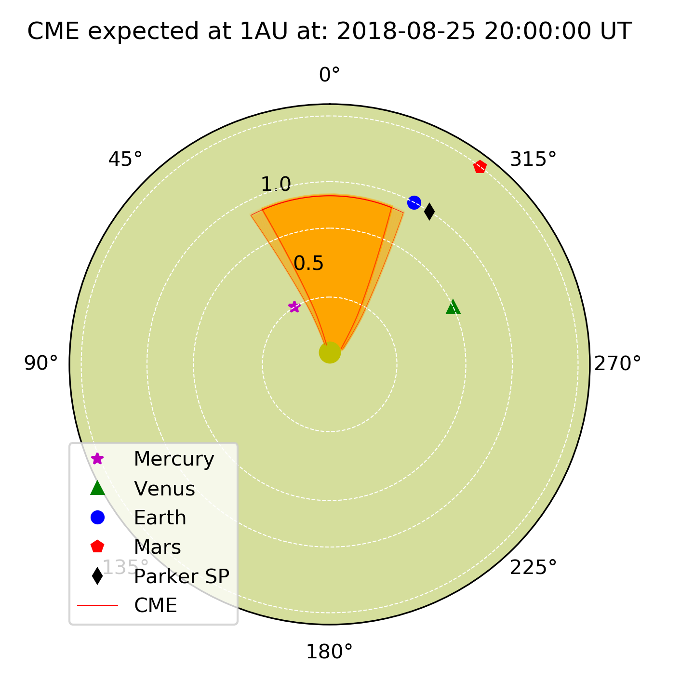
EXTRA SLIDES:

