Slide 1
Integrated navigation and docking systems for small satellites
Martina Imperatrice - 39th Cycle
Supervisor: To be defined
Admission to the 1st year - 14 December 2023

Slide 2
Outline
Introduction
In-Orbit Servicing
Space Rider Observer Cube (SROC)
Doctoral work objective
Research activities
PhD timeline

Slide 3
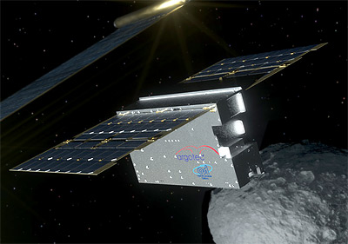
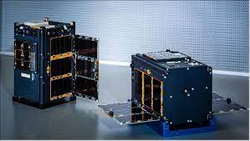
In-Orbit Servicing
LICIACube
In-Orbit Servicing (IOS) and In-Orbit Assembly (IOA) operations:
Refuelling
Refurbishment
Deorbiting
Inspection (LICIACube, AeroCube-10)
…
There are two satellites, a Chaser performing the servicing operations on the Target. To perform the servicing, the Chaser has to be equipped with:
Capture mechanism
Sensor suite
Navigation algorithm
Cubesat are playing a major role in the space industry but introduce challenges related to the miniaturization of technologies.
AeroCube-10
Notes:
- The in-orbit servicing missions aims to improve or extend the operational life of a satellite through operations like …
- The mission scenario includes two satellites … navigation algorithms that estimate the relative pose of the Chaser with respect to the Target.
- CubeSats and small satellites are playing a major role in the space industry as they offer the possibility of reducing mission development costs and are used as technology demonstrators
I reported here two images of inspection mission by means of cubesats, which is one of the possibilities enabled by the BY THE IN-ORBIT SERVICING MISSION.
The reason this two missions is because ->

Slide 4
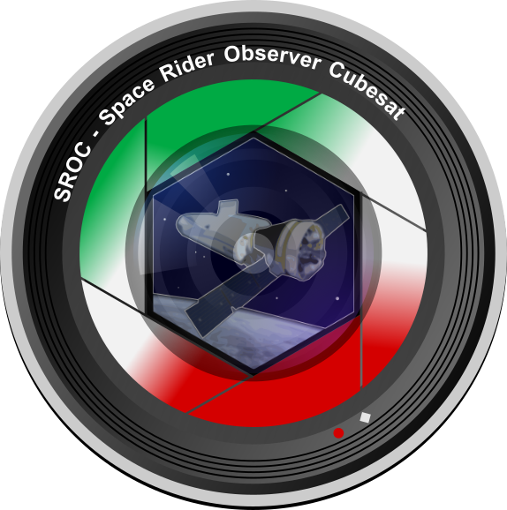
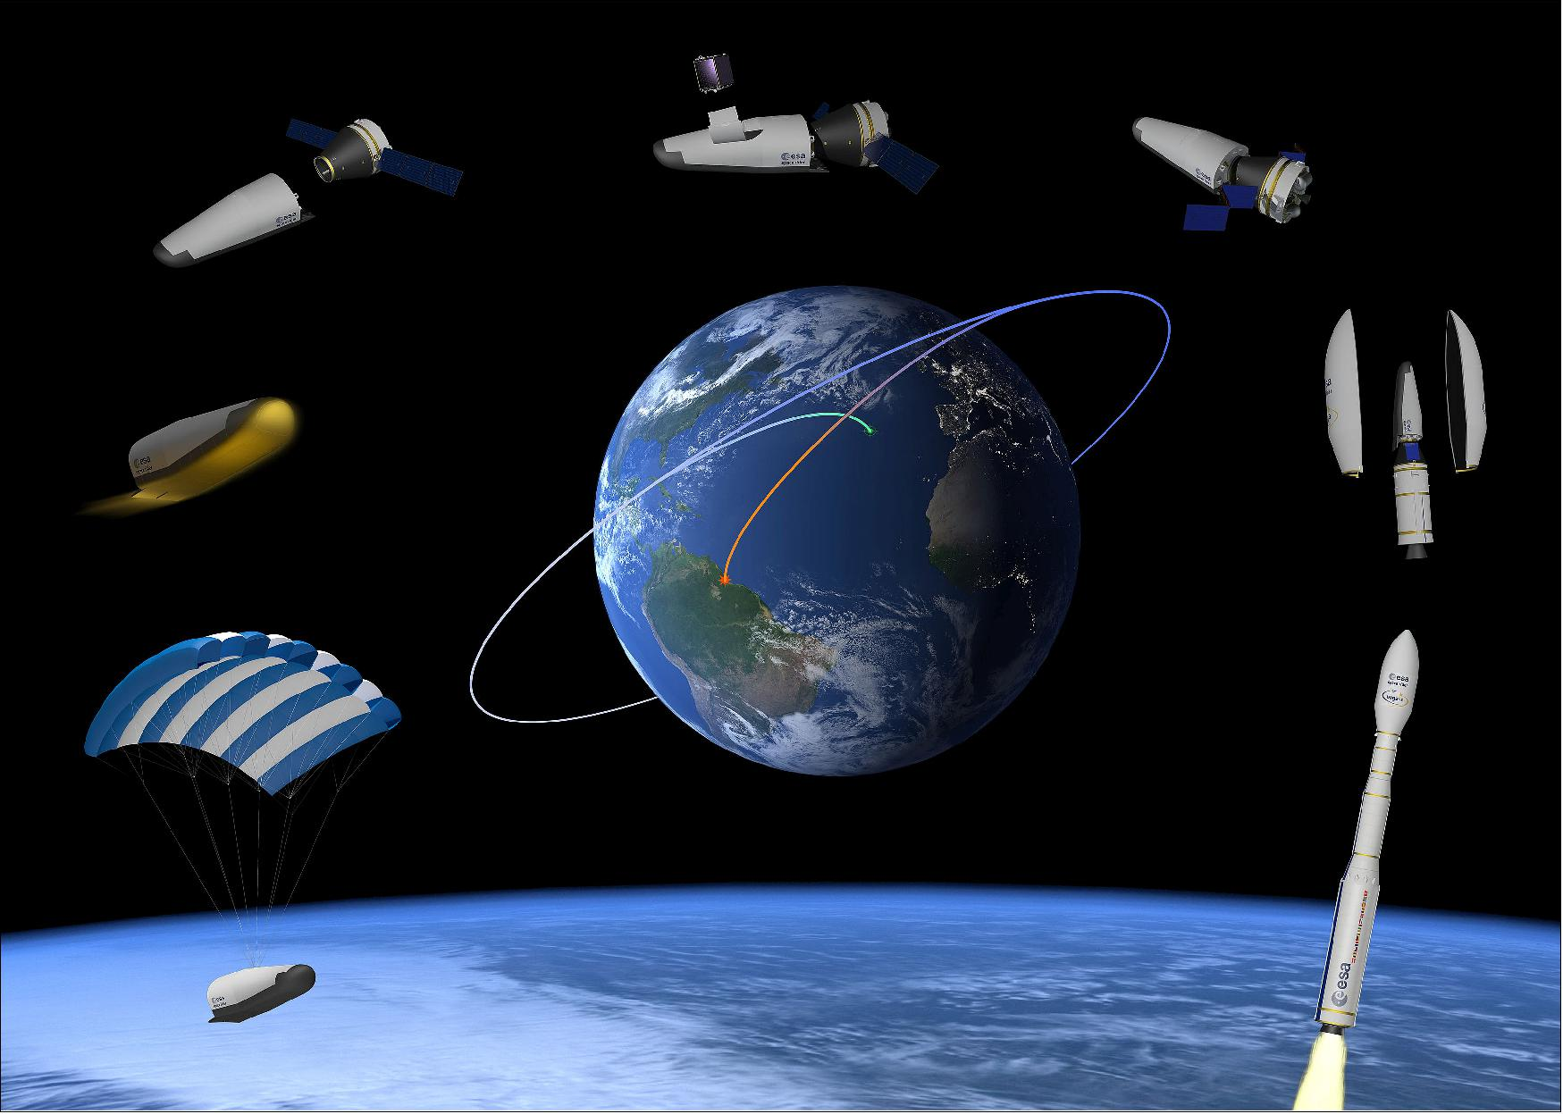
Space Rider Observer Cube (SROC)
Space Rider Observer Cube (SROC)
Space Rider (SR)
SROC
SROC will perform:
Inspection of SR
Rendezvous and docking through a docking mechanism with the MPCD located in the MPCB of Space Rider
SROC Consortium:
UniPD
Stellar Project
PoliTO
Tyvak
Development of the docking system DOCKS
Development of SROC CubeSat
Notes:
this research project is involved in the SROC (Space Rider Observer Cube) mission.
Which is a in-orbit servicing mission carried out using a CubeSat
is going to be released by the Space Rider,
And is going to perform inspection operations but the novelty lies in the fact that SROC will perform rendezvous and docking through a docking mechanism with the MPCD located in the MPCB of Space Rider.
Space Rider acts as a Reusable Unmanned Space Laboratory. Able to stay in low earth orbit for up to two months, enables the tests of new technologies in microgravity environment. And is capable of controlled atmospheric reentry from low Earth orbit
The SROC Consortium is composed by …
UNIPD and Stellar project is developing the docking system DOCKS which is the focus of this research project
While PoliTO and Tyvak is developing the bus

Slide 5
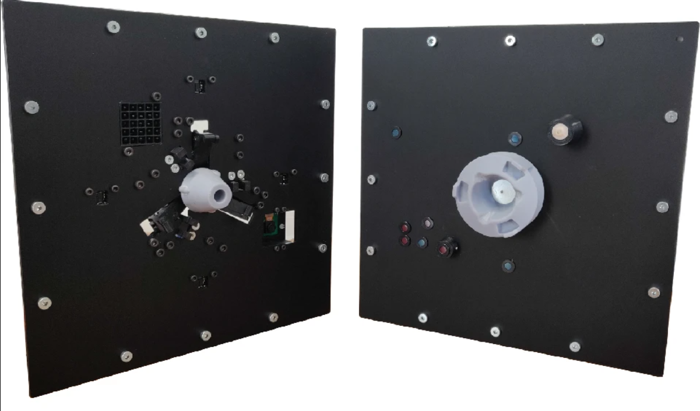
Doctoral work objective (1/3)
Objective: Development and testing of the advanced ENGINEERING MODELS of the docking system DOCKS:
Breadboard Model
Engineering Qualification Model (EQM)
Proto-Flight Model (PFM)
under Stellar Project supervision
DOCKS
Laboratory Prototype
Space
System
(Ready to fly)
Laboratory prototype of DOCKS
Notes:
The main objective of the doctoral research is …
The last two will be realized thanks to the supervision of Stellar Project.
The laboratory prototype is already been built and tested successfully and here you can see it. It was developed to be independent with respect to the system on which is mounted.
The main idea is to bring the laboratory prototype of DOCKS to the next level and build a system that is ready to be mounted on SROC CubeSat and ready to face the space environment.

Slide 6
Doctoral work objective (2/3)
DOCKS
Laboratory Prototype
Space System
Sensors and actuators vacuum compat.
Materials → space environment
Launch → vibrations
Electromagnetic soft docking
…
Critical features Design
Thermal/structural simulations
Dynamic simulations
…
Numerical Simulations
Manufacturing
(custom mechanical parts)
Low-friction table
Robotic arm
…
Test facility design
System performance
(mechanism, software, dynamics)
Component/Functional tests
Subsystem level tests
System level tests
Assembly & Testing
TVAC
Vibration test
…
Qualification/Acceptance tests
Notes:
In this slide we can see a schematic representation of what there is in-between the laboratory prototype and the final space system.
In order to realize the advanced engineering models, it will be necessary to focus firstly on the critical features that were not considered during the development of the laboratory prototype.
These are:
Sensors and actuators vacuum compat. And in general materials space compatibility,
Other considerations are on
vibrations during launch,
the electrostatic discharge that can occur between the two satellites that can be differentially charged during the approach,
and many others.
Then is crucial to perform virtual simulations and perform thorough tests to evaluate the system performance and compare the numerical results with the test results.

Slide 7
Doctoral work objective (3/3)
Docking mechanism
Sensor suite
Navigation algorithm
DOCKS
Laboratory Prototype
Space System
Phase 0
Concept studies
Phase A
Concept and technology development
Phase B
Preliminary design and technology Completion
Phase C
Final design and Fabrication
Phase D
System assembly, integration and test
Launch
Phase E
Operations and sustainment
Phase F
Closeout
Mission Milestones:
PDR
CDR
SIR
Advanced Models:
Bread.
EQM
PFM
Notes:
I reported here the phases of the space mission, highlighting the current status of DOCKS.
We are at mid-phase B, and the idea is to bring it to the end of phase D during my PhD.
I also reported here the mission milestone and the models that are going to be developed.
Phases E and F haven’t been defined yet.

Slide 8
Research Activities (1/2)
1. State of the art of Docking Systems for small satellites
Bibliographic research to study the state of the art of the technologies involved (space compatibility of materials) and of the qualification tests (ECSS standard regulations).
Study of the critical features that are not considered during the development of laboratory prototype
2. Design Phase
Numerical Simulations of the system to study its behaviour
Selection of actuators according to the simulations, and selection of sensors and materials that have vacuum compatibility/have flight heritage.
Detailed design, integrating the new solutions studied and selected.
Notes:
In more details, these are the research activities i foresee to do:
The first phase is going to be a state of art of docking systems for small satellites,
with the aim of studying the technologies involved,
the materials space compatibility,
the standard regulations of qualification tests,
And the study critical aspects I just mentioned in the previous slide and find a solution to them.
The second phase is the design phase.
Here the idea is to
perform virtual simulation of the system to study its behaviour,
perform components selection according to the simulations, and selections of the sensors vacuum compatible.
perform the detailed design, integrating the new solutions studied and new components selected.

Slide 9
Research Activities (2/2)
3. Testing Phase
Laboratory set-up definition
Manufacturing and assembly of the DOCKS Breadboard model. Functional and performance tests are going to be performed.
Manufacturing and assembly of the DOCKS EQM. Execution of functional/performance test and qualification tests.
Manufacturing and assembly of the DOCKS PFM. Execution of acceptance tests on PFM.
For all the models:
Functional and performance tests are going to be performed under representative kinematic/dynamic conditions.
Notes:
The third phase is going to be the testing phase, which involves
The Laboratory set-up definition
The functional and performance tests on the Breadboard model,
Same goes for the Engineering qualification model which will undergo a qualification test campaign,
and for what concern the Proto-flight model, it will be tested at acceptance level.
For all the models, the tests are going to be performed under representative kinematic/dynamic conditions.

Slide 10
PhD timeline
12 months – UniPD
Activities (foreseen):
DOCKS Breadboard model
Functional and performances tests under representative conditions
18 months – Stellar Project Srl
Activities (foreseen):
DOCKS EQM and PFM
Qualification/Accceptance tests
PNRR
6 months – Abroad
(TBD)
Notes:
To conclude, for scholarship funded by Ministerial Decree 117 there are some specific provisions to respect.
These are a period in an enterprise as foreseen by the research project and a minimum of 6 months abroad. In my case these are going to be 18 months in Stellar Project. So, these is the schedule I will follow,
- 12months at university of padova where I will focus on the realisation and testing of the breadboard model,
- 18 months as already said at stellar project where I'm going to focus on the development and testing of the engineering qualification model and proto-flight model,
- in the end 6 months abroad (where? is going to be defined later on).

Slide 11
Thanks for the attention

