Slide 1
Additive manufacturing for the development of a sustainable aerospace industry
Zahra Shafiei - 38th Cycle
Supervisor: Prof. Mirco Zaccariotto
Co-supervisors: Prof. Ugo Galvanetto and Dr. Vito Diana
Meeting - 9 October 2024

Slide 2
additive manufacturing for the development of a sustainable aerospace industry
Introduction of Additive Manufacturing
Material Extrusion (MEX)
Peridynamic Theory
Result and Discussion
Conclusion
Publications
References

Slide 3
Introduction of Additive Manufacturing
Additive Manufacturing (AM) is the term for the process formerly known as rapid prototyping, now often referred to generically as 3D printing.
The key to how AM works is that parts are made by adding material in layers
Produce solid structures
complex construction
high accuracy
cuts down greatly the design time
developing for the new products

Slide 4
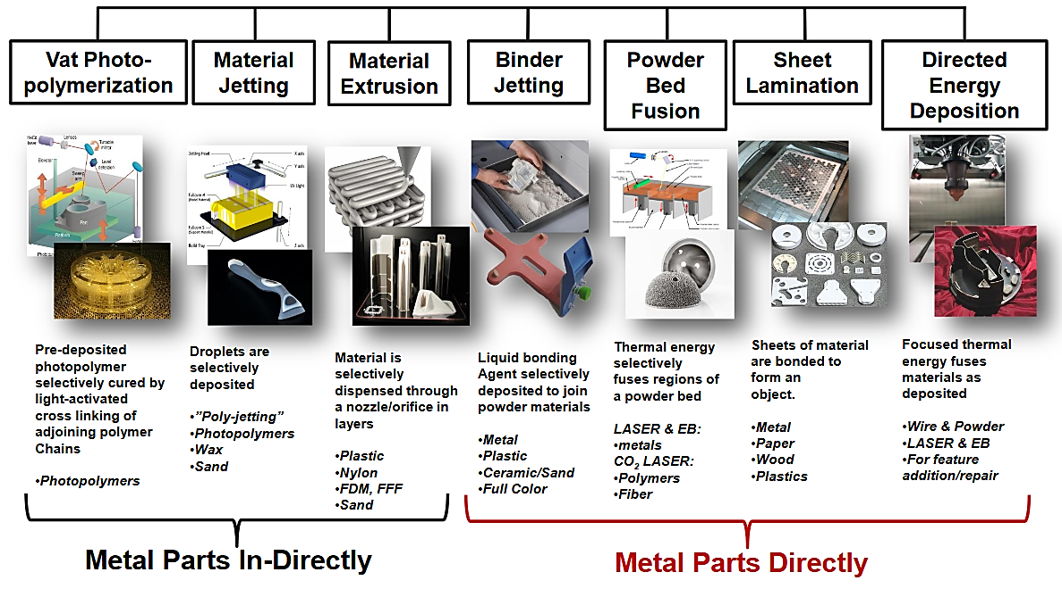
Introduction of Additive Manufacturing
All commercialized AM machines are different in the materials that can be used, how the layers are created, and how the layers are bonded to each other.
Additive manufacturing technologies:
Vat Photopolymerization (VPP)
Powder Bed Fusion (PBF)
Material Extrusion (MEX)
Material Jetting (MJT)
Binder Jetting (BJT)
Sheet Lamination (SHL)
Directed Energy Deposition (DED)

Slide 5
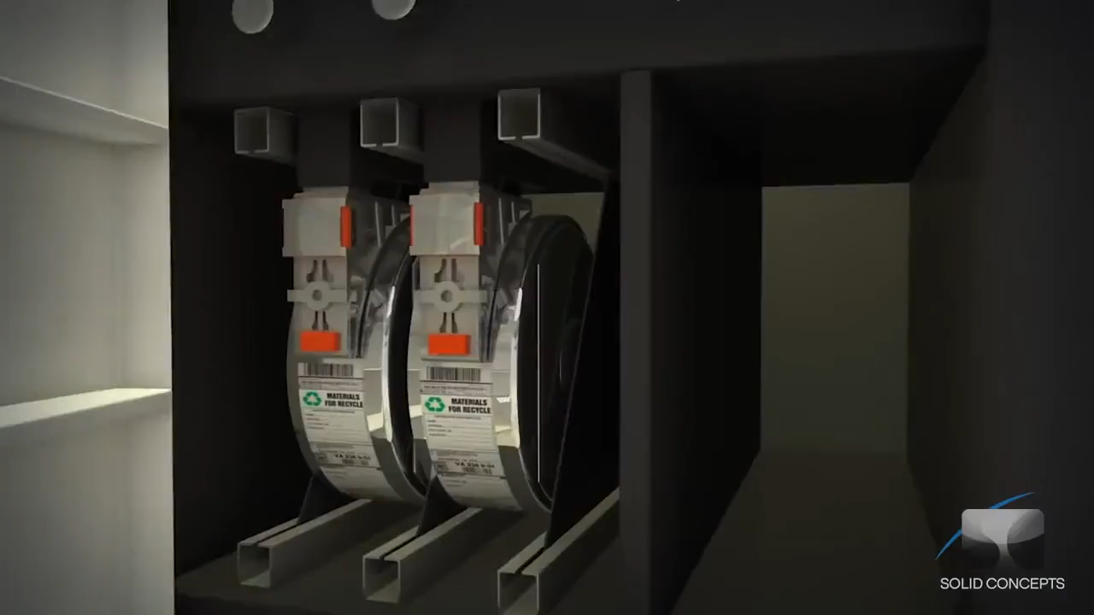
Material Extrusion (MEX)
Material Extrusion (MEX): processes that deposit a material by extruding it through a nozzle, typically while scanning the nozzle in a pattern that produces a part cross-section.
[2]

Slide 6
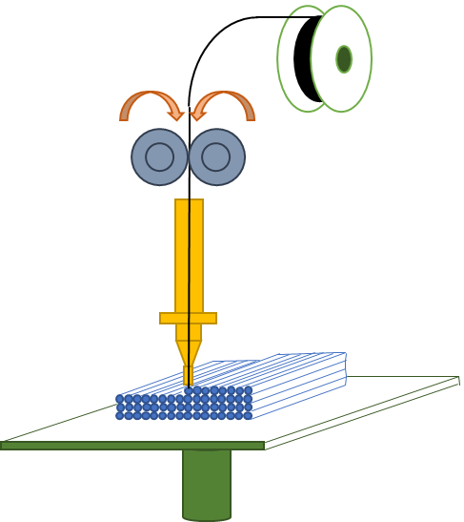
Material Extrusion (MEX)
filament
Material Loading
Nozzle feature
Pull gear
Extrusion speed
print speed
Heating
Heater element
Layer-by-Layer Deposition
Extrusion
Platform Movement

Slide 7



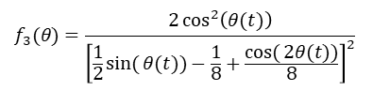
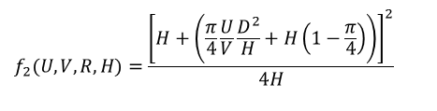
Material Extrusion (MEX)
U
Void
A_{N}
2θ
V
R
a
interface
Strand to strand gap (g)
h
O
θ
r
H
Surface
tension
Viscosity
dissipation
W
A_{S}
$$\frac{dθ(t)}{dt}=f_{1}(Λ,η).f_{2}(U,V,R,H).f_{3}(θ)$$
$$f_{1}(Λ,η)=\frac{Λ(T_{r})}{4η(T_{r})}$$
temperature-dependent surface tension
viscosity
printing speed
Extrusion speed
$$f_{2}(U,V,R,H)=\frac{{\left[H+\left(\frac{π}{4}\frac{U}{V}\frac{D^{2}}{H}+H\left(1−\frac{π}{4}\right)\right)\right]}^{2}}{4H}$$
$$W=\frac{π}{4}\frac{U}{V}\frac{D^{2}}{H}+H\left(1−\frac{π}{4}\right)$$
$$f_{3}(θ)=\frac{2\cos^{2}\left(θ(t)\right)}{{\left[\frac{1}{2}\sin{(}θ(t))−\frac{1}{8}+\frac{\cos{(}2θ(t))}{8}\right]}^{2}}$$

Slide 8
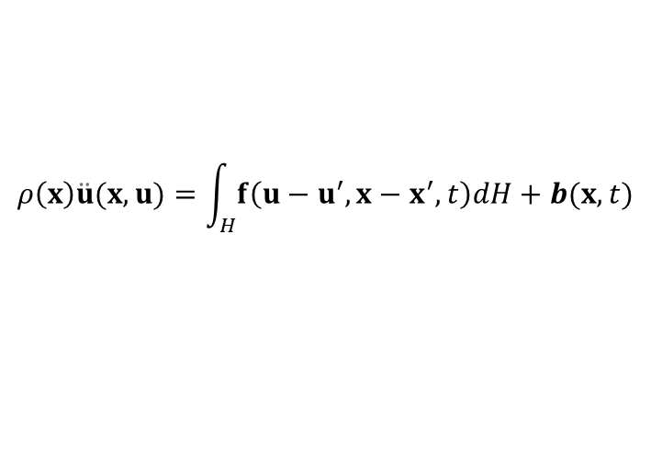

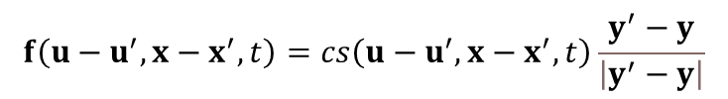
Peridynamic Theory
δ
j
$$ρ\left(x\right)\ddot{u}(x,u)=\int_{H}{f\left(u−u^{′},x−x^{′},t\right)dH}+b(x,t)$$
k
δ
$$f\left(u−u^{′},x−x^{′},t\right)=cs\left(u−u^{′},x−x^{′},t\right)\frac{y^{′}−y}{\left|y^{′}−y\right|}$$
$$s\left(u−u^{′},x−x^{′},t\right)=\frac{\left|y^{′}−y\right|−\left|x^{′}−x\right|}{\left|x^{′}−x\right|}$$

Slide 9
Peridynamic Theory

Slide 10
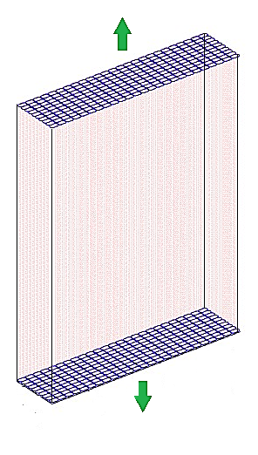
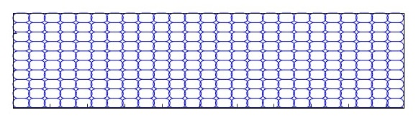
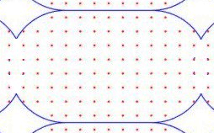
Result and Discussion
Peridynamic nodes
y
x
y
z
x

Slide 11
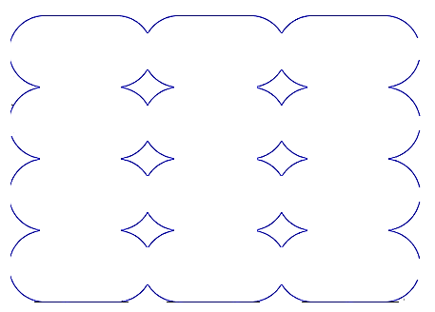
Result and Discussion
[6] Characterization of the mesostructure of fused-deposition acrylonitrile-butadienestyrene materials
Effect of strand-to-strand gap on void density
g (μm) | reference | modeling
-50.8 | 0.0682 | 0.05193
-25.4 | 0.0678 | 0.07131
0 | 0.1123 | 0.09627
Effect of extrusion speed on void density
Extrusion speed (mm/s) | reference | modeling
16.4 | 0.08104 | 0.08729
20 | 0.06777 | 0.07131
29.2 | 0.05450 | 0.04755
Strand to strand gap (g)

Slide 12
Result and Discussion
[6] Characterization of the mesostructure of fused-deposition acrylonitrile-butadienestyrene materials
The effect of stand-to-stand gap to bond density
g (μm) | reference | modeling
-50.8 | 0.702 | 0.652
-25.4 | 0.726 | 0.587
0 | 0.505 | 0.486
interface
Effect of extrusion speed on bond length densities
Extrusion speed (mm/s) | reference | modeling
16.4 | 0.64684 | 0.52336
20 | 0.72152 | 0.58695
29.2 | 0.77595 | 0.69481

Slide 13
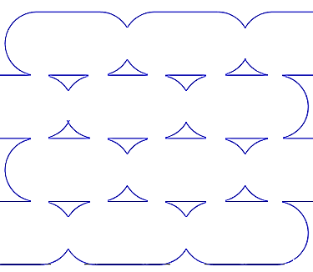
Result and Discussion
material extrusion process parameters
Extrusion temperature Textr | 270˚C
Envelope temperature Ts | 70˚C
Extrusion flow rate U | 20 (mils)
Extruded fiber height H | 0.254 mm
Extrusion nozzle diameter D | 0.305 mm
Print speed V | 12.7 mm/s
Properties of acrylonitrile butadiene styrene (ABS)
Young’s modulus E | 2230 MPa
Density ρ | 1050 kg/m³
Viscosity η | 5100 Pa⋅s
Temperature-dependent surface tension Λ ( at T=70 ˚C) | 0.029 N/m
12.7 mm
25.4 mm
Comparison of the module of elasticity evaluated with the proposed model for different specimens and related experimental measurements
 | Single strand | Longitudinal strand tensile specimens (Aligned, g = – 25.4 μm) | Longitudinal strand tensile specimens (Skewed, g = – 25.4 μm) | Transvers strand tensile specimens (g = – 25.4 μm)
Reference [1] (MPa) | 2140 | 1972 | 1986 | 1762
Model results (MPa) | 2070.8 | 1936.5 | 1923.8 | 1626.1
2.54 mm
2.54 mm
127 mm
190 mm
[5] Mechanical behavior of acrylonitrile butadiene styrene (ABS) fused deposition materials. Experimental investigation.

Slide 14
Result and Discussion
printing speed (mm/s) | reference | modeling
20 | 0.961 | 0.926
30 | 0.937 | 0.871
40 | 0.912 | 0.853
50 | 0.882 | 0.812
extrusion speed (mm/s) | reference | modeling
10 | 0.910 | 0.853
12 | 0.926 | 0.859
14 | 0.938 | 0.879
16 | 0.950 | 0.910
18 | 0.956 | 0.899
20 | 0.962 | 0.928
[7] A process-structure-performance modeling for thermoplastic polymers via material extrusion additive manufacturing

Slide 15
Result and Discussion
[7] A process-structure-performance modeling for thermoplastic polymers via material extrusion additive manufacturing
Layer thickness
layer thickness (mm) | Reference E/Eℴ | PD modeling E/Eℴ
0.15 | 0.863 | 0.920
0.2 | 0.848 | 0.908
0.3 | 0.808 | 0.831
Input data
nozzle diameter | 0.4 mm
Eℴ ABS filament | 1200 MPa
ν posson ratio | 0.34
viscosity ƞ raw ABS | 5100 pa.s
surface tension Ʌ | 0.029 N/m
compression rate | 20 mm/min
extrusion rate | 12.7 m/s
printing speed | 20 m/s

Slide 16
Result and Discussion
material extrusion process parameters
Extrusion temperature Textr | 270˚C
Envelope temperature Ts | 70˚C
Extrusion flow rate U | 20 (mils)
Extruded fiber height H | 0.254 mm
Extrusion nozzle diameter D | 0.305 mm
Print speed V | 12.7 mm/s
f (×c)
0.012
f = -0.8571xc+0.0204c
0.008
c
f = 0.005c
0.004
1
s
0
0.01
0.02
0.03
0.04
0.05
0.06
Properties of acrylonitrile butadiene styrene (ABS)
Young’s modulus E | 2230 MPa
Density ρ | 1050 kg/m³
Viscosity η | 5100 Pa⋅s
Temperature-dependent surface tension Λ ( at T=70 ˚C) | 0.029 N/m
f (×c)
0.012
0.008
c
0.004
1
s
0
0.01
0.02
0.03
0.04
0.05
0.06

Slide 17
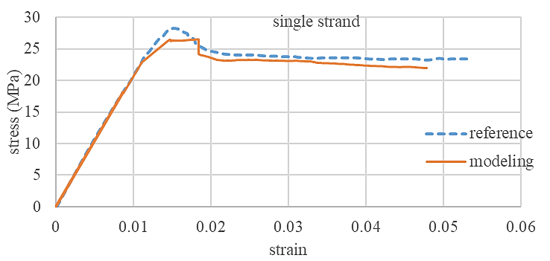
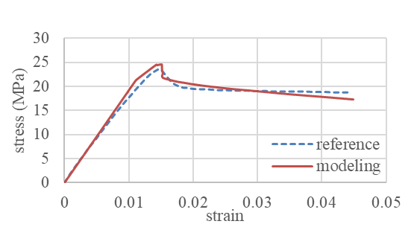
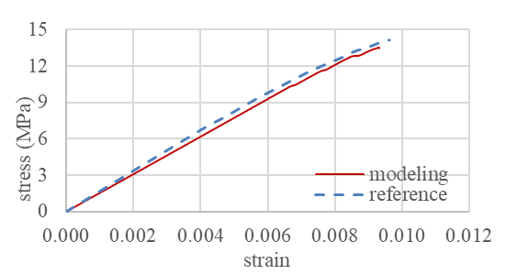
Result and Discussion
[5] Mechanical behavior of acrylonitrile butadiene styrene (ABS) fused deposition materials. Experimental investigation.
12.7 mm
25.4 mm
2.54 mm
2.54 mm
127 mm
190 mm

Slide 18
Conclusion
The study successfully modeled the material extrusion parts using Peridynamic theory, providing insights into the mechanical properties of 3D-printed components.
The results show good agreement with experimental data, confirming the validity of our assumptions about parameters related to the shape and interface between strands.
We demonstrated the impact of key process parameters, such as print speed, extrusion speed, and air gap, on void density, interface formation and overall mechanical performance.
The developed model can be used to predict mechanical properties without extensive experimental test, helping optimize material extrusion processes in additive manufacturing.

Slide 19
Publications
Poster: “A peridynamic approach to modelling the mechanical properties of material extrusion-based 3D printed components”, presented at second annual network meeting “Researchers’ Career Development: Tools and Perspectives”. Padova, 7 June, 2024.
Abstract: “Modelling of material extrusion-based 3D printed components by using Peridynamics” presented at the Euromech conference 'Advanced in Peridynamic Material Modelling' in Venice, Italy, from 25 to 27 September 2024.
Paper under preparation:
“Analysing the out of plane deformation of flat plate by coupling of Peridynamic and Finite Strip Method”: a coupling strategy is proposed between a peridynamic grid and the finite strip method for analysing the mechanical behaviour of flat plates including displacements orthogonal to the mid-surface.

Slide 20
Final Remarks

Slide 21
References
[1] Gibson, Ian, et al. Additive manufacturing technologies. Vol. 17. Cham, Switzerland: Springer, 2021.
[2] material extrusion - YouTube
[3] Hartmann, Philipp, Christian Weißenfels, and Peter Wriggers. "A curing model for the numerical simulation within additive manufacturing of soft polymers using peridynamics." Computational Particle Mechanics 8 (2021): 369-388.
[4] Wang, Bingquan, Selda Oterkus, and Erkan Oterkus. "Thermomechanical phase change peridynamic model for welding analysis." Engineering Analysis with Boundary Elements 140 (2022): 371-385.
[5] Rodríguez, José F., James P. Thomas, and John E. Renaud. "Mechanical behavior of acrylonitrile butadiene styrene (ABS) fused deposition materials. Experimental investigation." Rapid prototyping journal 7.3 (2001): 148-158.
[6] Rodriguez, Jose F., James P. Thomas, and John E. Renaud. "Characterization of the mesostructure of fused‐deposition acrylonitrile‐butadiene‐styrene materials." Rapid Prototyping Journal 6.3 (2000): 175-186.
[7] Rao, Yanni, et al. "A process-structure-performance modeling for thermoplastic polymers via material extrusion additive manufacturing." Additive Manufacturing 39 (2021): 101857.
[8] Zhu, Jinggao, Xiaodan Ren, and Miguel Cervera. "Peridynamic buildability analysis of 3D-printed concrete including damage, plastic flow and collapse." Additive Manufacturing 73 (2023): 103683.
[9] Pradel, Patrick, et al. "Investigation of design for additive manufacturing in professional design practice." Journal of Engineering Design 29.4-5 (2018): 165-200.

Slide 22
Thanks for the attention

