Slide 1
Numerical methods to study damage propagation in materials for aerospace structures
Majid Nasrollahnejad - 40th Cycle
Supervisor: Prof. Ugo Galvanetto
Meeting - 13 Nov

Slide 2


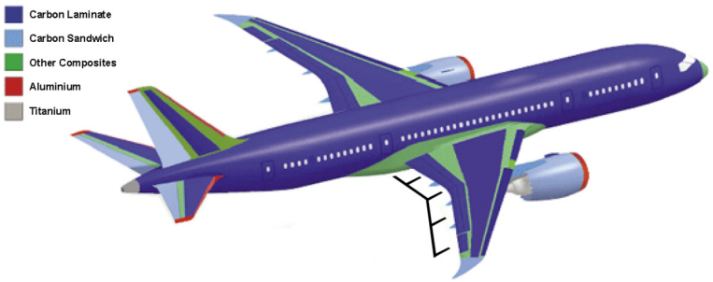
Materials in Aerospace Structures
Boeing 787 Dreamliner
2

Slide 3
Loads on aerospace structures
Loads on Aerospace structures
cyclic loading
Aerodynamic loads
Cracks initiation and propagation in aerospace structures
3

Slide 4
Continuum mechanics
Classical theory of continuum mechanics
Some limitations for crack propagation
Some assumptions like a body remains continuous as it deforms
Use partial differential equations (PDEs)
It has partial derivatives with respect to spatial coordinates, which are undefined along the cracks
Not appropriate for spontaneous cracks
4

Slide 5
Continuum mechanics
Finite Element Method (FEM)
Cracks along element boundaries
Re-meshing for crack growth
Extended FEM (XFEM)
Not suitable for multiple cracks
5

Slide 6
Peridynamic
Peridynamic is a nonlocal continuum mechanics formulation (developed by Silling in 2000).
Introduced to overcome limitations of classical continuum mechanics, especially for discontinuities
Uses integral equations, enabling natural fracture propagation
Appropriate for large number of cracks
Simulate crack initiation and propagation
6

Slide 7

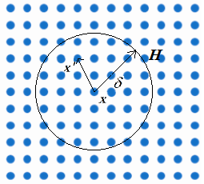
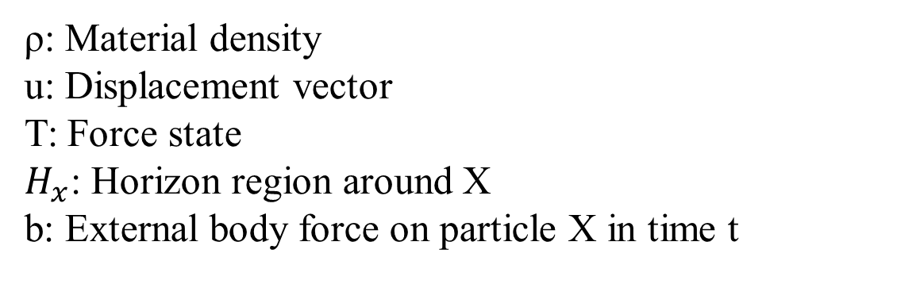
Peridynamic Equation
ρ: Material density
u: Displacement vector
T: Force state
$H_{x}$: Horizon region around X
b: External body force on particle X in time t
7

Slide 8
Purposes
The purpose of this research is developing a Peridynamic approach to study crack propagation in aerospace materials.
Investigating the mechanisms of damage propagation, specifically focusing on dynamic and quasi-static damage propagation.
It is necessary to develop a detailed mathematical model between load and crack propagation.
8

Slide 9
References
[1] A. Applications, “A Literature Review on Crack Arrest Features for Composite Materials and Composite Joints with a Focus on,” 2023.
[2] S. Georgiadis, A. J. Gunnion, R. S. Thomson, and B. K. Cartwright, “Bird-strike simulation for certification of the Boeing 787 composite moveable trailing edge,” vol. 86, pp. 258–268, 2008, doi: 10.1016/j.compstruct.2008.03.025.
[3] P. Robinson, U. Galvanetto, D. Tumino, G. Bellucci, and D. Violeau, “Numerical simulation of fatigue-driven delamination using interface elements,” no. February 2004, doi: 10.1002/nme.1338.
[4] A. Pirzadeh, F. D. Barba, F. Bobaru, L. Sanavia, and M. Zaccariotto, “Elastoplastic peridynamic formulation for materials with isotropic and kinematic hardening,” Engineering with Computers, vol. 40, no. 4, pp. 2063–2082, 2024, doi: 10.1007/s00366-024-01943-x.
[5] A. Shojaei, F. Mossaiby, M. Zaccariotto, and U. Galvanetto, “PT US CR,” International Journal of Mechanical Sciences, 2018, doi: 10.1016/j.ijmecsci.2018.06.020.
[6] M. Zaccariotto, T. Mudric, D. Tomasi, A. Shojaei, and U. Galvanetto, “Coupling of FEM meshes with Peridynamic grids,” Comput. Methods Appl. Mech. Engrg., 2017, doi: 10.1016/j.cma.2017.11.011.
[7] Silling, S.A. Reformulation of elasticity theory for discontinuities and long-range forces. Journal of the Mechanics and Physics of Solids 48, 175–209 (2000)

Slide 10
Thanks for your attention

