Slide 1
Computational Investigation of Brain Mechanics under Impacts
Karan Gupta - 37th Cycle
Supervisor: Prof. Ugo Galvanetto, Co-Supervisor: Prof. Piero Pavan
PhD Course in Science, Technologies and Measurements for Space
Admission to the thesis evaluation procedure - 13/11/2024

Slide 2
Research Objective
Objective: Understand and develop subject-specific head models incorporating age and gender variations to recognize how morphological differences affect strains induced by impact cases.
Problem Statement: Existing head models uses a “One-size-fits to all ” approach, which limits accuracy in:
Predicting precise brain injury.
Designing personalized protective equipment's (helmets, sports equipment).
Accident reconstruction for reliable injury outcomes.
Our Approach: We follow a systematic approach, where we account to:
Develop individualized head models using advanced meshing approach.
Use tissue-based injury indicators instead of traditional kinematic indicators.
Analysed key physical attributes to understand injury outcome in detail.

Slide 3
Research Phases
Phase 1: Brain Biomechanics: A Strategic Choice for Broad Applications
Phase 2: Development of FEHM & its Validation Procedure
Phase 4: Evaluating the effects of head morphology on brain tissue strains induced by impacts
Phase 3: Understanding the Material Laws defining Head Models

Slide 4
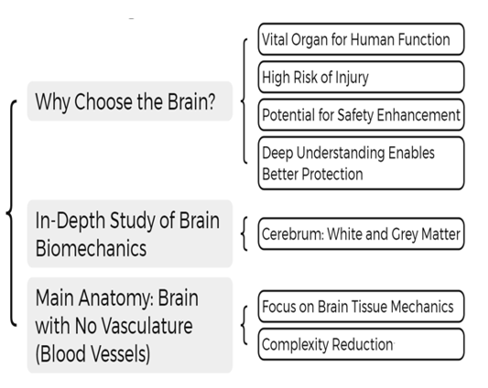
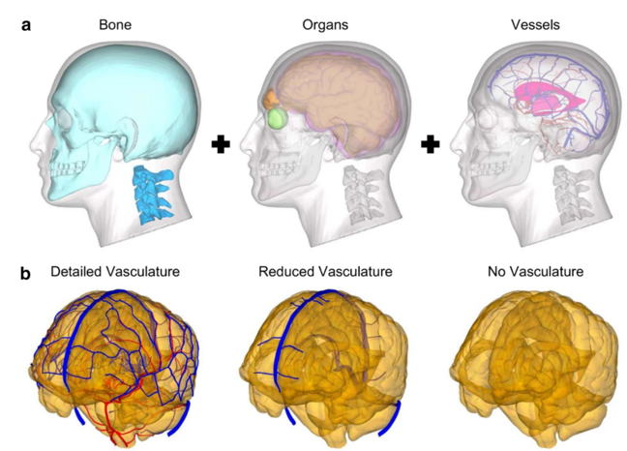





Phase 1
Biomechanics of Brain

Slide 5
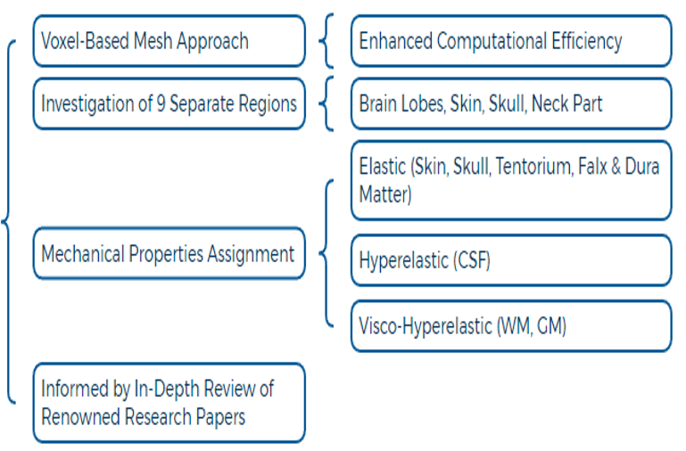
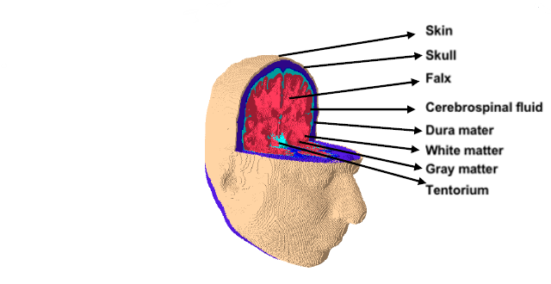

Phase 2
Development of UNIPD Head Models

Slide 6
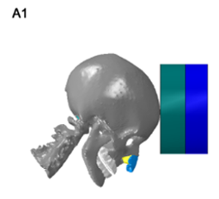
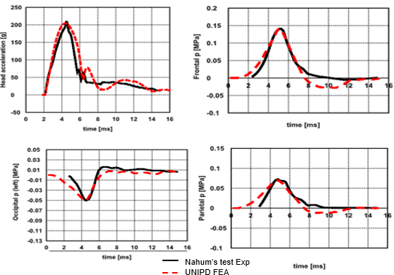
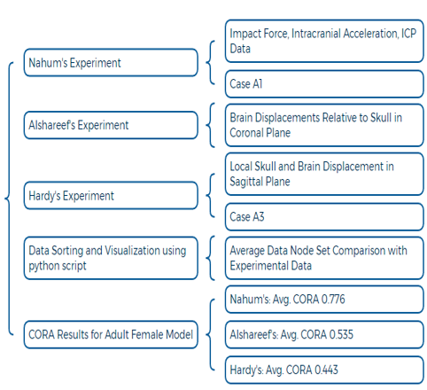
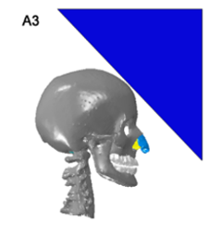
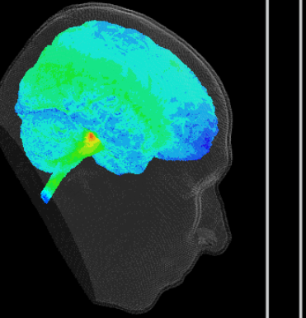
Phase 2
Validation of UNIPD Head Models

Slide 7
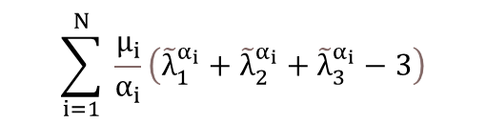

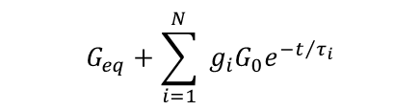

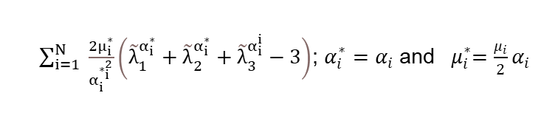
Phase 3
In this phase, we investigated the role of material properties and constitutive models in defining the tissue behaviour (includes all the 8 brain elements of head models).
Computational analysis in Abaqus CAE required understanding how these models are implemented within the software, compared to analytical formulation.
Comparison of Constitutive Material Models
Comparative Analysis of Constitutive Models
General Form
Abaqus Implementation
1- Hyperelastic (Ogden) Formulation
1- Hyperelastic (Ogden) Formulation
$$\sum_{i=1}^{N}{ }\frac{μ_{i}}{α_{i}}\left({\tilde{λ}}_{1}^{α_{i}}+{\tilde{λ}}_{2}^{α_{i}}+{\tilde{λ}}_{3}^{α_{i}}−3\right)$$
$\sum_{i=1}^{N}{ }\frac{2μ_{i}^{∗}}{α_{i}^{∗_{i}^{2}}}\left({\tilde{λ}}_{1}^{α_{i}^{∗}}+{\tilde{λ}}_{2}^{α_{i}^{∗}}+{\tilde{λ}}_{3}^{α_{i}^{i}}−3\right)$; $α_{i}^{∗}=α_{i}$ and ${ μ}_{i}^{∗}=\frac{μ_{i}}{2}α_{i}$
2- Viscoelastic Formulation
2- Viscoelastic Formulation
$$G_{eq}+\sum_{i=1}^{N}{ }G_{i}e^{−β_{i}t}$$
$$G_{eq}+\sum_{i=1}^{N}{ }g_{i}G_{0}e^{−t/{τ_{i}}}$$
Long – Term Modulus: $G_{eq}= G_{∞} ,$
Prony Pairs (Viscoelastic Branch):
$g_{i}= G_{i}/G_{0}$ ; $τ_{i }=\frac{1}{β_{i}}$
$t= \frac{ε}{{\dot{ε}}_{1}}$

Slide 8
Phase 3
Objective: Compare UNIPD head model’s stress relaxation behaviour (white/grey matter) with other studies.
Observation: Model achieves balanced stiffness—neither overly stiff nor soft.
Challenge: Experimental validation of precise properties is hindered by ethical, financial, and technical constraints.
Key Insight: Time-varying shear moduli are important as they directly correlate with the defined strain outcomes
Comparative Analysis of Constitutive Models

Slide 9
Phase 4: Significance of Head Morphology
Tissue Variability
Injury Localization
Tailored Biomechanical Head Models
Differences among Age and Gender
Detailed Assessment of Injury
Soft tissue Injury examination
Diverse Applications Across Multiple Domains
Personalized Protection
Clinical Procedure
Individualized Protective Gear
Development of Standardized Rules
Precision in Injury Treatment
Accessibility for Virtual Surgery

Slide 10
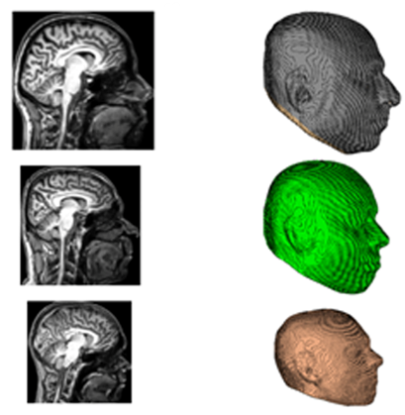
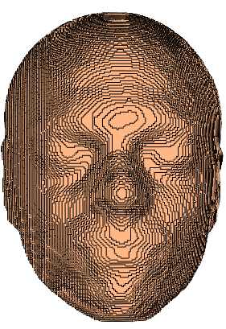
UNIPD Head Models: Anthropometry Comparison
Adult Male (35 yrs)
Adult Female (32 yrs)
Young Male (16 yrs)
Head Length
Head Width

Slide 11
UNIPD Head Models: Morphometry Comparison
General section (a), coronal (b), sagittal (c), and axial (d) views

Slide 12
Brain Injury Indicators
Global Kinematics-Based Indicators
Tissue Level-Based Injury Indicators
Translational Kinematics:
Associated with brain motion and ICP due to brain-skull interactions
Rotational Kinematics:
Linked to strain generation within brain tissue
Combined Kinematics:
Involvement of translational and rotational kinematics to predict injury
Subject–Specific FE head models:
Tailored FE head models for individual or average anatomy
Incorporation of Real Experimental Data:
Transform external head impact kinematics into tissue-level impact responses
Post–Processing of Injury:
Detailed tissue-level analysis of injury such as strain
Analytical Approach
Computational Approach

Slide 13
Methodology
Research Methodology
Loading Conditions
Translation (3 DOF)
Rotational (3 DOF)
Combined (6 DOF)
Load Curve Development
MATLAB script was designed to generate 3 DOF kinematic profile
Directional Implementation
Each loading condition applied independently along each axis
Model Evaluations
Each model (Adult Male, Adult Female, Young Male) strain outcomes were compared

Slide 14
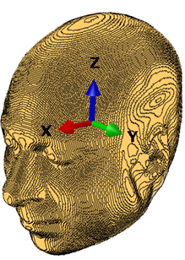
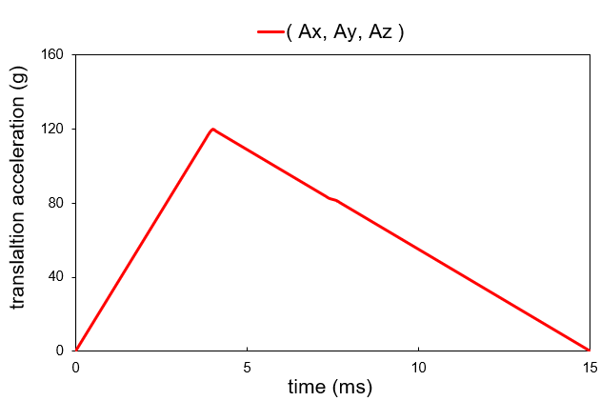
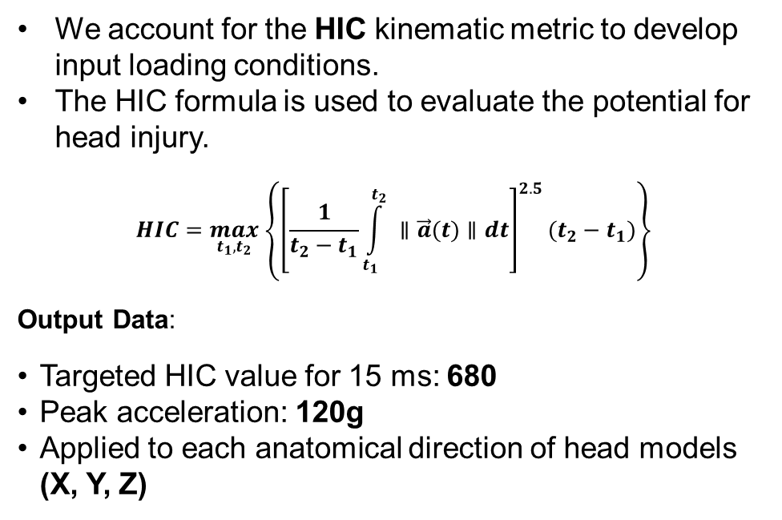
Loading Condition (Case 1)
Pure Translation
We account for the HIC kinematic metric to develop input loading conditions.
The HIC formula is used to evaluate the potential for head injury.
$$HIC=\max_{t_{1},t_{2}} \left\{{\left[\frac{1}{t_{2}−t_{1}}\int_{t_{1}}^{t_{2}}{ }∥\vec{a}(t)∥dt\right]}^{2.5}(t_{2}−t_{1})\right\}$$
Output Data:
Targeted HIC value for 15 ms: 680
Peak acceleration: 120g
Applied to each anatomical direction of head models (X, Y, Z)

Slide 15
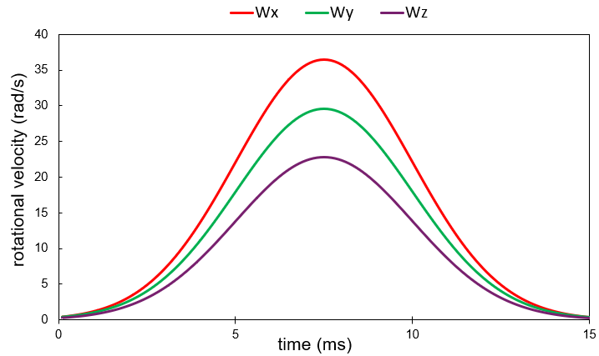
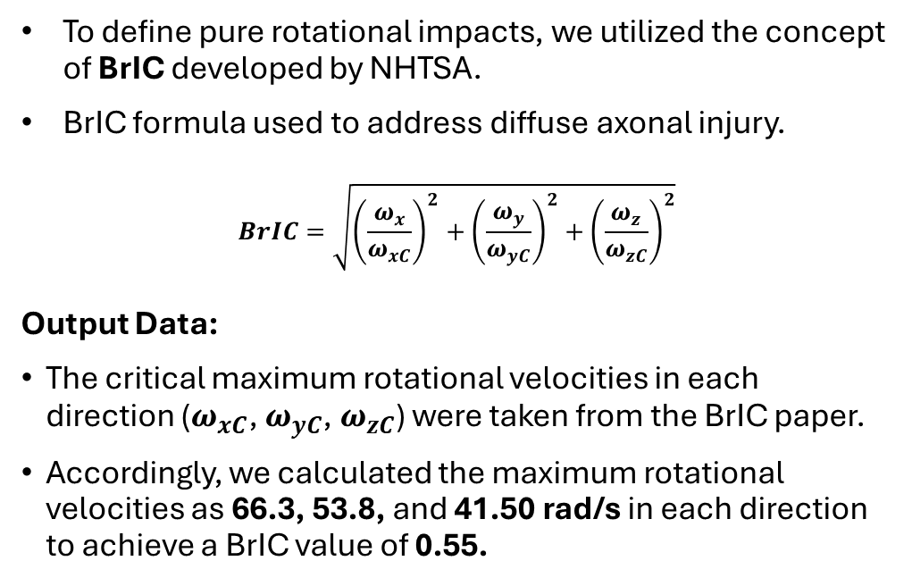
Loading Condition (Case 2)
Pure Rotational
To define pure rotational impacts, we utilized the concept of BrIC developed by NHTSA.
BrIC formula used to address diffuse axonal injury.
$$BrIC=\sqrt{{\left(\frac{ω_{x}}{ω_{xC}}\right)}^{2}+{\left(\frac{ω_{y}}{ω_{yC}}\right)}^{2}+{\left(\frac{ω_{z}}{ω_{zC}}\right)}^{2}}$$
Output Data:
The critical maximum rotational velocities in each direction ($ω_{xC}$, $ω_{yC}$, $ω_{zC}$) were taken from the BrIC paper.
Accordingly, we calculated the maximum rotational velocities as 66.3, 53.8, and 41.50 rad/s in each direction to achieve a BrIC value of 0.55.

Slide 16
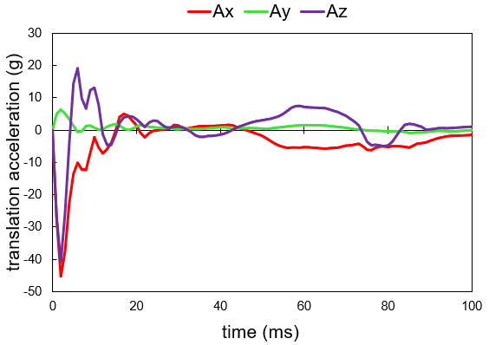
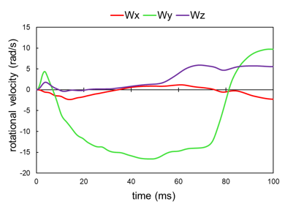
Loading Condition (Case 3)
Combined Translation-Rotational
To investigate the effects of combined kinematics, we considered real experimental test data from Hardy’s experiment (C383-T1).
The experiment involved a deceleration test with a cadaveric head striking a fixed, inclined acrylic block with an impact speed of 3 m/s.
The data was applied to head models to evaluate the combined effects of translation and rotation on head injury potential.

Slide 17
Results
Comparative Analysis
  Total of 42 simulations were accomplished (21 in +ve anatomical direction).
  Two Tissue based metrics were accounted MPS (maximum elongation along principal axis) and SS (maximum distortional deformation).
  Fortran script was developed to account the maximum values for the entire time history of analysis.
Strain Analysis
  Emphasize on WM and GM that comprise most of the brain volume subject to potential injury.
  95th percentile of brain tissue were analysed, since top 5% of values may not account the overall response of strain behaviour.
Morphological Differences
  Four physical attributes were accounted to state the morphological comparison.
  All the findings are consistent with prior research on the role of brain morphology in injury susceptibility.

Slide 18
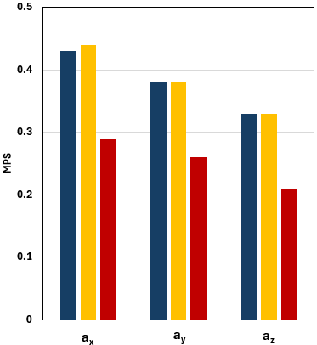
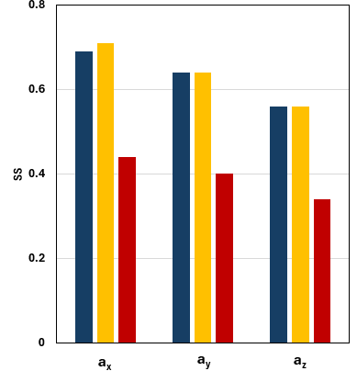

Result: Loading conditions based on translational accelerations
Peak strain variability addressing the existence of Morphological differences among the three head models
Addressing the Vulnerability of impact direction across three anatomical axis

Slide 19
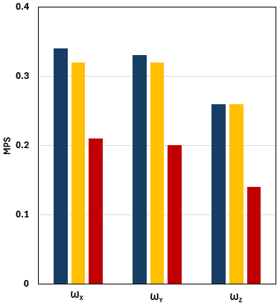
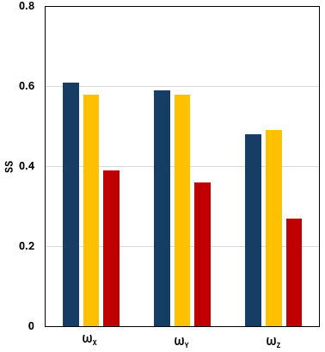
Result: Loading conditions based on rotational velocity
Peak strain variability addressing the existence of Morphological differences among the three head models
Addressing the Vulnerability of impact direction across three anatomical axis

Slide 20
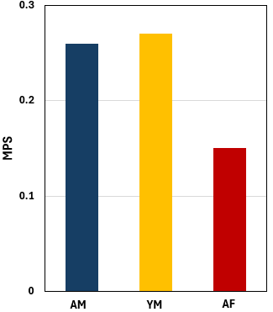
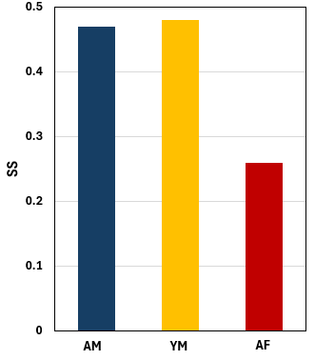
Result: Loading conditions based on combined accelerations
Strain outcomes from the real experimental loading condition.
Peak strain variability addressing the existence of Morphological differences among the three head models

Slide 21
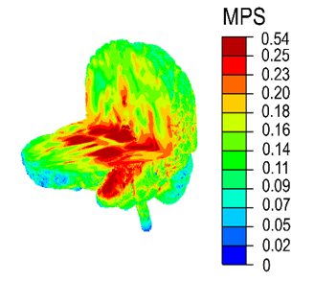
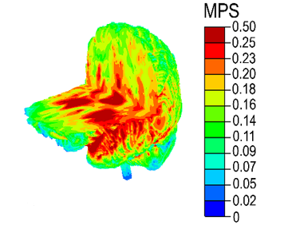
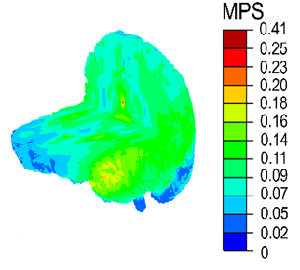
Result: Strain Variability
Diverse strain localization due to difference in head morphology
(a)
(b)
(c)
Contour plot of MPS for male (a), female (b), and young male (c) FE head model for the combined loading condition C383-T1.

Slide 22
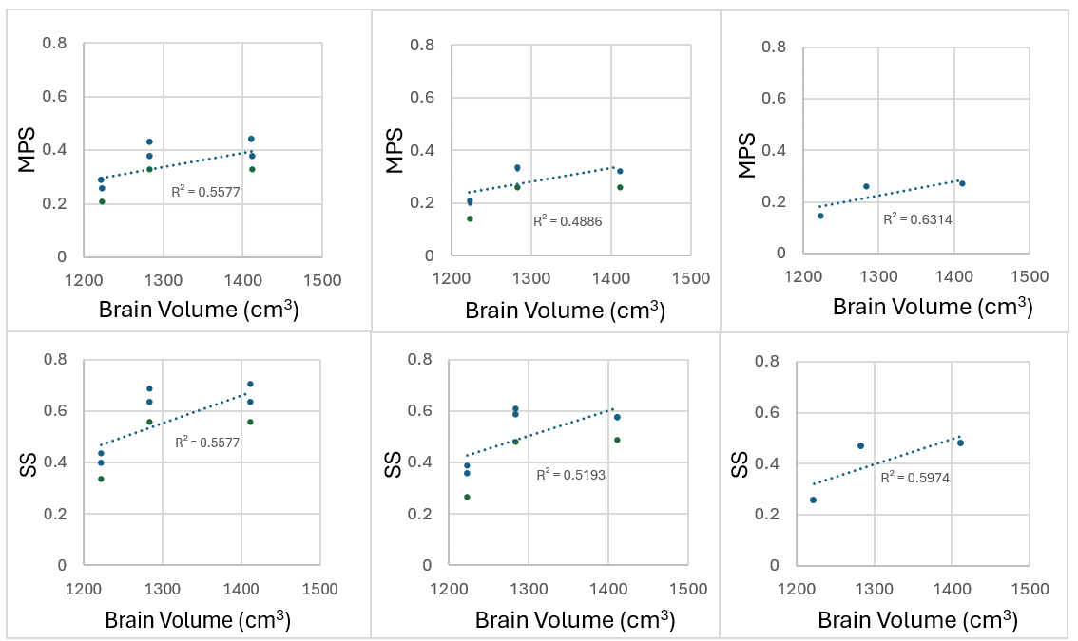
Result: Brain Volume vs Strain Outcome
Combined Translation and Rotational Impact
Translational Impact
Rotational Impact
A consistent linear relationship between brain volume, and strain metrics MPS and SS.

Slide 23
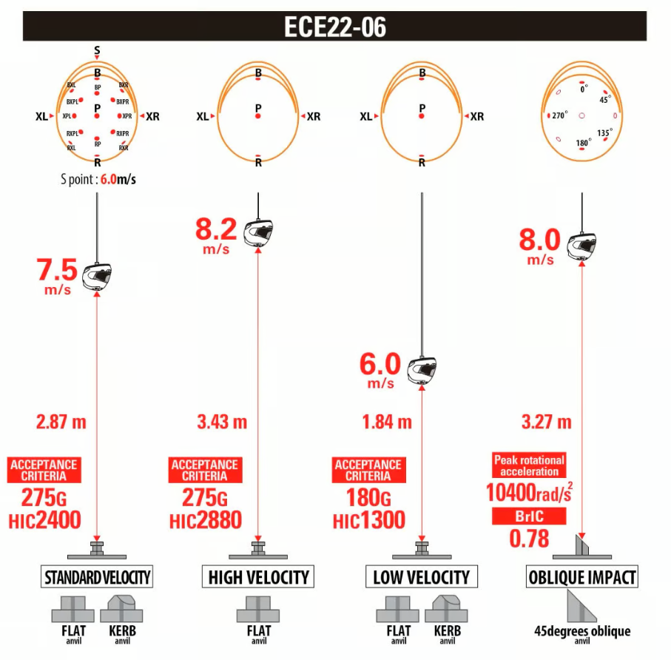
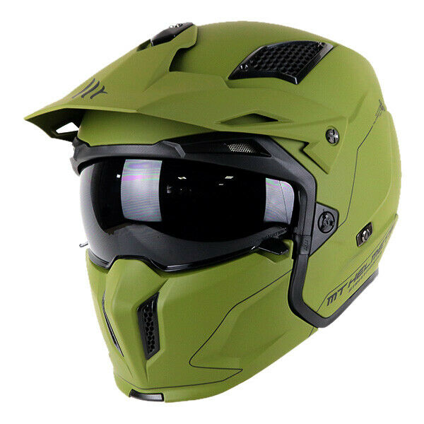
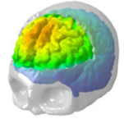
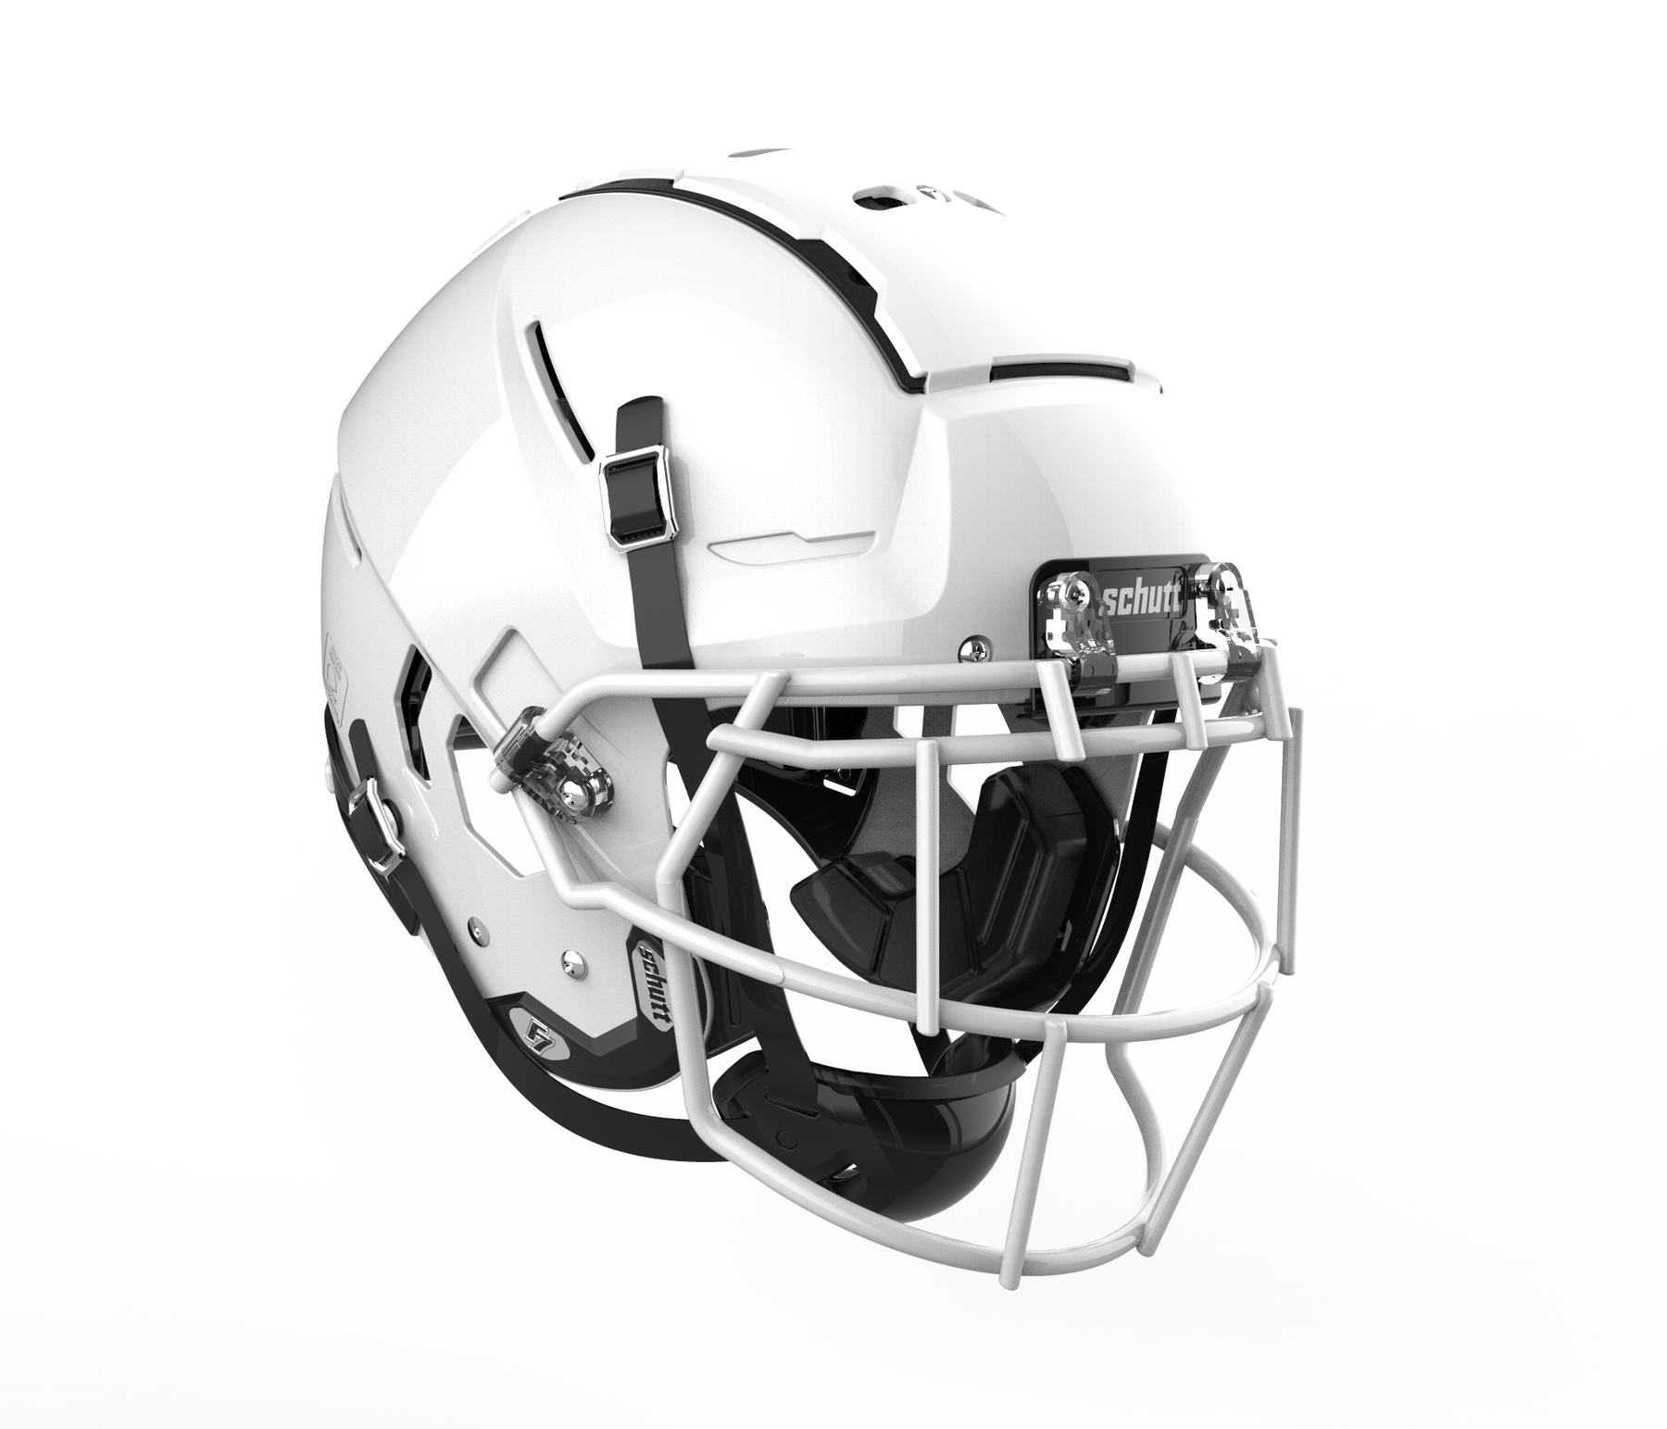
Research Implementation
Importance of Tissue-based injury metrics
  Implementation of tissue-based metrics in safety regulations to account for the realistic strain outcome, strain threshold, particularly in ECE 22.06, where HIC and BrIC are defined as a threshold for helmet acceptance criteria.
Helmet & PPE Design
  Development of individualized personal protective devices accounting the head morphology and the strain outcomes.
  3. Biomedical & Clinical Use
  The applications of these models extend to biomedical research, aiding in surgical procedure and treatment planning.

Slide 24
Conclusion
Computational Head Model
Head Morphology
Future Works
Development of loading curve based on kinematic- based metrics.
Addressing the morphological variations among head models, through tissue - based metrics.
Evaluated the consequence of impact direction.
Accomplished the development procedure of three distinct finite element head models.
Addressed the advanced meshing techniques to ensure precise anatomical representation.
Integration of new impact cases and loading conditions.
Development of new subject specific head models.
Incorporation of ML algorithms to streamline the mesh morphing techniques.

Slide 25
Conferences and Papers
Piero G. Pavan, Mohammed Nasim, Veronica Brasco, Silvia Spadoni, Francesco Paoloni, Domenico D'Avella, Siamak Farajzadeh Khosroshahi, Niccolò de Cesare, Karan Gupta, Ugo Galvanetto. ‘Development of detailed finite element models for in silico analyses of brain impact dynamics’, accepted for publication Computer Methods and Programs in Biomedicine - Elsevier - Sep 11, 2022.
Karan Gupta, Silvia Spadoni, Piero G. Pavan, Ugo Galvanetto. ‘Evaluation of the effects of head morphology on the strain of brain tissue induced by impacts’, paper under progress”.
Karan Gupta, Piero Pavan, Ugo Galvanetto. ‘Effects of Head Morphology on Brain Strains Due to Impacts: A Numerical Approach’, The Twelfth International Conference on Engineering Computational Technology in Prague, Czech Republic.
Karan Gupta, 3D brain model for prediction of TBI and its surgical approaches, FNIP day “International Symposium on Neuroscience and Microscopy” University of Padova, Department of Biomedical Science. FNIP day – 29 September 2022.
HPCSIM Frontiers of High-Performance Computing in Modelling and Simulation September 14th & 15th 2023 the most recent methodologies available to accelerate simulation software on massively parallel platforms & the potential of HPC in real world application.

Slide 26
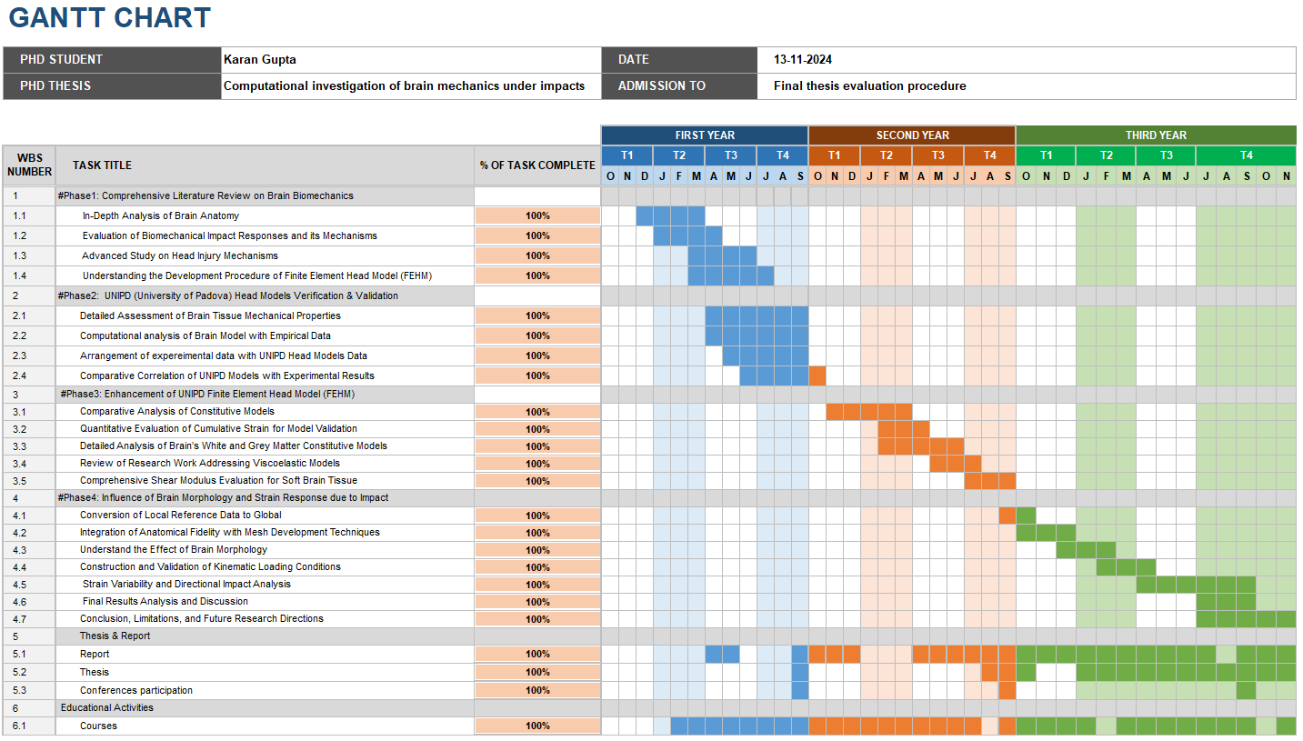
Gantt Chart

Slide 27
Thanks for the attention

